Slide 2
SESSION 1 THE PENTATEUCH

Slide 3
CLASS INTRODUCTION
Each session will consist of:
Teaching (approx. 45min)
Break or Q&A (approx. 15min)
Group Breakout Discussions (approx. 30-45min)
Closing Remarks & Assignments (10-15min)

Slide 4
CLASS SESSIONS
Here are the 8 sessions we’ll be going through in this class:
THE PENTATEUCH - The Patriarchs, Sinai Covenant & Decalogue
THE TORAH (Part 1) - Tabernacle, Sacrifices, Priests, Feasts and OT Worship
THE TORAH (Part 2) - Law & Covenant, Promised Land and Foreshadowing
THE PROPHETS & WRITINGS - OT Prophets, Psalms & Wisdom Literature
THE GOSPELS - Matthew, Mark, Luke & John
THE EARLY CHURCH - Acts & Galatians
THE PAULINE LETTERS - The rest of the letters of Paul
THE GENERAL EPISTLES - The rest of the NT letters

Slide 5
WEEKLY ASSIGNMENTS
Each week, you’ll be given something to:
READ – various passages of scripture to prepare you for next week’s session.
WATCH – short animated videos to help summarize big concepts.
ASK – short questions to think about and come ready to answer for next session.
Recommended Resource – a good resource to check out if you want more info on the topic covered in that session.

Slide 6
HOW TO MAKE THE MOST OF THIS COURSE
In order to get the most out of this class, we recommend you:
Get a folder to keep your handouts and notes from the sessions
Write out notes as you do your weekly Bible reading assignments
Write down questions for the next week’s session
Journal your thoughts and discoveries
Pray that God would apply the truths you are learning to your lives.

Slide 7
SESSION 1: Pentateuch
GOAL
Understanding God's relation to humanity through Law and Covenant from the beginning to Sinai.

Slide 8
1ST READING ASSIGNMENT
Genesis 1-3, 15, 22, 26:1-5, 35:1-15, & 50:24-26
Did you notice any continuing themes?

Slide 9
THE KEY TO INTERPRETING THE LAW
Turn to Luke 24

Slide 10
THE KEY TO INTERPRETING THE LAW
Turn to Luke 24

Slide 11
THE KEY TO INTERPRETING THE LAW
“O foolish ones, and slow of heart to believe all that the prophets have spoken! Was it not necessary that the Christ should suffer these things and enter into his glory?”
(Luke 24:25)

Slide 12
THE KEY TO INTERPRETING THE LAW
“And beginning with Moses and all the Prophets, he interpreted to them in all the Scriptures the things concerning himself.” (v.26)
CHRIST IS THE KEY!

Slide 13
Threefold task to understand the LAW:
In its own historical context - what would it have meant to the original recipients?
As the beginning of God’s Story of Redemption - which the New Testament completes.
In our context - how do we obey and apply God’s word to ourselves today?

Slide 14
STOP & PRAY

Slide 15
THE PENTATEUCH: Creation to Abrahamic Covenant

Slide 16
PENTATEUCH
Pentateuch
The name comes from two Greek terms, penta (πεντα), meaning ‘five’ and teuchos (τεῦχος), meaning ‘book’.
So, the word simply means “five books”.
It refers to the first five books of the Old Testament (Genesis, Exodus, Leviticus, Numbers, Deuteronomy) which were written by Moses.

Slide 17
PENTATEUCH
TaNaK
Stands for the 3 categories of Jewish Old Testament books:
Torah, Nevi’im and Ketuvi’im (a.k.a. the Law, the Prophets and the Writings)

Slide 18
“The Pentateuch begins with the creation of the universe and records God’s dealings with mankind in the Garden of Eden, his preparation of a seed-bearing line (the patriarchal stories), and the formation of the nation Israel. A substantial portion of the Pentateuch consists of laws governing the religious and civil life of the theocratic nation.”
(Baker Encyclopedia of the Bible, pg 1639)

Slide 19
CREATION
Here are the two important themes we must understand from creation:
ORDER & LIFE– we see that God brings order from disorder and life from non-life.
The FALL Since the Fall - God’s life and order have been disrupted in creation and humanity

Slide 20
ABRAHAMIC COVENANT
God will make Abraham into a “great nation” (Gen 12:2)
God will bless him (Gen 12:2)
His name will be “great” and he will be a “blessing” to the world (Gen 12:2–3)
God will give the land of Canaan (i.e. Palestine) to him and his descendants (Gen 12:7)
His descendants will be many (Gen 13:16; 15:5)

Slide 21
God’s promise to Abraham of LAND and SEED are repeated many times in Genesis. (see Gen 13:14–18; 15:7, 13–16, 18–21; 17:6–8; 22:15–17)
This is important for us because the promise to Abraham is the basis of the Mosaic covenant (see Exodus 2:24-25).

Slide 22
LAW & COVENANT

Slide 23
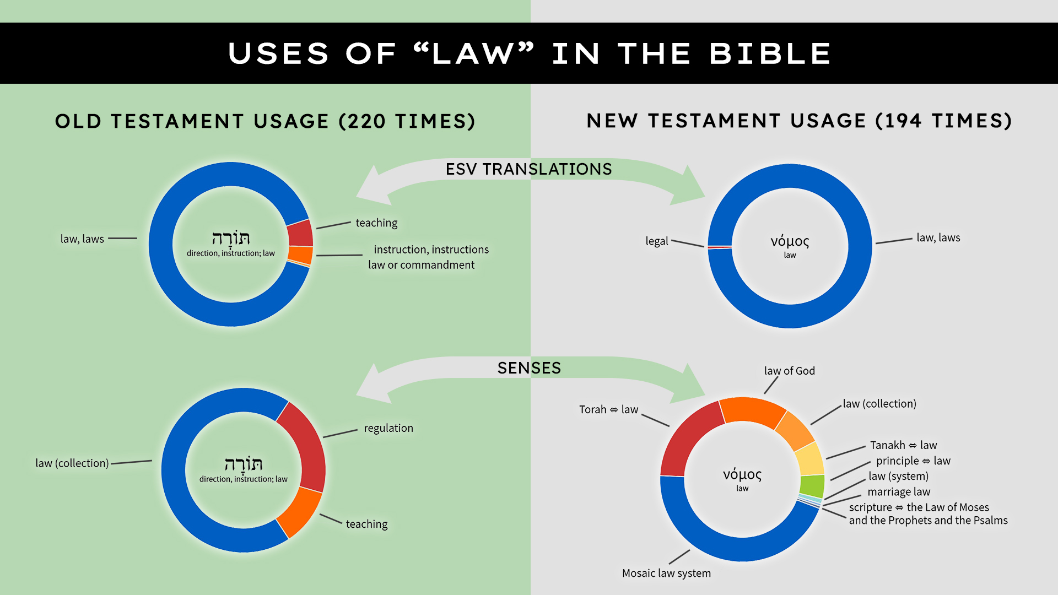

Slide 24
SOME SYNONYMS FOR LAW IN THE OT
WORDS - duties of man to God (eg. 10 Commandments)
JUDGMENTS - civil regulations and duties
ORDINANCES - cultic regulations or ceremonial laws
COMMAND(MENT)S - regulations given by a higher authority
DECREES - commands spoken from the King
PRECEPTS - a general rule intended to regulate behavior or thought
STIPULATIONS, REQUIREMENTS - a condition that is demanded as part of an agreement
THE “WAY(S)” (cf. 1 Kgs 2:3; Pss 18:21; 25:9; 37:34).

Slide 25
WHAT IS THE PURPOSE OF THE LAW?

Slide 26
WHAT IS THE PURPOSE OF THE LAW?
“Moses and the prophets emphasize that the purpose of the Law is not strict adherence to the Law for its own sake (legalism) or for a reward (Pharisaism). Keeping the Law is an act of devotion to God, for the sake of God.
The Law of God is his means of sanctification. He consecrated Israel by an act of grace, and He required Israel to remain holy.”
(Baker Encyclopedia of the Bible, 2, p.1316)

Slide 27
The purpose of the Law was to help transform God’s redeemed people into maturity.
“The saints in the OT who loved God delighted in his Law as a reflection of his will; saw in it God’s fatherly concern for His children to learn to love, to be just and righteous, and to walk humbly before him (cf. Gen. 17:1; Mic. 6:8).
God’s goal was to train individuals in Israel to maturity, freedom, and sonship.
(Baker Encyclopedia of the Bible, 2, p.1317)

Slide 28
VIDEO Reading Biblical Law (6:19)

Slide 30
WHAT IS A COVENANT?

Slide 31
WHAT IS A COVENANT?
“A covenant is a formalized pact with sanctions...
When such pacts were made between human beings, the parties expressed loyalty to one another and spelled out their mutual obligations (e.g. Gen. 21:26-31; 26:28-30; 31:44-54).
They also took an oath calling down curses on themselves if they did not keep the terms of the covenant.”
(Poythress, The Shadow of Christ in the Law of Moses, p.63)

Slide 32
A covenant is a formalized pact expressing loyalty between two parties to one another, based on prior relationship, outlining their mutual obligations, blessings and the curses/consequences for failing to keep the terms of the covenant.

Slide 33
ALL COVENANTS HAD 3 PARTS:
IDENTIFICATION - An identification of the parties involved and recounting the previous relational interactions between them
STIPULATIONS - Specification of their mutual obligations
SANCTIONS - An oath indicating how God would reward obedience and punish disobedience to the stipulations

Slide 34
Hittite Suzerainty Treaties
In these treaties, they would write up a document that contained:
Preamble identifying the parties
Historical Prologue explaining their relationship
Stipulations specifying the duties of the vassal
Provision for a written copy to be deposited in the vassal’s temple and periodically read publicly
List of witnesses
Sanctions - a list of curses and blessings for violations or loyalty to the treaty.

Slide 35
DEUTERONOMY: An example of OT Covenant
The structure of the book can be divided like this:
A Preamble - identifying the parties (1:1-5)
Historical Prologue - recounting the prior relationship of God and His people (1:6-4:49)
Stipulations - list of duties (5:1-26:49)
A written copy was placed in ark in the temple/tabernacle (10:1-5)
Sanctions - blessings & curses (27:1-30:20)
Covenant Continuity - Moses sets up Joshua to take his place (31:1-34:12)

Slide 36
GOD’S COVENANTAL RELATIONSHIP WITH HIS PEOPLE
God’s relationship with His people is ‘covenantal’ since it involves:
PERSONAL PRESENCE - Corresponding with His self-identification to and relationship with His chosen people
DIVINE ORDER - Corresponding to His covenant stipulations
GOD’S POWER to bless or curse and to make atonement - corresponding to the covenant sanctions.

Slide 37
THE RELATIONSHIP BETWEEN LAW & COVENANT

Slide 38
The Ten Commandments aren’t about how we become God’s people, but rather are given to us because we are His people.
They presume a prior relationship with Him already.

Slide 39
The difference is this:
It is NOT: do these things and keep these laws, then you’ll have a right relationship with God
It IS: God, out of His love for us, has provided the way to have a right relationship with Him, therefore, this is the way we are to live in light of that

Slide 40
How is this relationship of Law & Covenant relevant to us?

Slide 41
COVENANT THROUGH CHRIST
PERSONAL PRESENCE - Christ is God dwelling with His people - Immanuel - “God with us”. (cf. Col. 2:9; John 14:20-23)
DIVINE ORDER - Christ’s character is the perfect pattern of righteousness as he perfectly kept the law of God for us (cf. 1 Cor. 1:30; Rom. 13:14)
GOD’S POWER - Christ expresses God’s power to atone for sin (cf. Heb. 9:28; 1 John 2:2)

Slide 42
VIDEO The Covenants (5:14)

Slide 44
THE SINAI COVENANT (Go to Exodus 20)

Slide 45
Indicatives THEN Imperatives
God’s commands (imperatives) are always predicated on the description (indicatives) of His gracious saving work.

Slide 46
Indicatives THEN Imperatives
Note that before the Lord gives to Israel the Ten Commandments which are part of the Sinai Covenant, He reminds them first of His saving work (Exodus 19:3-6 & 20:2).
They are to obey these commandments in light of the fact that God has already freed them from their bondage.

Slide 47
THE DECALOGUE (Ten Commandments)
The Ten Commandments are an expression of God’s holy character and order.

Slide 48
COMMANDMENT #1
YOU SHALL HAVE NO OTHER GODS (Ex. 20:3)
God is the sole LORD, Creator and source of life, so any competition with another supposed ‘god’ introduces disordered worship and leads to spiritual death.
Every sin has the same root - idolatry - a confusing of who God is as the standard of all earthly order.

Slide 49
COMMANDMENT #2
YOU SHALL NOT MAKE IDOLS (Ex. 20:4-6)
The second commandment deals with making images for worship. It expands on the first commandment by forbidding not only the worship of false gods, but also the improper worship of the True God through attempting to make images of Him.
It shows us that worship to God must conform to the order of God’s own revelation.

Slide 50
COMMANDMENT #3
YOU SHALL NOT TAKE THE LORD’S NAME IN VAIN (Ex. 20:7)
This command enjoins us to protect the holiness of God’s Name which is the revelation of His character.

Slide 51
“The LORD descended in the cloud and stood with him there, and proclaimed the Name of the LORD. The LORD passed before him and proclaimed, “The LORD, the LORD, a God merciful and gracious, slow to anger, and abounding in steadfast love and faithfulness, keeping steadfast love for thousands, forgiving iniquity and transgression and sin, but who will by no means clear the guilty, visiting the iniquity of the fathers on the children and the children’s children, to the third and the fourth generation.”
(Exodus 34:5-7)

Slide 52
COMMANDMENT #3
YOU SHALL NOT TAKE THE LORD’S NAME IN VAIN (Ex. 20:7)
This command enjoins us to protect the holiness of God’s Name which is the revelation of His character.
This also means that we, as God’s people, are not to do or say anything that would profane God’s holy character.

Slide 53
COMMANDMENT #4
REMEMBER THE SABBATH AND KEEP IT HOLY (Ex. 20:8-11)
This commandment is special in character in that it focuses on human relationship to God, but it also involves a creation pattern as well taken from the seven days of creation.
It is a sort of mediating point between the commandments concerning God and the commandments concerning one’s neighbour.

Slide 54
COMMANDMENT #5
HONOUR YOUR FATHER & MOTHER (Ex. 20:12)
This is the first commandment dealing with our responsibilities to other humans. It makes sense that it would relate to the primary relationship of closest family.
An attack on parents then is an attack on God Himself.

Slide 55
COMMANDMENT #6
YOU SHALL NOT MURDER (Ex. 20:13)
Enjoins the preservation of human life as image bearers of God.

Slide 56
COMMANDMENT #7
YOU SHALL NOT COMMIT ADULTERY (Ex. 20:14)
Enjoins orderliness of human sexuality - which is closely related to the creation of new life and thus is a natural consequence of the call to holiness.

Slide 57
COMMANDMENT #8
YOU SHALL NOT STEAL (Ex. 20:15)
Deals with the orderliness of human property since theft disorders the relationship of human ownership which is closely related to the dominion that humans have been given, which images God’s dominion over the world.

Slide 58
COMMANDMENT #9
YOU SHALL NOT LIE (Ex. 20:16)
Orderliness of human speech - truthful human speech imitates God’s speech and law.

Slide 59
COMMANDMENT #10
YOU SHALL NOT COVET (Ex. 20:17)
This commandment demands orderliness of our desires and is the only commandment on the second table that deals with the heart.
We can see murder, theft, and adultery - but we cannot see covetuousness. Jesus expands on this point by saying that all sin ultimately springs from the heart (Mark 7:20-23) and that breaking the other commandments starts in the heart (lust, hatred - cf. Matthew 5).

Slide 60
The Ten Commandments form the basis for what is called the MORAL LAW.

Slide 61
THE PROBLEM OF SIN AND THE LAW

Slide 62
Now when all the people saw the thunder and the flashes of lightning and the sound of the trumpet and the mountain smoking, the people were afraid and trembled, and they stood far off and said to Moses, “You speak to us, and we will listen; but do not let God speak to us, lest we die.”
(Exodus 20:18-19)

Slide 63
God’s law acts like a mirror to show us our own dirtiness.

Slide 64
WHAT IS THE SOLUTION?

Slide 65
And the Lord said to Moses, “Thus you shall say to the people of Israel: ‘You have seen for yourselves that I have talked with you from heaven. You shall not make gods of silver to be with me, nor shall you make for yourselves gods of gold. An altar of earth you shall make for me and sacrifice on it your burnt offerings and your peace offerings, your sheep and your oxen. In every place where I cause my name to be remembered I will come to you and bless you.
(Exodus 20:22-24)

Slide 66
THE SACRIFICIAL SYSTEM

Slide 67
ASSIGNMENTS FOR SESSION 2
READ
Exodus 40
Leviticus 4-7 and 16 & 17
WATCH
Overview: TaNaK
READ SCRIPTURE: Leviticus
NEW CITY CATECHISM - Q14
(Video links are in your email)

Slide 68
ASSIGNMENTS FOR SESSION 2
ASK
How does God's Covenant relationship with us relate to the Laws that He gives to us today?
From Exodus 40, what stands out to you?
From Leviticus 4-7 & 16-17, if you lived in ancient Israel, how would these laws make you feel? How do you imagine the sight of all these things impacting you?

Slide 69
Recommended Resource:
The Ten Commandments: What They Mean, Why They Matter, and Why We Should Obey Them by Kevin DeYoung

Slide 70
Q & A

Slide 71
GROUP DISCUSSIONS
READ: Exodus 19:1 – 20:21
OBSERVE | INTERPRET | APPLY

Slide 72
Thanks for coming! YOU ARE LOVED

