Slide 1
SESSION 2 THE TORAH (Part 1)

Slide 2
CLASS SESSIONS
Here are the 8 sessions we’ll be going through in this class:
THE PENTATEUCH - The Patriarchs, Sinai Covenant & Decalogue
THE TORAH (Part 1) - Tabernacle, Sacrifices, Priests, Feasts and OT Worship
THE TORAH (Part 2) - Law & Covenant, Promised Land and Foreshadowing
THE PROPHETS & WRITINGS - OT Prophets, Psalms & Wisdom Literature
THE GOSPELS - Matthew, Mark, Luke & John
THE EARLY CHURCH - Acts & Galatians
THE PAULINE LETTERS - The rest of the letters of Paul
THE GENERAL EPISTLES - The rest of the NT letters

Slide 3
GOALS
CLASS
To understand how the Law of Moses points to Christ and how it is relevant to us today.

Slide 4
GOALS
CLASS
To understand how the Law of Moses points to Christ and how it is relevant to us today.
SESSION 2
Understanding how the Torah (Law) functioned within the OT Covenant with Israel and what it foreshadowed. This session will focus on the laws about the worship of Israel.

Slide 5
2nd READING ASSIGNMENT
Exodus 40, Leviticus 4-7 & 16-17
How does God's covenant relationship with us relate to the Laws that He gives to us today?
From Exodus 40, what stands out to you at the end of the chapter?
From Leviticus 4-7 & 16-17, if you lived in ancient Israel, how would these laws make you feel? How do you imagine the sight of all these things impacting you?

Slide 6
STOP & PRAY (Psalm 119:18)

Slide 7
CLASS ROADMAP

Slide 8
“The pattern established in the Mosaic covenant, which is redemption followed by obedience, functions as a type or pattern for New Testament believers… Such grateful obedience, under both the Mosaic covenant and the new covenant established by Jesus Christ, is not legalistic, for there is no idea that such obedience earns or merits salvation under either the old covenant or the new.”
(Tom Schreiner, 40 Questions about Christians and Biblical Law, pg 26)

Slide 9
Where we are in today’s session
At the end of Exodus:
“Then the cloud covered the tent of meeting, and the glory of the Lord filled the tabernacle. And Moses was not able to enter the tent of meeting because the cloud settled on it, and the glory of the Lord filled the tabernacle.” (Exodus 40:34-35)

Slide 10
Where we are in today’s session
At the beginning of Leviticus:
God speaks to Moses FROM the tent (cf. Lev. 1:1)
Leviticus deals with how God graciously provides a way for people to live in His presence.
It concerns how sinful Israel can approach and enter the presence of their Holy God.

Slide 11
VIDEO The Book of Leviticus (6:30)

Slide 13
1. THE TABERNACLE & TEMPLE

Slide 14
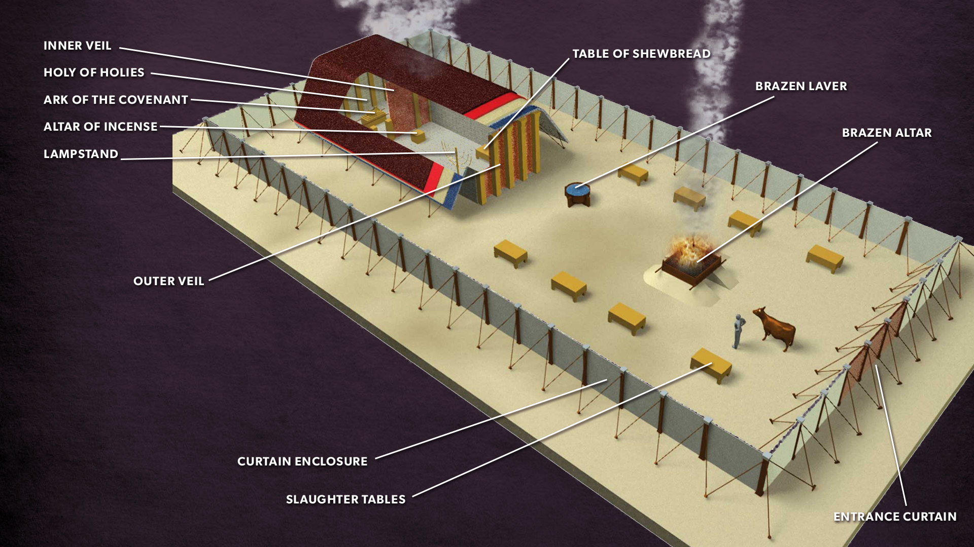

Slide 15
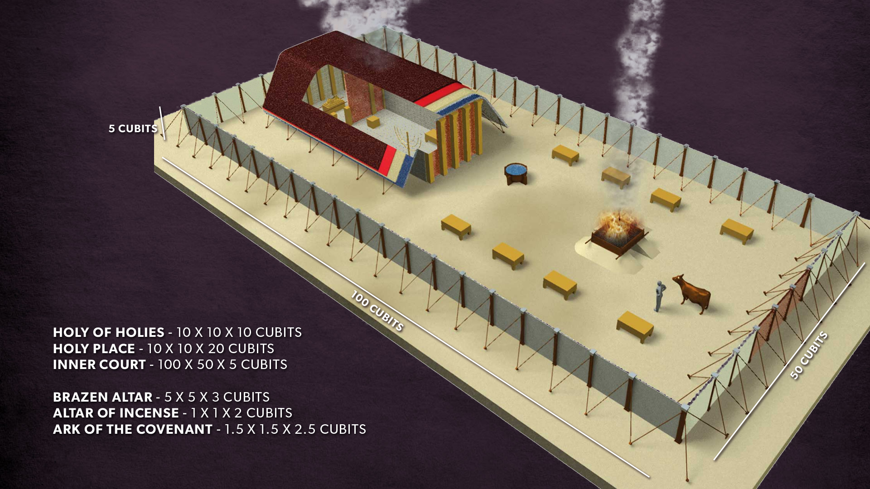

Slide 16
1. THE TABERNACLE & TEMPLE
Israel’s holy space was meant to communicate God’s perfection to them.
It said to them that as you moved further away from God - you moved further away from perfection.

Slide 17
1. THE TABERNACLE & TEMPLE
the tabernacle itself is a sort of replica of the law - God’s word given to them on 2 tablets of stone containing the 10 commandments. Many of the measurements are factors of 2, 5 and 10.
God’s word sets the pattern for His worship.

Slide 18
1. THE TABERNACLE & TEMPLE
CONTRASTS WITH OTHER ANE TEMPLES
Pagan temples had an image (idol) of the god – Israel’s temple had no image. (cf. Ex. 33:20)
Pagan worship served and fed the god through sacrifices and rituals to earn the god’s favour – Israel’s God came to serve and provide for them out of His own favour. (cf. Acts 17:25)

Slide 19
THE TABERNACLE’S FORESHADOW
In pictorial form, God was saying, as it were, “Look at My provisions for you. This is how I redeem you and bring you to My presence. But look again, and you will see that it is all an earthly symbol of something better. Do not rely on it as if it were the end. Trust Me to save you fully when I fully accomplish My plans.”
(Vern Poythress, The Shadow of Christ in the Law of Moses, 11)

Slide 20
THE TABERNACLE’S FORESHADOW
A. GOD IS KING
The tabernacle (and later the temple) was set up as an earthly mirror of God’s throne-room.
There were symbols of God’s rule over His creation and people.

Slide 21
“The tabernacle is a renewed version of the Garden of Eden. But curtains with cherubim on them still bar the way into God’s presence, just as cherubim barred the way into the original Garden of Eden after the Fall (Gen. 3:24)”
(Vern Poythress, The Shadow of Christ in the Law of Moses, pg 19)

Slide 22
THE TABERNACLE’S FORESHADOW
B. GOD DWELLS WITH US
God was telling them through the tent of meeting - the tabernacle - that He was majestic and beautiful, but also that He was not just far off in heaven, but dwelt among them.
Unlike the pagan temples which were often built far off or high up on a mountain, this God dwelt with and among His people.

Slide 23
THE TABERNACLE’S FORESHADOW
C. GOD’S INACCESSIBILITY AND HOLINESS
It emphasized the separation of a Holy God and sinful people.

Slide 24
THE TABERNACLE’S FORESHADOW
D. GOD’S SALVATION
The tabernacle was a visual and experiential parable to the Israelites, reminding them of God’s salvation.

Slide 25
MOVING THROUGH THE STORY OF GOD’S SALVATION

Slide 26
2. SACRIFICES

Slide 27
“Sacrifice in the Bible, however, is the bloody reality of a bellowing animal being butchered on an altar. Imagine the sensory overload of this experience—the violent resistance of the animal, the spurting of blood, the feel of pulling the animal apart, the smell of its burning flesh and bones. Imagine the emotional and spiritual impact of offering this sacrifice, knowing that it was your sin that made this death necessary. And imagine the frustration in knowing that you’ll be back tomorrow or next week because you will sin again.”
(Nancy Guthrie)

Slide 28
2. SACRIFICES
Who here has been confused by OT sacrifices?

Slide 29
2. SACRIFICES
Why do we need to know about sacrifices in the OT?

Slide 30
2. SACRIFICES
Why do we need to know about sacrifices in the OT?
We should do so because they help us to understand how the work of Christ saves us from our sin since each sacrifice points to a different aspect of Christ’s sacrifice of himself.

Slide 31
Different to pagan sacrifices
Israel had no commandments for human sacrifice, unlike Molech and other pagan gods.
The sacrificial system for Israel was a gracious gift of God to show them His provision for dealing with their sins.

Slide 32
ATONEMENT

Slide 33
ATONEMENT
“...the act by which God and man are brought together in personal relationship. The term is derived from Anglo-Saxon words meaning “making at one,” hence “at-one-ment.”
It presupposes a separation or alienation that needs to be overcome if human beings are to know God and have fellowship with him.”
(Baker Encyclopedia of the Bible, p.231)

Slide 34
ATONEMENT
“The biblical concept of atonement cannot be understood except in the context of the wrath of God against sin.”
(Holman Illustrated Bible Dictionary, p.139)

Slide 35
ATONEMENT
Only atonement fulfills God’s JUSTICE
while at the same time allowing Him
to show MERCY to sinners.

Slide 36
ATONEMENT IS:
PENAL - meaning it dealt with the penalty of sin.
SACRIFICIAL - meaning it involved the sacrifice of something.
SUBSTITUTIONARY - meaning it was an innocent substitute taking the place of the guilty.

Slide 37
Types of Sacrifices
You can divide the sacrifices into 2 categories:
VOLUNTARY - Burnt, grain and peace offerings
MANDATORY - Sin & trespass offerings

Slide 38
Types of Sacrifices
You can divide the sacrifices into 2 categories:
VOLUNTARY - Burnt, Grain and Peace offerings
MANDATORY - Sin & Trespass offerings
The sacrifices were a way of saying:
THANK YOU - Grain and Peace offerings
I’M SORRY – Burnt, Sin & Trespass offerings

Slide 39
Types of Sacrifices
A. BURNT OFFERING (Lev. 1)
This was the most important sacrifice. It was offered once every morning and once every evening at most of Israel’s festivals.
It was a voluntary act of worship expressing devotion to God and used for atonement for unintentional sins.

Slide 40
Types of Sacrifices
A. BURNT OFFERING (Lev. 1)
Worshipper lays his hand on the animal’s head.
Kills the animal.
Priests sprinkle & throw blood.
The whole sacrifice is burnt up.

Slide 41
Types of Sacrifices
A. BURNT OFFERING (Lev. 1)
PURPOSE: This communicated that atonement was being made solely to God and the destruction that sin requires.

Slide 42
Types of Sacrifices
B. GRAIN OFFERING (Lev. 2)
“Along with the burnt offering, offered twice each day, was the grain offering of fine flour, oil, frankincense, and salt, which expressed gratitude to God and served as a way of asking the Lord to remember the offerer with favor (Lev. 2).”
(Nancy Guthrie)

Slide 43
Types of Sacrifices
B. GRAIN OFFERING (Lev. 2)
Accompanied by a drink offering of wine poured on the altar (cf. Num. 15:4-5).
Priests given some of the offering and had to eat it within the tabernacle court.
Worshipper didn’t eat it.
The idea is to give back a portion of what God provided.

Slide 44
Types of Sacrifices
B. GRAIN OFFERING (Lev. 2)
PURPOSE: to express thanks for God’s provision and unmerited favour/grace to the person making the sacrifice.

Slide 45
Types of Sacrifices
C. PEACE/FELLOWSHIP OFFERING (Lev. 3)
This was more than just a sacrifice - it was a festive meal. The worshipper was even allowed to bring family and friends along to spend a couple days enjoying the feast in the presence of God at the tabernacle.

Slide 46
Types of Sacrifices
C. PEACE/FELLOWSHIP OFFERING (Lev. 3)
The priest shall dip his finger in the blood and sprinkle part of the blood seven times before the Lord in front of the veil of the sanctuary. And the priest shall put some of the blood on the horns of the altar of fragrant incense before the Lord that is in the tent of meeting, and all the rest of the blood of the bull he shall pour out at the base of the altar of burnt offering that is at the entrance of the tent of meeting. (Lev. 4:6–7)

Slide 47
Types of Sacrifices
C. PEACE/FELLOWSHIP OFFERING (Lev. 3)
“For the life of the flesh is in the blood, and I have given it for you on the altar to make atonement for your souls, for it is the blood that makes atonement by the life.” (Leviticus 17:11)

Slide 48
Types of Sacrifices
C. PEACE/FELLOWSHIP OFFERING (Lev. 3)
Blood everywhere
All this visual imagery of blood told the Israelites in a vivid way that the price of sin required their life - “the wages of sin is death” (cf. Rom. 6:23) - but God provided a substitute to die in their place, that they might live.

Slide 49
Types of Sacrifices
C. PEACE/FELLOWSHIP OFFERING (Lev. 3)
PURPOSE: to show the worshipper the joy of restored fellowship with God through His provision for atonement.

Slide 50
Types of Sacrifices
D. GUILT/SIN OFFERING (Lev. 4)
This is sometimes seen as an atonement for unintentional sin (cf. Lev. 4:2-3 & 20) or as a guilt offering, removing the consequences for a lack of perfection (cf. Lev. 4:13-14 & 22-23).
It contained elements of a Burnt offering, and elements of a peace offering. However, unlike the peace offering, the meal was not shared by the one offering the sacrifice.

Slide 51
Types of Sacrifices
D. GUILT/SIN OFFERING (Lev. 4)
PURPOSE: not only to atone for sins, but also to purify oneself for re-entering God’s presence.

Slide 52
Types of Sacrifices
E. TRESPASS/RESTITUTION OFFERING (Lev. 5)
This offering required something beyond sacrifice - it required restitution to be made. The guilty sinner had to confess their sin publicly, offer the blood sacrifice, and also make full restitution of what was defrauded plus an additional twenty percent (cf. Lev. 5:16-17).

Slide 53
Types of Sacrifices
E. TRESPASS/RESTITUTION OFFERING (Lev. 5)
PURPOSE: it showed that true repentance cost something dear to the sinner.

Slide 54
THE GOOD NEWS OF SACRIFICES

Slide 55
“Now the appearance of the glory of the Lord was like a devouring fire on the top of the mountain in the sight of the people of Israel.”
(Exodus 24:17)

Slide 56
“Imagine the expense of taking the best animal in your herd down to the temple in Jerusalem just to be burnt up. That was the animal that would have produced the best offspring, and it wasn’t easy to give up. Imagine the time burden, especially if you didn’t live in Jerusalem. You would have to travel and find a place to stay. Imagine the emotional or spiritual burden as you made this trek, knowing that you would have to identify and confess your sin to the priest in offering your sacrifice…”

Slide 57
But also imagine the burden rolling away. When you slit that animal’s throat and watched it burn, and the priest declared your sin forgiven, imagine the sense of relief you felt. You would think, It should be me. I am the one who deserves to die. But this innocent animal has become my substitute. This animal has died so I can live.
This was good news.”
(Nancy Guthrie)

Slide 58
VIDEO Sacrifice & Atonement (6:00)

Slide 60
3. FEASTS

Slide 61
The 7 Feasts
The feasts tell the story of who Israel was, who God was to them and where He was taking them.
They are also helpful to us in reminding us of God’s salvation - past and future.
The feasts often began and ended with a “Sabbath rest,” and the Jews were commanded to not do any customary work on those days. These Sabbaths point us to the ultimate Sabbath rest, which is found only in Jesus Christ.

Slide 62
1. Feast of PASSOVER
Reminds them of redemption from slavery in Egypt. It was the time when the Passover Lamb was offered as an atonement to cover them from death (see Exodus 12). The Lord’s Supper was a passover meal.

Slide 63
2. Feast of Unleavened Bread
Immediately followed Passover and reminded them of the time when they ate no bread in hastily preparing for their Exodus from slavery. Later, yeast is associated with evil (cf. 1 Cor. 5:6-8; Gal. 5:9) - so signifying removal of evil & sin.

Slide 64
3. Feast of First Fruits
Took place at the beginning of the harvest season on the ‘third day’ of Passover and expressed gratitude and dependence on God for provision. Reminds us of Christ being the ‘firstfruit’ of resurrection (cf. 1 Cor. 15:20) - being raised to life on the third day.

Slide 65
4. Feast of Weeks/Pentecost
50 days after the feast of First Fruits, (Pentecost - from Greek meaning ‘fiftieth’) it focused on gratitude for God sending the harvest. In the NT, Pentecost signals the sending of the Holy Spirit 50 days after Jesus’ resurrection and we see then the harvest beginning with 3000 souls (cf. Acts 2) and continuing even until today.

Slide 66
5. Feast of Trumpets
This was a day of trumpet blast (cf. Num. 29:1) to commemorate the end of the agricultural and festival year and entering of a sacred season and was a solemn day of rest. In the NT, this feast is associated with the Second Coming of Christ (cf. 1 Thes. 4:16), and the eternal rest we will enter into then.

Slide 67
6. The Day of Atonement
10 days after the Feast of Trumpets, this was the one day the high priest could enter the Holy of Holies to make atonement for Israel’s sins. There was to be a reckoning of the sins of the people (on the Day of Atonement).
We will look at and discuss this feast in our breakout session.

Slide 68
7. Feast of Tabernacles/Booths
5 days after the Day of Atonement, for seven days, the Israelites were to present offerings to God and live in tents or booths to remind them of their time in the wilderness when God ‘tabernacled’ with them.
This feast was to be a week long celebration where God commanded them to “rejoice before the Lord”! (cf. Lev. 23:40-41)

Slide 69
The feasts ordered the yearly cycle of Israel’s life with constant reminders of God’s salvation, both what He had done and what He is going to do.

Slide 70
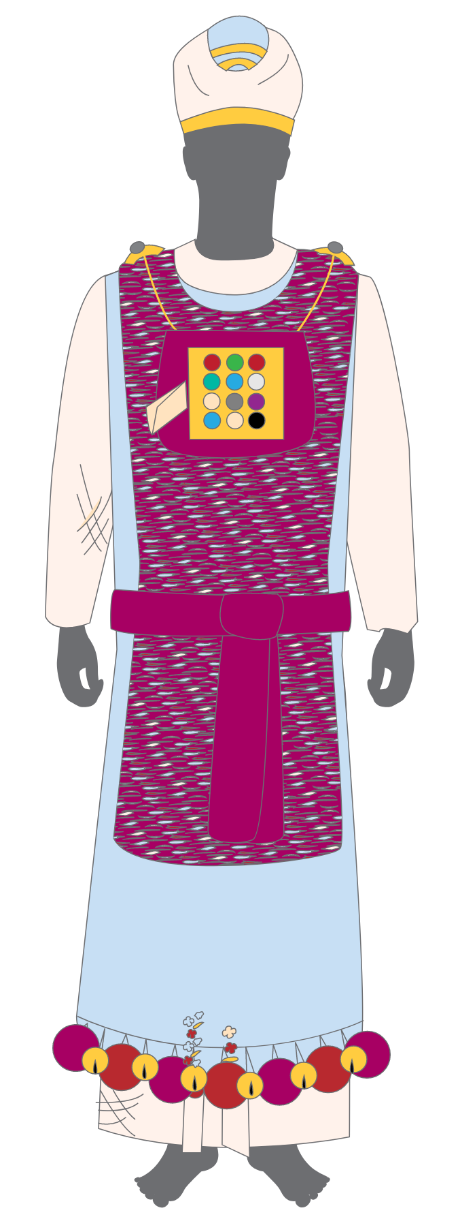
4. PRIESTS

Slide 71
4. PRIESTS
Priests were mediators between God and people.

Slide 72
4. PRIESTS
Priests were mediators between God and people.
The inadequacy and failures of Israel’s priests should have made them long for what the priests pointed to…

Slide 73
GROUP DISCUSSIONS
READ: Leviticus 9 & 10
Why was Aaron’s offering accepted? (see 9:1-7)
Why was the offering of Nadab and Abihu not accepted? (see. 10:1-3)
What lesson(s) do we learn from these stories about our worship of God?

Slide 74
5. PURITY

Slide 75
“They signify and foreshadow the way in which God cleanses sin. They show that a renewed or recreated people are characterized by renewed behaviour, behaviour conforming to God’s order and separating them from sin. A close look at the classification of things into categories of holy, clean, and unclean shows a pattern of this order… death is associated with sin and disorder. Hence, things associated with death or producing disorder are also unclean.”
(Poythress, 81)

Slide 76
THEY TEACH US
we cannot stroll into a Holy God’s presence haphazardly. His people must be set apart (holy) from all other people in every area of life.

Slide 77
In the OT, salvation had not come in its final form of Christ’s sacrifice on the Cross.
So, the OT shadows did not actually cleanse from the curse of sin but pointed forward to what would.

Slide 78
“Hence, it was appropriate that the need for cleansing the heart be expressed in external ways through food distinctions. It was appropriate also that these distinctions be related to separation from the curse of Genesis 3.”
(Vern Poythress)

Slide 79
The purity laws show us that God’s holiness affects ALL areas of life:
separation from evil and things associated with sin and death, care for the poor, sexual integrity, social justice, etc

Slide 80
THE DAY OF ATONEMENT

Slide 81
GROUP DISCUSSIONS
READ: Leviticus 16
What stands out to you about this ceremony apart from the others?
What are some strange things you noticed in the text?
How do you think the Israelites would have felt during this ceremony?
Why is the Day of Atonement important for us today?

Slide 82
THE DAY OF ATONEMENT
High priest enters the Holy of Holies to make atonement on behalf of the people.
2 goats - one is killed, the other is the ‘scapegoat’. These represent the 2 aspects of Atonement: propitiation - where wrath is appeased, and expiation - where guilt is sent away.
7 time sprinkling of blood signifying complete covering of sin
Imputation of sins
Done once a year - symbolizing the once-for-all sacrifice to come

Slide 83
FINAL COMMENTS
“I will make my dwelling among you, and my soul shall not abhor you. And I will walk among you and will be your God, and you shall be my people.” (Lev. 26:11)
Note that God’s dwelling with His people in the tabernacle was meant to be a sort of restoration of Eden - where God ‘walks among His people’.

Slide 84
FINAL COMMENTS
Yet for all that, when they are in the land of their enemies, I will not spurn them, neither will I abhor them so as to destroy them utterly and break my covenant with them, for I am the Lord their God. But I will for their sake remember the covenant with their forefathers, whom I brought out of the land of Egypt in the sight of the nations, that I might be their God: I am the Lord.” (Lev. 26:44-45)
God promises to be faithful even though they are unfaithful.

Slide 85
FINAL COMMENTS
At the beginning of the book of Numbers - God speaks to Moses from IN the tent.
The book of Leviticus worked! Now God’s people have access into His presence - and that is the story we’re going to look at more in next week’s session...

Slide 86
ASSIGNMENTS FOR SESSION 3
READ
Numbers 11, 14 & 16
Deuteronomy 9-11
WATCH
The Book of Numbers
The Temple
NCC Q15: Since no one can keep the law, what is its purpose?
(Video links are in your email)

Slide 87
ASSIGNMENTS FOR SESSION 3
ASK
What are some similarities you noticed in the stories of the people’s rebellions in Numbers 11, 14, & 16?
How would it have felt to be Moses in these situations?
What do you notice about this retelling of the story of Exodus in Deuteronomy 9-11? What repeated words, phrases or themes stand out to you?

Slide 88
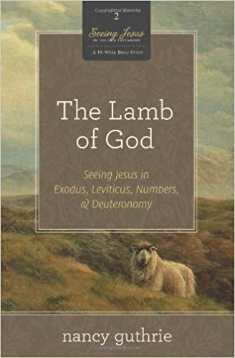
Recommended Resource:
The Lamb of God: Seeing Jesus in Exodus, Leviticus, Numbers, and Deuteronomy by Nancy Guthrie

Slide 89
Q & A

Slide 90
Thanks for coming! YOU ARE LOVED

