Slide 1
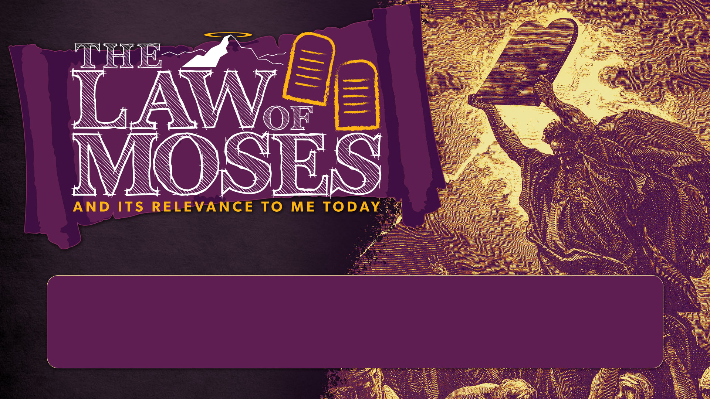
SESSION 3
THE TORAH (Part 2)

Slide 2

GOALS
CLASS
To understand how the Law of Moses points to Christ and how it is relevant to us today.
SESSION 3
Understanding the 3 major categories of law, and how Numbers and Deuteronomy tell the continuing narrative of Israel’s journey to the Promised Land, and God’s covenant with them.

Slide 3
3rd READING ASSIGNMENT
Num. 11, 14 & 16 and Deut. 9-11
What are some similarities you noticed in the stories of the people’s rebellions in Numbers 11, 14, & 16?
How would it have felt to be Moses in these situations?
What do you notice about this retelling of the story of Exodus in Deuteronomy 9-11? What repeated words, phrases or themes stand out to you?

Slide 4


STOP & PRAY
(Psalm 25:4-14)

Slide 5

CLASS ROADMAP

Slide 6



3 CATEGORIES OF BIBLICAL LAW

Slide 7

Are Christians Hypocrites for ‘picking and choosing’ laws?

Slide 8

VIDEO
The West Wing
(3:00)

Slide 9
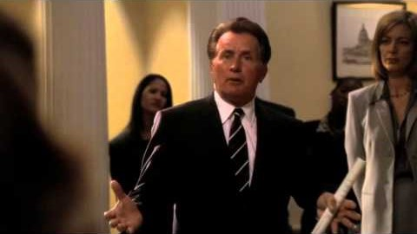

Slide 10
Why do Christians ‘pick and choose’ laws?

Slide 11
Why do Christians ‘pick and choose’ laws?
The main reason why Christians ‘pick and choose’ is because THE BIBLE itself teaches us HOW and WHY to do so.

Slide 12

THE THREEFOLD DIVISION OF THE LAW
In Chapter 19 of both the Westminster Confession of Faith (WCF) and the Second London Baptist Confession (1689 SLBC) contain sections on the Law of God which show us these 3 categories of law:

Slide 13
THE THREEFOLD DIVISION OF THE LAW
In Chapter 19 of both the Westminster Confession of Faith (WCF) and the Second London Baptist Confession (1689 SLBC) contain sections on the Law of God which show us these 3 categories of law:
MORAL Law

Slide 14
THE THREEFOLD DIVISION OF THE LAW
In Chapter 19 of both the Westminster Confession of Faith (WCF) and the Second London Baptist Confession (1689 SLBC) contain sections on the Law of God which show us these 3 categories of law:
MORAL Law
CEREMONIAL Law

Slide 15
THE THREEFOLD DIVISION OF THE LAW
In Chapter 19 of both the Westminster Confession of Faith (WCF) and the Second London Baptist Confession (1689 SLBC) contain sections on the Law of God which show us these 3 categories of law:
MORAL Law
CEREMONIAL Law
CIVIL Law

Slide 16
THE THREEFOLD DIVISION OF THE LAW
1. MORAL Law
1689 SLBC – Chapter 19.2
“The same law that was first written in the heart of man continued to be a perfect rule of righteousness after the fall, and was delivered by God upon Mount Sinai, in the Ten Commandments, and written in two tables, the four first containing our duty towards God, and the other six, our duty to man.”
(cf. Romans 2:14, 15; Deuteronomy 10:4)

Slide 17
THE THREEFOLD DIVISION OF THE LAW
2. CEREMONIAL Law
1689 SLBC – Chapter 19.3 (paraphrased)
“Besides this law (commonly called moral) God was pleased to give to the people of Israel ceremonial laws, containing several typical ordinances, partly of worship, prefiguring Christ, his graces, actions, sufferings, and benefits; and partly giving various instructions of moral duties, all these ceremonial laws were appointed only to the time of Christ’s first coming, and are now by Jesus Christ (the true Messiah and only law-giver) abrogated and taken away.”
(cf. Hebrews 10:1; Colossians 2:17; 1 Corinthians 5:7; Colossians 2:14, 16, 17; Ephesians 2:14, 16 )

Slide 18
THE THREEFOLD DIVISION OF THE LAW
2. CEREMONIAL Law
A. These laws served to protect against the danger of the Jews assimilating into surrounding pagan cultures.

Slide 19
THE THREEFOLD DIVISION OF THE LAW
2. CEREMONIAL Law
A. These laws served to protect against the danger of the Jews assimilating into surrounding pagan cultures.
B. Christ does not ‘break the law’ - rather he fulfills what its original purpose was.

Slide 20
THE THREEFOLD DIVISION OF THE LAW
2. CEREMONIAL Law
A. These laws served to protect against the danger of the Jews assimilating into surrounding pagan cultures.
B. Christ does not ‘break the law’ - rather he fulfills what its original purpose was.
The ceremonial law teaches us principles about worship of God, and Christian living.

Slide 21
THE THREEFOLD DIVISION OF THE LAW
3. CIVIL Law
1689 SLBC – Chapter 19.4 (paraphrased)
“To them also he gave various judicial laws, which expired together with the OT nation of Israel (not obliging any now by virtue of that institution) their general value to us only being of moral use.”
(cf. 1 Corinthians 9:8-10 )

Slide 22
THE THREEFOLD DIVISION OF THE LAW
3. CIVIL Law
A. Israel’s civil laws are no longer in effect today because unlike the OT, God’s people are no longer defined by national or ethnic boundaries.

Slide 23

Christ fulfills what Israel was supposed to be.
Christ is the True Israel, and we are in Christ - grafted in to God’s people.
(see Eph. 2:19; 3:6; Rom. 4:16; 8:14-16; 9:8; 11:17-24; Gal 3:29; 4:28; 6:16)
These laws are abrogated because of Christ’s fulfillment of them. However, these laws do have some value in shaping how we think about civil laws today and what values are useful in forming a just society – such as fair recompense for work.
(e.g. 1 Cor. 9:8-10 )

Slide 24
Why does the Moral Law still stand?

Slide 25
Why does the Moral Law still stand?
The Moral law is forever binding on all people - Christians and non-Christians. The moral law is never abrogated because its origin is in the character and nature of God Himself - who never changes.
Christ himself affirms and clarifies the moral law to us.
(cf. Rom. 13:8-10; Jam. 2:8-12; Matt. 5:17-19; Rom. 3:31)

Slide 26
Why do Christians ‘pick and choose’ laws?
The main reason why Christians ‘pick and choose’ is because THE BIBLE itself teaches us HOW and WHY to do so.

Slide 27
Q & A
(15 mins)

Slide 28

NUMBERS
REBELLION & WANDERING

Slide 29
NUMBERS: Rebellion & Wandering
The book asks:
Will the new generation be faithful and enter the Land or rebel and fail like their forefathers?

Slide 30
NUMBERS: Rebellion & Wandering
The book asks:
Will the new generation be faithful and enter the Land or rebel and fail like their forefathers?
The book shows us:
God’s ultimate plan of redemption is not tied to a particular generation.

Slide 31
NUMBERS: Rebellion & Wandering
3 major patterns in the narrative:
1. Pattern of ORGANIZATION

Slide 32
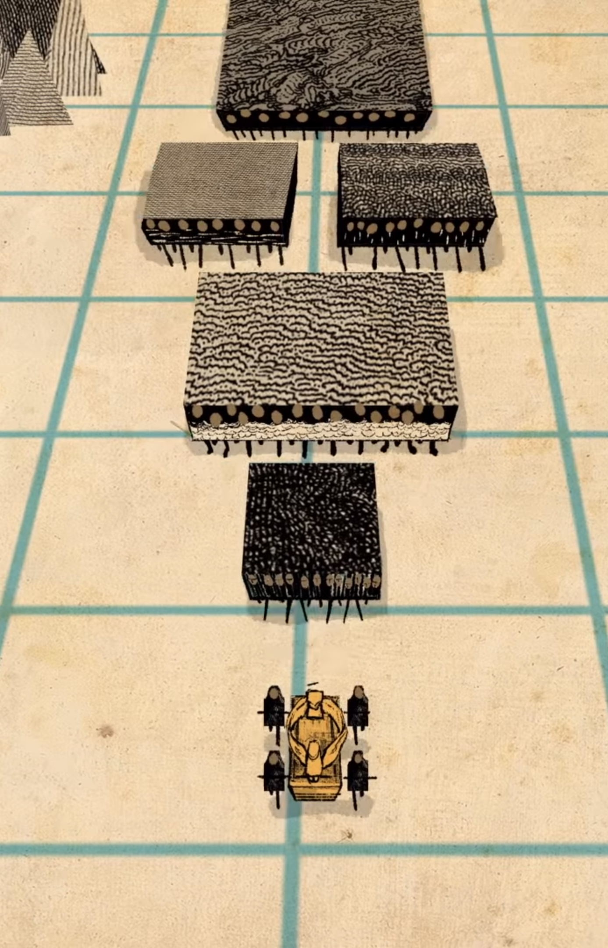
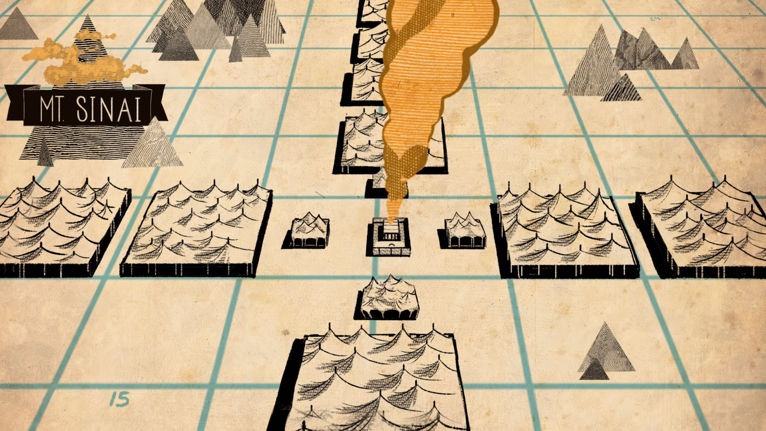
Moving
Encamped
God at the centre
God leading

Slide 33
NUMBERS: Rebellion & Wandering
3 major patterns in the narrative:
1. Pattern of ORGANIZATION
2. Pattern of REBELLION

Slide 34
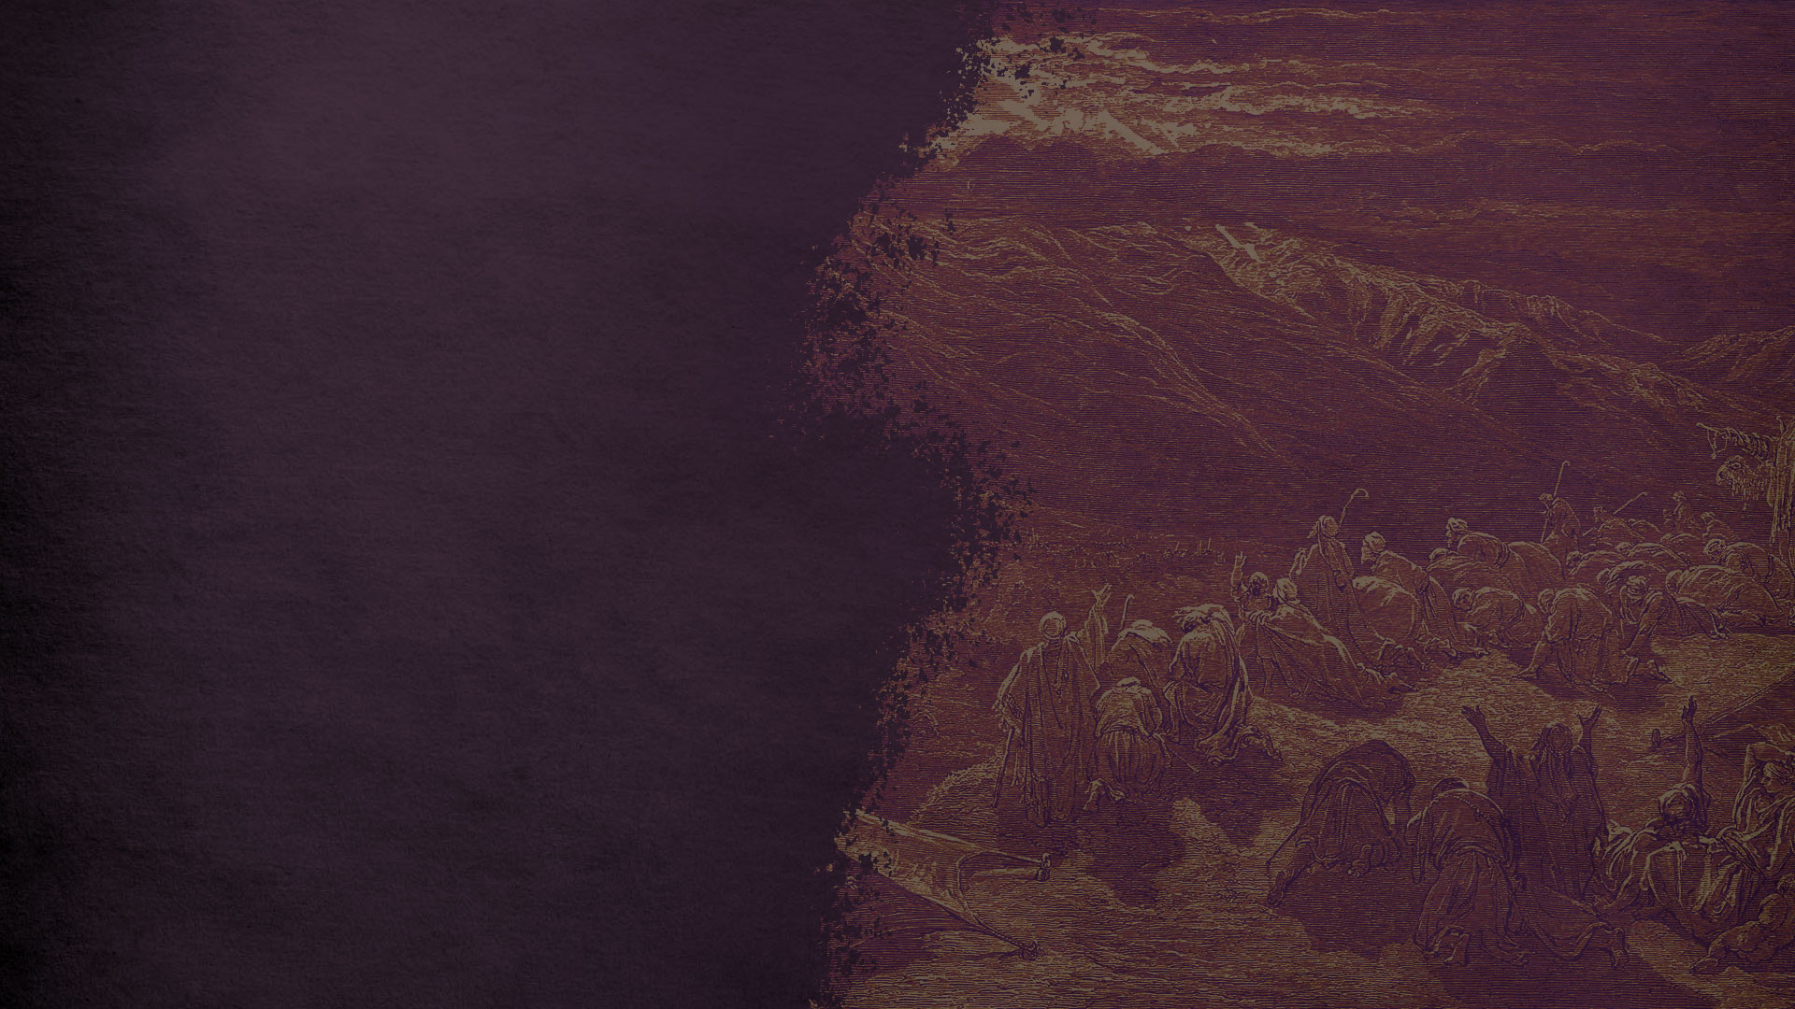
PATTERN OF REBELLION
“In fact, apart from the future blessing that God speaks through a pagan prophet, there is hardly a good word about them in the entire narrative.”
(Gordon Fee)

Slide 35
PATTERN OF REBELLION
A. Each rebellion involves the death and/or threat of death on a portion of the first generation.

Slide 36
PATTERN OF REBELLION
A. Each rebellion involves the death and/or threat of death on a portion of the first generation.
B. The laws in between the rebellion stories provide clarification about laws they may have transgressed, or put measures in place to prevent future transgression, and prepare them for when they enter the land.

Slide 37
PATTERN OF REBELLION
A. Each rebellion involves the death and/or threat of death on a portion of the first generation.
B. The laws in between the rebellion stories provide clarification about laws they may have transgressed, or put measures in place to prevent future transgression, and prepare them for when they enter the land.
It shows that God is still going to be faithful to His promise despite the people’s failures and rebellion.

Slide 38
NUMBERS: Rebellion & Wandering
3 major patterns in the narrative:
1. Pattern of ORGANIZATION
2. Pattern of REBELLION
3. Pattern of God’s SALVATION

Slide 39
PATTERN OF GOD’S SALVATION
A. The ROCK – Numbers 20:10-13

Slide 40
PATTERN OF GOD’S SALVATION
A. The ROCK – Numbers 20:10-13
Moses disobeys God’s instructions (he was supposed to speak to it) and even puts himself on par with God saying:
“shall WE bring water for you out of this rock?” (20:10)
For this Moses is barred from entrance to the Promised Land.

Slide 41
PATTERN OF GOD’S SALVATION
A. The ROCK –1 Corinthians 10:1-6
“For I do not want you to be unaware, brothers, that our fathers were all under the cloud, and all passed through the sea, and all were baptized into Moses in the cloud and in the sea, and all ate the same spiritual food, and all drank the same spiritual drink. For they drank from the spiritual Rock that followed them, and the Rock was Christ. Nevertheless, with most of them God was not pleased, for they were overthrown in the wilderness.
Now these things took place as examples for us, that we might not desire evil as they did.”

Slide 42
PATTERN OF GOD’S SALVATION
A. The ROCK – Numbers 20:10-13
B. The SERPENT – Numbers 21:4-9

Slide 43
PATTERN OF GOD’S SALVATION
A. The ROCK – Numbers 20:10-13
B. The SERPENT – Numbers 21:4-9
C. The Conquering KING – Numbers 24:17

Slide 44
PATTERN OF GOD’S SALVATION
C. The Conquering KING – Numbers 24:17
In Balaam’s third oracle, he says that he sees this kingly figure:
“a star shall come out of Jacob, a scepter shall rise out of Israel”
who will crush the enemy of God’s people (cf. Num 24:17).
This is directly connected to Jacob’s blessing of Judah in Genesis 49, that the scepter shall never depart from Judah - and one day, the Lion from the tribe of Judah would come.

Slide 45
How amazing that while Israel is in the camp complaining and murmuring about God, He is in the hills protecting from and blessing them through a pagan prophet!?

Slide 46
How amazing that while Israel is in the camp complaining and murmuring about God, He is in the hills protecting from and blessing them through a pagan prophet!?
How often is that the case for us?
When we are too busy complaining, we don’t see God’s protection and blessing over us?

Slide 47

GROUP DISCUSSIONS
READ: Numbers 21:4-9 & John 3:5-15
What do you notice caused the people to rebel in the incident in Numbers 21:4-9? What do the people accuse God and Moses with?
What is odd about God’s provision to cure His judgement against the people’s sin?
How does Jesus use this story from Numbers in his discussion with Nicodemus in John 3? What is the connection?

Slide 48
NUMBERS: TAKEAWAY
“Numbers illustrates one of the main themes of the whole Bible. The sin of the first generation could have led to the end of the story of redemption and the destruction of the people of God. But God does not abandon His people even in their rebellion and sin… The principle actor in Numbers is Yahweh. Even under extreme provocation, He keeps His covenant with Israel, guides them through the wilderness and provides for their needs…
Each generation of Christians should place themselves in the position of the new generation of the book of Numbers. God has acted redemptively in our midst, and by so doing, he has given our lives meaning and hope. Just like the Numbers generation, we are called upon to respond to God’s grace with obedience.”
(Longman & Dillard, An Introduction to the Old Testament, pg. 100)

Slide 49

DEUTERONOMY
LISTEN & LOVE

Slide 50
DEUTERONOMY: Listen & Love
The tone of Deuteronomy was more hortatory than legal - that is, it is more exhortation than legislation.

Slide 51
“...its provisions tend to be less technical or specific than other codes. Deuteronomy is more interested in the ‘spirit’ than in the ‘letter’ of the law.”
(Longman & Dillard, An Introduction to the Old Testament, pg. 114)

Slide 52
THE IMPORTANCE OF CONTEXT FOR UNDERSTANDING LAWS

Slide 53
SOME STRANGE LAWS
In London, England, it is illegal to wear armour when visiting Parliament. Equally strange, it is illegal to die in the House of Parliament. Due to the fact that the building is considered royal, the deceased would be entitled to a state funeral.
In the UK, nineteenth-century English law made it illegal for women to eat chocolate on public transport. (I’m not sure why, but it’s humorous)
According to ‘The Outer Space Act 1986’, the secretary of state is permitted to use ‘reasonable force’ to prevent an alien invasion of the UK. (I guess alien invasion was a real concern at the time?)
Three settlements in southern France have prohibited death. The mayor of Le Lavandou outlawed death in 2000, after planning permission for a new cemetery was turned down due to environmental concerns. He described the new bylaw as "an absurd law to counter an absurd situation".

Slide 54
SOME STRANGE LAWS
There’s an old law in Scotland that you are not allowed to wear any underwear under your kilt or else be fined two beers.
In York, (Scotland) it is legal to murder a Scotsman within the ancient city walls, but only if he is carrying a bow and arrow.
In Washington State, there is a law making it illegal to kill Big Foot.
In Alberta it’s illegal to set fire to the leg of a wooden-legged man.
In St. Johns, Newfoundland, it’s illegal to keep cows in your house.
Under Canada’s Criminal Code’s Sec. 71, it is illegal to challenge or be challenged by someone to a duel.
In Toronto, it’s illegal to drag a dead horse down Yonge Street on a Sunday. (Why on earth would this be a necessary law unless some guy did it already?)

Slide 55
CONTEXT OF ANE LAW CODES
Not ‘legislative’ like how we understand laws today.
Examples of verdicts by ancient kings
Meant to offer a model of the king’s justice
These example cases and verdicts were meant to justify and legitimize the king as the chosen representative of the pagan gods
They sort of functioned similar to a party platform before political elections

Slide 56
CONTRASTING ISRAEL’S LAW TO THE REST OF THE ANE
PENTATEUCH | ANCIENT NEAR EAST
Self-revelation of God | Self-glorification of the king
Describes a vision of the right exercise of what it means to be God’s holy nation | Describes a vision of the right exercise of justice to legitimize the king
Portrays the ideal covenant keeper | Portrays the ideal human king
Prime purpose is the people’s sanctification | Prime purpose is showing the king’s justice
Showed the perfect standard of justice by the Holy King of Israel | Many examples of partiality and ignorance by fallible human kings

Slide 57
CONTEXT OF ANE LAW CODES
We take it for granted today that ‘God is near’ - not so in the ANE.
“Nothing in the ancient Near East compares to the extent of revelation that Yahweh gives to His people and the depth of relationship that He desires with them.”
(Walton, Ancient Near Eastern Thought and the Old Testament, pg 298)

Slide 58
“Keep them and do them, for that will be your wisdom and your understanding in the sight of the peoples, who, when they hear all these statutes, will say, ‘Surely this great nation is a wise and understanding people.’ For what great nation is there that has a god so near to it as the Lord our God is to us, whenever we call upon him? And what great nation is there, that has statutes and rules so righteous as all this law that I set before you today?”
(Deuteronomy 4:6-8)

Slide 59
VIDEO
The Book of Deuteronomy
(6:00)

Slide 60
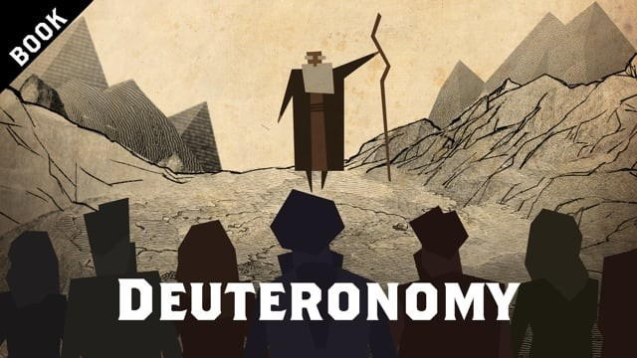

Slide 61
DEUTERONOMY: Listen & Love
Deuteronomy’s emphasis is on God’s sovereign initiative as Israel’s covenant Lord who chose them out of His own mysterious love (7:7-8).
They owe their existence to Him, and thus this grace calls for their response of loving obedience.

Slide 62
DEUTERONOMY: Listen & Love
We can see the emphasis on God’s grace towards them in that of the 167 times that the verb “give” is used in the book, 131 times it is Yahweh who is giving to them out of His gracious love.

Slide 63
CLASS DISCUSSIONS
Open your Bibles to Deuteronomy 4

Slide 64
DEUTERONOMY: 7 Takeaways
1. Israel is about to possess the Land
God, in His love, is about to fulfill the oath He made with Abraham so many generations ago!
2. It shows us what discipleship of the next generation looks like
Moses is re-telling the new generation of God’s gracious covenant relationship with His people. The emphasis is God’s gracious love to His people and their reasonable response of loving obedience.
3. Be killing sin or sin will be killing you...
The commands to completely destroy the places of pagan worship and people is so that Israel would not compromise with paganism and not be a blessing to the nations.

Slide 65
DEUTERONOMY: 7 Takeaways
4. God gives graciously to Israel
He likewise gives lavish grace and blessings to us though we are often stubborn, undeserving and rebellious.
5. Deuteronomy foreshadows of Christ
It speaks of a day when God would raise up a prophet like Moses (see Deut. 8:14-22) who does signs and wonders like Moses (cf. Deut. 34:11-12 & John 6:14).
6. Deuteronomy gives Israel the Shema
(Deut. 6:4) the central confession of Israel’s faith which says that the Lord, the God of Israel is one. Jesus claims to be one with the Father (cf. John 10:30; 17:21-23).3

Slide 66
DEUTERONOMY: 7 Takeaways
7. Israel was chosen as the least of all the nations as God’s treasured possession
(see Deut. 7:6; 14:2; 26:18)
So too the church is chosen from the weak, foolish and lowly (1 Cor. 1:26-30) and believers are the ‘new Israel’ - His treasured possession (Eph. 1:14; Tit. 2:14; 1 Pet. 2:9).

Slide 67
FINAL COMMENTS
“Deuteronomy brings the Pentateuch to a conclusion with its constant reminders of God’s love and faithfulness despite His people’s constant rebellion, but the final word is one of hope that God will ultimately prevail with His people.”
(Fee & Stuart, How to read the Bible book by book, pg 62)

Slide 68
FINAL COMMENTS
Where’s we’re going next: Law and Wisdom
The OT Law was the ideal vision for God’s Kingdom.
Wisdom literature is how we live out that vision in a fallen world where things don’t work out perfectly.

Slide 69
FINAL COMMENTS
Covenant and Lordship
This has not changed for us - as we’ll see in the NT - Jesus himself comes as the Conquering King of kings and Lord of lords announcing “the Kingdom of God” and demanding repentance and belief. The citizens of His Kingdom are still required to show exclusive loyalty and obedience to His rule.
God’s Kingdom is not a democracy… we don’t serve an exalted version of an elected politician. We serve a risen King.
His law is the expression of His loving rule over us.
Our submission to His law in all areas of our lives is the mark of true citizens of His Kingdom.

Slide 70
STOP & PRAY
(Numbers 6:24-26)

Slide 71
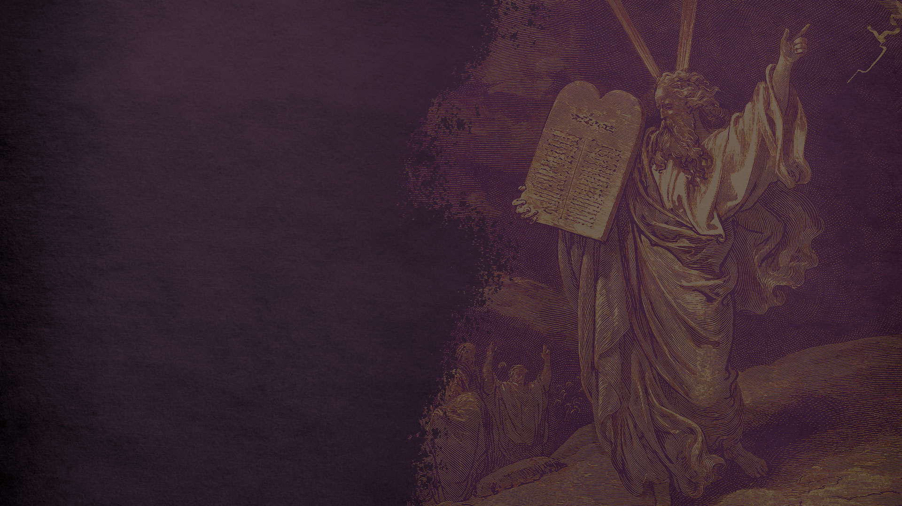
ASSIGNMENTS FOR SESSION 4
READ
Nehemiah 9
WATCH
The Prophets
How would you describe Wisdom in relation to Law and Gospel?
How were Old Testament saints saved? (optional)
(Video links are in your email)

Slide 72
ASSIGNMENTS FOR SESSION 4
ASK
Read Nehemiah 9 and circle/highlight every reference to the law, commandments or disobedience. Do these references keep coming up? If so, why do you think these references keep coming up

Slide 73
Thanks for coming!
YOU ARE LOVED

