Slide 1
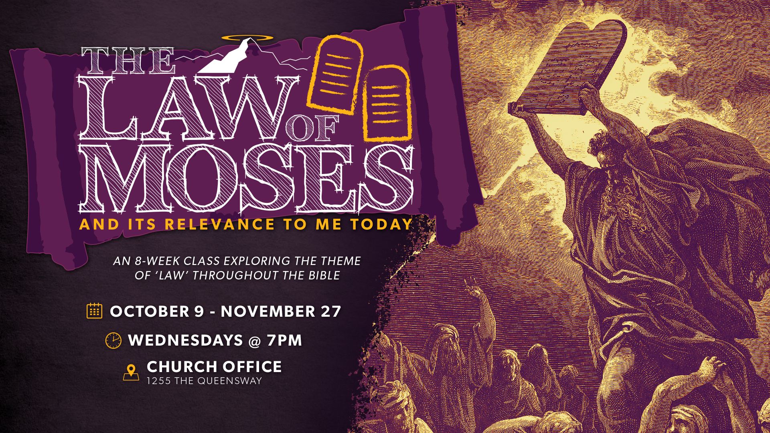

Slide 2
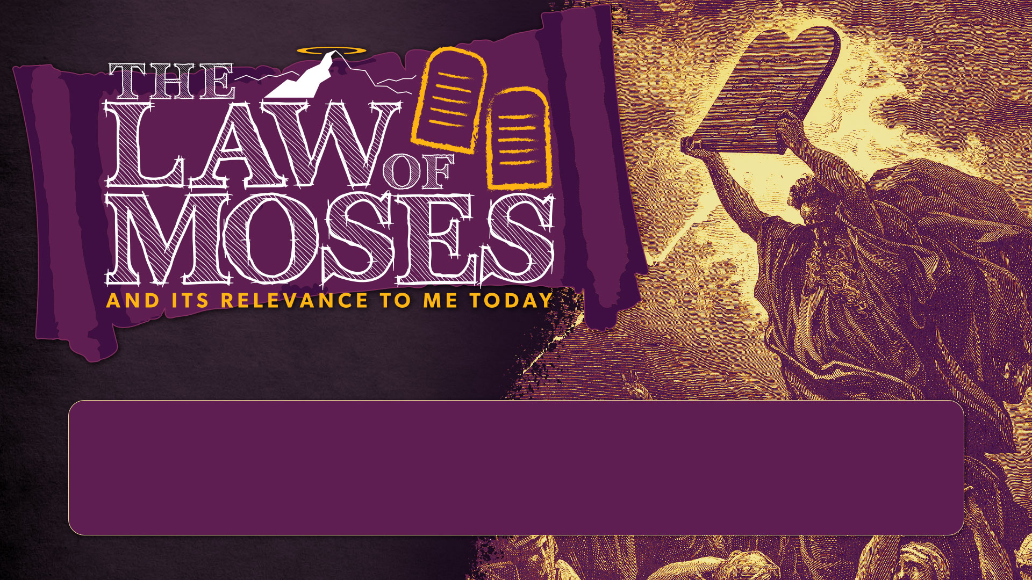
SESSION 4
THE PROPHETS & WRITINGS

Slide 3
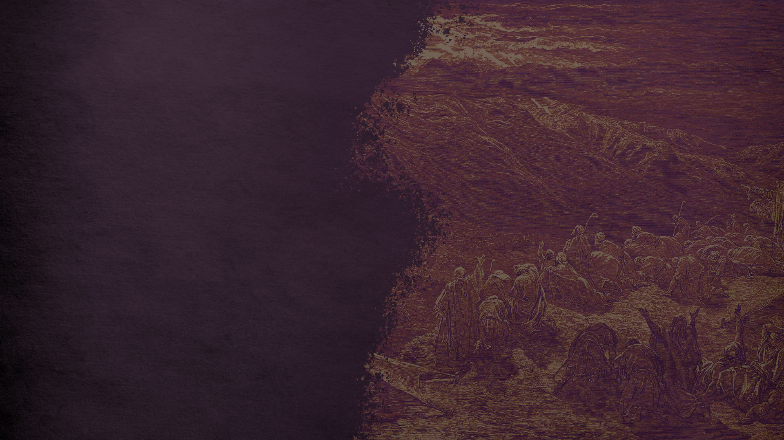
CLASS SESSIONS
Here are the 8 sessions we’ll be going through in this class:
THE PENTATEUCH - The Patriarchs, Sinai Covenant & Decalogue
THE TORAH (Part 1) - Tabernacle, Sacrifices, Priests, Feasts and OT Worship
THE TORAH (Part 2) - Law & Covenant, Promised Land and Foreshadowing
THE PROPHETS & WRITINGS - OT Prophets, Psalms & Wisdom Literature
THE GOSPELS - Matthew, Mark, Luke & John
THE EARLY CHURCH - Acts & Galatians
THE PAULINE LETTERS - The rest of the letters of Paul
THE GENERAL EPISTLES - The rest of the NT letters

Slide 4

EVENING PREVIEW
7 - 7:15pm 7:15 - 7:55 pm 8:10 – 8:30 pm 8:30 – 9 pm | ARRIVAL and FELLOWSHIP time STUDY the text together RESPOND in small groups PRAY in small groups

Slide 5
INTRODUCTION:
WHERE WE’VE BEEN
^{NEHEMIAH 9 RECAP}

Slide 6
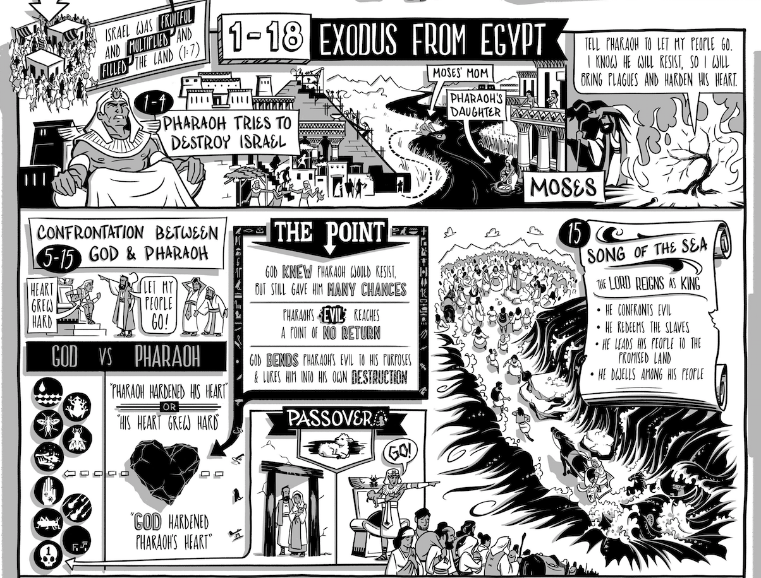
GOD FREES ISRAELITES FROM EGYPT
⁹ “And you saw the affliction of our fathers in Egypt and heard their cry at the Red Sea, ¹⁰ and performed signs and wonders against Pharaoh and all his servants and all the people of his land, for you knew that they acted arrogantly against our fathers. And you made a name for yourself, as it is to this day.
Nehemiah 9:9-10
*Every “comic” graphic was taken from READ SCRIPTURE by The Bible Project

Slide 7
GOD FREES ISRAELITES FROM EGYPT
¹¹ And you divided the sea before them, so that they went through the midst of the sea on dry land, and you cast their pursuers into the depths, as a stone into mighty waters. ¹² By a pillar of cloud you led them in the day, and by a pillar of fire in the night to light for them the way in which they should go.

Slide 8
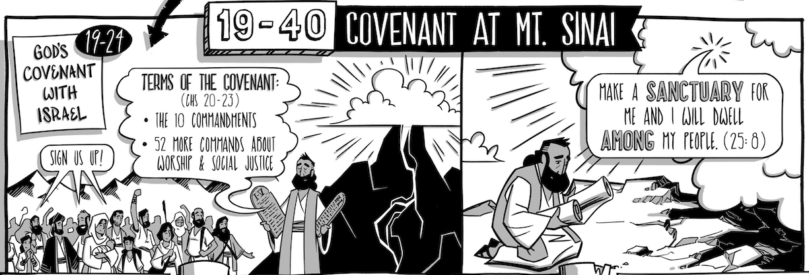
GOD MAKES COVENANT AT SINAI
¹³ You came down on Mount Sinai and spoke with them from heaven and gave them right rules and true laws, good statutes and commandments, ¹⁴ and you made known to them your holy Sabbath and commanded them commandments and statutes and a law by Moses your servant. ¹⁵ You gave them bread from heaven for their hunger and brought water for them out of the rock for their thirst, and you told them to go in to possess the land that you had sworn to give them.

Slide 9
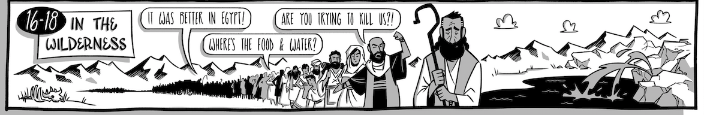
ISRAELITES GRUMBLE IN THE WILDERNESS
¹⁶ “But they and our fathers acted presumptuously and stiffened their neck and did not obey your commandments. ¹⁷ They refused to obey and were not mindful of the wonders that you performed among them, but they stiffened their neck and appointed a leader to return to their slavery in Egypt. But you are a God ready to forgive, gracious and merciful, slow to anger and abounding in steadfast love, and did not forsake them.

Slide 10
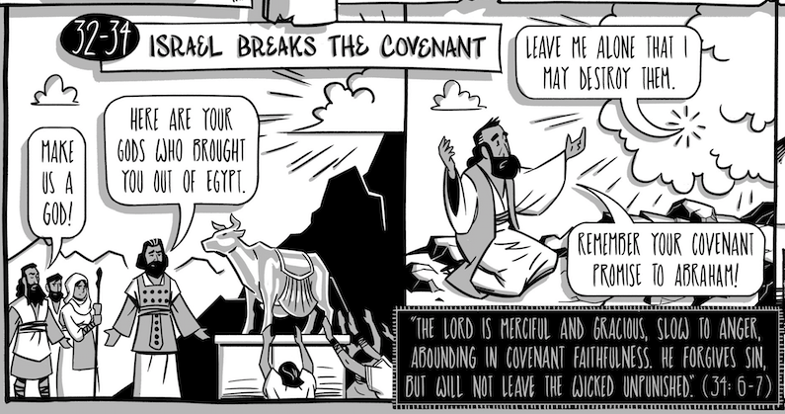
GOLDEN CALF
¹⁸ Even when they had made for themselves a golden calf and said, ‘This is your God who brought you up out of Egypt,’ and had committed great blasphemies, ¹⁹ you in your great mercies did not forsake them in the wilderness. The pillar of cloud to lead them in the way did not depart from them by day, nor the pillar of fire by night to light for them the way by which they should go.

Slide 11
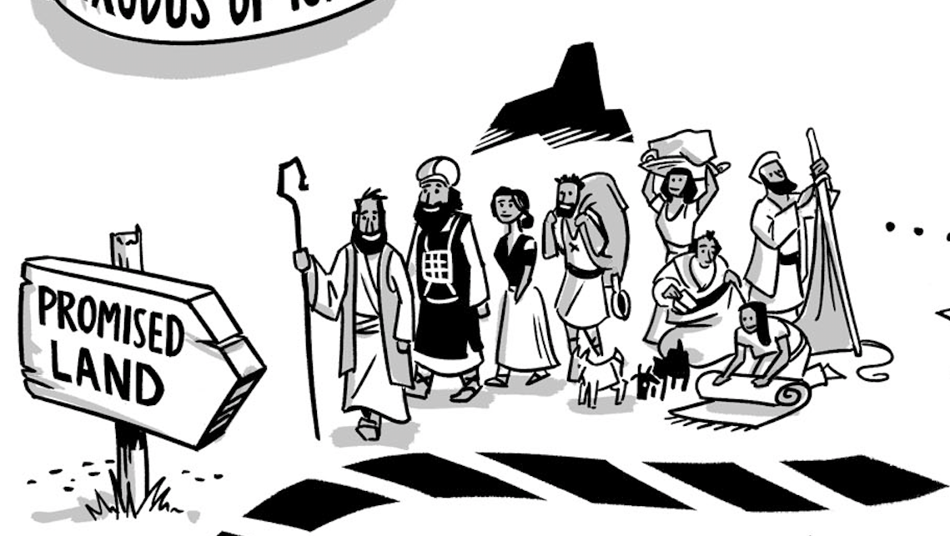
GOD’S FAITHFULNESS IN THE WILDERNESS
²⁰ You gave your good Spirit to instruct them and did not withhold your manna from their mouth and gave them water for their thirst. ²¹ Forty years you sustained them in the wilderness, and they lacked nothing. Their clothes did not wear out and their feet did not swell.

Slide 12
A TURN FOR THE BETTER IN JOSHUA?

Slide 13
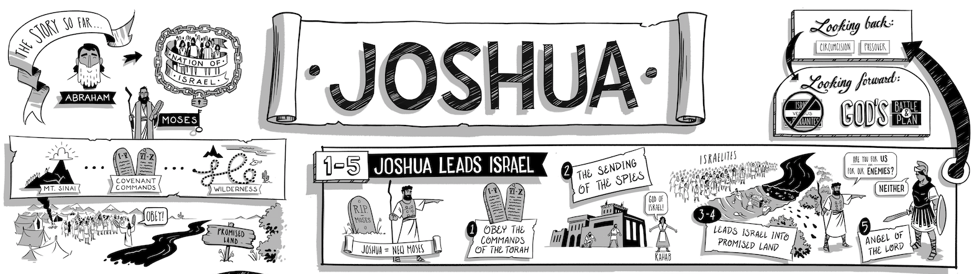
OPTIMISTIC RESULTS

Slide 14
INSPIRATIONAL ENDING?

Slide 15
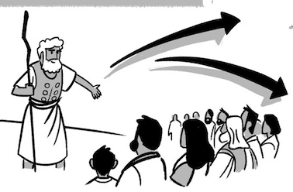
AN OMINOUS REALITY CHECK
¹⁶ Then the people answered, “Far be it from us that we should forsake the Lord to serve other gods, ¹⁷ for it is the Lord our God who brought us and our fathers up from the land of Egypt, out of the house of slavery…Therefore we also will serve the Lord, for he is our God.”
Joshua 24:16-18

Slide 16
AN OMINOUS REALITY CHECK
¹⁹ But Joshua said to the people, “You are not able to serve the Lord, for he is a holy God. He is a jealous God; he will not forgive your transgressions or your sins. ²⁰ If you forsake the Lord and serve foreign gods, then he will turn and do you harm and consume you, after having done you good.”
Joshua 24:19-20

Slide 17
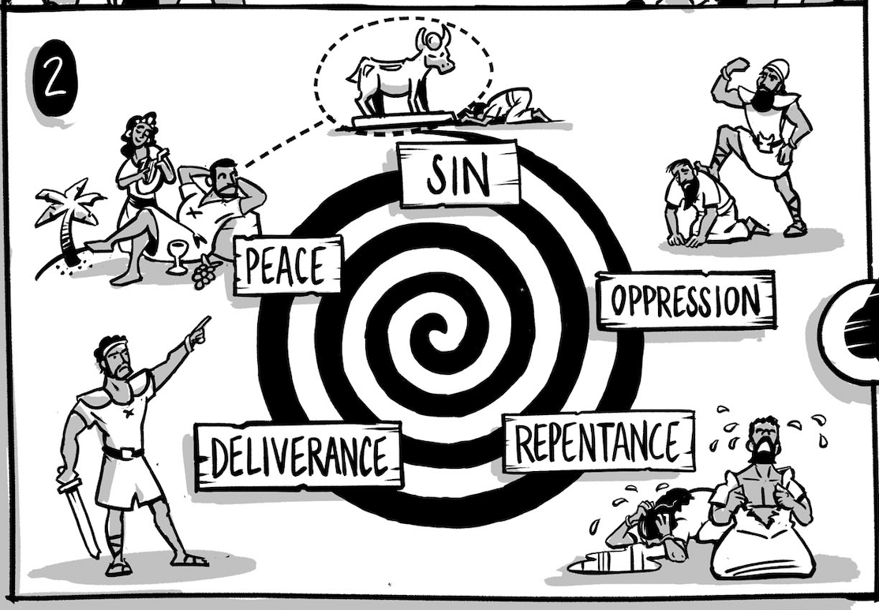
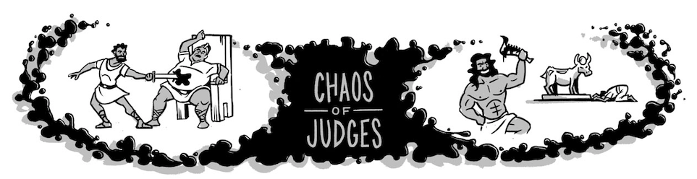
THE CYCLE OF APOSTASY (JUDGES 2)

Slide 18
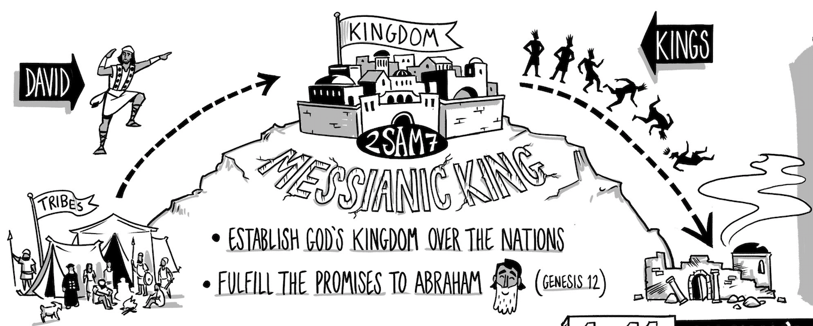
THE KINGDOM ERA

Slide 19
TONIGHT’S OUTLINE
The Writings and the Prophets is a story of:
A Declining Nation
Escalating Prophecies
Dashed Hopes

Slide 20
1. A DECLINING NATION
DISCUSS IN GROUPS:
Read Nehemiah 9:22-25.
What were some of the blessings that God had given to the people of Israel?
Read Nehemiah 9:26-31 and circle/highlight every reference to the law, commandments or disobedience. How often do these come up?
In what way is this important to the history of Israel?
What does Nehemiah 9:26-31 tell us about the role of the prophets during the Kingdom Era?

Slide 21

MISSION OF THE PROPHETS
The MISSION of the prophets was to WARN and CALL Israel back to COVENANT OBEDIENCE.

Slide 22
Yet the Lord warned Israel and Judah by every prophet and every seer, saying, “Turn from your evil ways and keep my commandments and my statutes, in accordance with all the Law that I commanded your fathers, and that I sent to you by my servants the prophets.”
2 Kings 17:13

Slide 23
MISSION OF THE PROPHETS
The MISSION of the prophets was to WARN and CALL Israel back to COVENANT OBEDIENCE.

Slide 24
But they would not listen, but were stubborn, as their fathers had been, who did not believe in the Lord their God. They despised his statutes and his covenant that he made with their fathers and the warnings that he gave them. They went after false idols and became false, and they followed the nations that were around them, concerning whom the Lord had commanded them that they should not do like them.
2 Kings 17:14-15

Slide 25
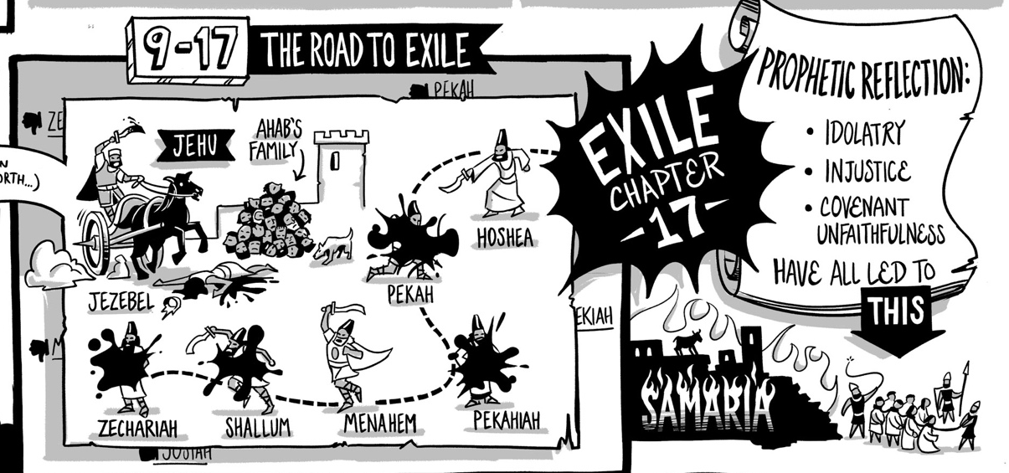
FINAL DESCENT: EXILE
²² The people of Israel walked in all the sins that Jeroboam did. They did not depart from them, ²³ until the Lord removed Israel out of his sight, as he had spoken by all his servants the prophets. So Israel was exiled from their own land to Assyria until this day.
2 Kings 17:22-23

Slide 26
TONIGHT’S OUTLINE
The Writings and the Prophets is a story of:
A Declining Nation
Escalating Prophecies
Dashed Hopes

Slide 27
HOPE OF THE PROPHETS
The HOPE of the prophets was to PREDICT a future MADE NEW.

Slide 28
2. ESCALATING PROPHECIES
EZEKIEL
JEREMIAH
MICAH

Slide 29
2. ESCALATING PROPHECIES
EZEKIEL
JEREMIAH
MICAH

Slide 30
MICAH’S PROPHECY
The LORD HIMSELF would TEACH the NATIONS His law.

Slide 31
It shall come to pass in the latter days that the mountain of the house of the Lord shall be established as the highest of the mountains, and it shall be lifted up above the hills; and peoples shall flow to it, and many nations shall come, and say:
“Come, let us go up to the mountain of the Lord,
to the house of the God of Jacob,
that He may teach us His ways and that we may walk in His paths.”
For out of Zion shall go forth the law,
and the word of the Lord from Jerusalem.
Micah 4:1-2

Slide 32
MICAH’S PROPHECY
The LORD HIMSELF would TEACH the NATIONS His law.

Slide 33
2. ESCALATING PROPHECIES
EZEKIEL
JEREMIAH
MICAH

Slide 34

JEREMIAH’S PROPHECY
The LORD would establish a NEW COVENANT: He would WRITE the law on their HEARTS

Slide 35
³¹“Behold, the days are coming, declares the Lord, when I will make a new covenant with the house of Israel and the house of Judah, ³² not like the covenant that I made with their fathers on the day when I took them by the hand to bring them out of the land of Egypt, my covenant that they broke, though I was their husband, declares the Lord.
³³ For this is the covenant that I will make with the house of Israel after those days, declares the Lord: I will put my law within them, and I will write it on their hearts. And I will be their God, and they shall be my people. ³⁴ And no longer shall each one teach his neighbor and each his brother, saying, ‘Know the Lord,’ for they shall all know me, from the least of them to the greatest, declares the Lord. For I will forgive their iniquity, and I will remember their sin no more.”
Jeremiah 31:31-34

Slide 36
JEREMIAH’S PROPHECY
The LORD would establish a NEW COVENANT: He would WRITE the law on their HEARTS

Slide 37
2. ESCALATING PROPHECIES
EZEKIEL
JEREMIAH
MICAH

Slide 38
EZEKIEL’S PROPHECY
The LORD would REPLACE their HEARTS and put his SPIRIT within them.

Slide 39
²⁵ I will sprinkle clean water on you, and you shall be clean from all your uncleannesses, and from all your idols I will cleanse you. ²⁶ And I will give you a new heart, and a new spirit I will put within you. And I will remove the heart of stone from your flesh and give you a heart of flesh. ²⁷ And I will put my Spirit within you, and cause you to walk in my statutes and be careful to obey my rules. ²⁸ You shall dwell in the land that I gave to your fathers, and you shall be my people, and I will be your God.
Ezekiel 36:25-28

Slide 40
EZEKIEL’S PROPHECY
The LORD would REPLACE their HEARTS and put his SPIRIT within them.

Slide 41
2. ESCALATING PROPHECIES
EZEKIEL: The LORD would REPLACE their HEARTS and put his SPIRIT within them.
JEREMIAH: The LORD would establish a NEW COVENANT: He would WRITE the law on their HEARTS
MICAH: The LORD HIMSELF would TEACH Israel his LAW.

Slide 42
TONIGHT’S OUTLINE
The Writings and the Prophets is a story of:
A Declining Nation
Escalating Prophecies
Dashed Hopes

Slide 43
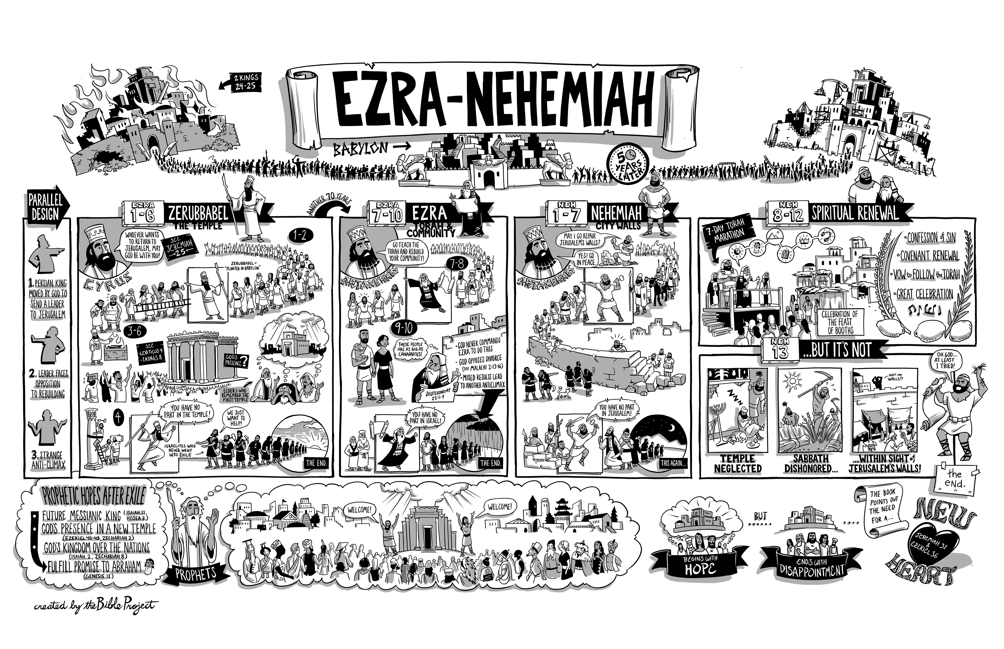
3. DASHED HOPES
EZEKIEL

Slide 44
3. DASHED HOPES

Slide 45
ZERUBBABEL’S LETDOWN
Rebuilds the TEMPLE, but it falls short of its former GLORY

Slide 46
And all the people shouted with a great shout when they praised the Lord, because the foundation of the house of the Lord was laid. ¹² But many of the priests and Levites and heads of fathers’ houses, old men who had seen the first house, wept with a loud voice when they saw the foundation of this house being laid, though many shouted aloud for joy, ¹³ so that the people could not distinguish the sound of the joyful shout from the sound of the people’s weeping, for the people shouted with a great shout, and the sound was heard far away.
Ezra 3:11b-13

Slide 47
ZERUBBABEL’S LETDOWN
Rebuilds the TEMPLE, but it falls short of its former GLORY

Slide 48
3. DASHED HOPES

Slide 49
EZRA’S LETDOWN
Sent to the TEACH the law, but is APPALLED by the INIQUITY of the people

Slide 50
9 After these things had been done, the officials approached me and said, “The people of Israel and the priests and the Levites have not separated themselves from the peoples of the lands with their abominations, from the Canaanites, the Hittites, the Perizzites, the Jebusites, the Ammonites, the Moabites, the Egyptians, and the Amorites. ² For they have taken some of their daughters to be wives for themselves and for their sons, so that the holy race has mixed itself with the peoples of the lands. And in this faithlessness the hand of the officials and chief men has been foremost.”
Ezra 9:1-2

Slide 51
³ As soon as I heard this, I tore my garment and my cloak and pulled hair from my head and beard and sat appalled. ⁴ Then all who trembled at the words of the God of Israel, because of the faithlessness of the returned exiles, gathered around me while I sat appalled until the evening sacrifice.
Ezra 9:3-4

Slide 52
⁵ And at the evening sacrifice I rose from my fasting, with my garment and my cloak torn, and fell upon my knees and spread out my hands to the Lord my God, ⁶ saying:
“O my God, I am ashamed and blush to lift my face to you, my God, for our iniquities have risen higher than our heads, and our guilt has mounted up to the heavens. ⁷ From the days of our fathers to this day we have been in great guilt. And for our iniquities we, our kings, and our priests have been given into the hand of the kings of the lands, to the sword, to captivity, to plundering, and to utter shame, as it is today.
Ezra 9:5-7

Slide 53
EZRA’S LETDOWN
Sent to the TEACH the law, but is APPALLED by the INIQUITY of the people

Slide 54
3. DASHED HOPES

Slide 55
NEHEMIAH’S LETDOWN
Builds WALL and brings RENEWAL, but it doesn’t LAST

Slide 56
NEHEMIAH’S LETDOWN
DISCUSS IN GROUPS:
Read Nehemiah 9:32-37.
In what ways do you see the people rightly acknowledging and confessing their sin? Why is that important?
Read Nehemiah 9:38.
In this verse, how did they respond to their conviction over sin? Do you think this will work?

Slide 57

NEHEMIAH’S LETDOWN
Builds WALL and brings RENEWAL, but it doesn’t LAST
VIDEO
Ezra-Nehemiah

Slide 58
NEHEMIAH’S LETDOWN

Slide 59
TONIGHT’S OUTLINE
The Writings and the Prophets is a story of:
A Declining Nation
Escalating Prophecies
Dashed Hopes

Slide 60
DISAPPOINTING ENDING…

Slide 61
…BUT THE STORY ISN’T OVER
And you show that you are a letter from Christ delivered by us, written not with ink but with the Spirit of the living God, not on tablets of stone but on tablets of human hearts.
2 Cor 3:3

Slide 62
GROUP PRAYER
²⁶ And I will give you a new heart, and a new spirit I will put within you. And I will remove the heart of stone from your flesh and give you a heart of flesh. ²⁷ And I will put my Spirit within you, and cause you to walk in my statutes and be careful to obey my rules.
Ezekiel 36:25-28
In my heart, you have taken away old ________ [“anger”, ”anxiety”…]
and given me new ____________ [“joy”, “love for you”…].
I praise you.

Slide 63
GROUP PRAYER
²⁶ And I will give you a new heart, and a new spirit I will put within you. And I will remove the heart of stone from your flesh and give you a heart of flesh. ²⁷ And I will put my Spirit within you, and cause you to walk in my statutes and be careful to obey my rules.
Ezekiel 36:25-28
I fail to walk in your statutes WHEN ___________. Spirit, fill us.

Slide 64
Thanks for coming!
YOU ARE LOVED

