Slide 1
SESSION 5 THE GOSPELS

Slide 2
GOALS
CLASS
To understand how the Law of Moses points to Christ and how it is relevant to us today.
SESSION 5
Understanding Jesus’s relationship to the Law and how he fulfills what it foreshadowed.

Slide 3
5th READING ASSIGNMENT
Matthew 4 & 5
How do you see Jesus using the Law in Matthew 4?
What are each of the 3 temptations about and how does Jesus’ response answer each one?
How does Jesus’ teaching in Matthew 5 correspond to some of the themes and topics we saw in the Pentateuch?

Slide 4
STOP & PRAY (Ephesians 1:15-22)

Slide 5
CLASS ROADMAP

Slide 15
CLIFFHANGER ENDING OF OT
Thus says Cyrus king of Persia, ‘The Lord, the God of heaven, has given me all the kingdoms of the earth, and he has charged me to build him a house at Jerusalem, which is in Judah. Whoever is among you of all his people, may the Lord his God be with him. Let him go up…’
(2 Chronicles 36:23)

Slide 16
WHERE WE ARE
400 years of silence, and the question hanging in the air:
“Will God fulfill His promises?”

Slide 17
WHERE WE’RE GOING
THE GOSPEL OF MATTHEW

Slide 18
SESSION OUTLINE
Matthew 1-7 - The Greater Moses - Pentateuch
Matthew 8-10 - The Greater Joshua - Conquest of the Land
Matthew 11-13 - The Greater Wisdom - The Writings
Matthew 14-18 - The Greater King - Kingdom of God
Matthew 19-25 - The Greater Prophet - The Prophets
Matthew 26-27 - The Passion - Jesus fulfills Everything
Matthew 28 - The Resurrection & The Great Commission

Slide 19
STRUCTURE OF MATTHEW
In Matthew’s Gospel there are 5 narrative blocks, each followed by a block of Jesus’ teaching.
At the end of every division is the repeated phrase, “When Jesus had finished saying [these things].” (see 7:28, 11:1, 13:553; 19:1 and 26:1)

Slide 20
STRUCTURE OF MATTHEW
From the very structure of his gospel – we see that Matthew is intent on showing us how Jesus fulfills everything the OT pointed to!
“And beginning with Moses and all the Prophets, he interpreted to them in all the Scriptures the things concerning himself.”
(Luke 24:27)

Slide 22
1. THE GREATER MOSES JESUS FULFILLS THE PENTATEUCH (Matthew 1-7)

Slide 23
1. THE GREATER MOSES
The first seven chapters of Matthew’s Gospel generally follow the motifs of the Pentateuch - picking up on major themes from Genesis to Exodus, Leviticus, Numbers and Deuteronomy.

Slide 24
1. THE GREATER MOSES
In doing this, Matthew is demonstrating Jesus’ identification with Israel.
But even more significantly, showing how Jesus is the ‘True Israel’ of God.

Slide 25
A. THE PATRIARCHS

Slide 26
A. THE PATRIARCHS
i. A NEW GENESIS
The first line of Matthew’s Gospel reads:
Βίβλος γενέσεως Ἰησοῦ χριστοῦ υἱοῦ Δαυὶδ υἱοῦ Ἀβραάμ.

Slide 27
A. THE PATRIARCHS
i. A NEW GENESIS
The first line of Matthew’s Gospel reads:
Βίβλος γενέσεως Ἰησοῦ χριστοῦ υἱοῦ Δαυὶδ υἱοῦ Ἀβραάμ.
“the Book of Genesis of Jesus Christ, the son of David, the son of Abraham.”

Slide 28
A. THE PATRIARCHS
i. A NEW GENESIS
Just as the OT book of Genesis begins by telling us of the genealogy of God’s OT people (Israel), here in Matthew, we find a genealogy of Jesus Christ.

Slide 29
A. THE PATRIARCHS
ii. THE FULLNESS OF TIME
“Jesus’ genealogy selects just enough ancestors (“begat” can mean “was the ancestor of”) to create three series of fourteen names, probably employing gematria (the numerical value of the sum of the Hebrew consonants of a given word) on the name “David”, which equaled fourteen.”
(Craig Blomberg, “Commentary on the New Testament use of the Old Testament, p. 3)

Slide 30
A. THE PATRIARCHS
ii. THE FULLNESS OF TIME
The coming of the seventh seven is meant to signal an ultimate completion.
Hence, “when the fullness of time had come, God sends His Son.” (see Gal. 4:4)

Slide 31
A. THE PATRIARCHS
iii. SECOND ADAM – THE PROMISED SEED
His birth is reminiscent of the story of Isaac’s birth: God had promised to miraculously provide a seed to Abraham - which was fulfilled in the birth of Isaac to Abraham and Sarah when they were in their old age.

Slide 32
A. THE PATRIARCHS
iii. SECOND ADAM – THE PROMISED SEED
His birth is reminiscent of the story of Isaac’s birth: God had promised to miraculously provide a seed to Abraham - which was fulfilled in the birth of Isaac to Abraham and Sarah when they were in their old age.
Jesus Christ is the ultimate fulfillment of God’s promise of miraculous provision of a seed to Abraham through whom blessing to all nations would come!

Slide 34
B. THE EXODUS

Slide 35
B. THE EXODUS
i. THE GREATER MOSES
The angel tells Joseph that Mary “will bear a son, and you shall call his name Jesus, for he will save his people from their sins.” (1:21)

Slide 36
B. THE EXODUS
i. THE GREATER MOSES
The angel tells Joseph that Mary “will bear a son, and you shall call his name Jesus, for he will save his people from their sins.” (1:21)
Moses saved God’s people from slavery to a tyrannical Pharaoh in a pagan land. However, Christ was not to save his people from Roman oppression, but rather from their true slavery - their sins.

Slide 37
B. THE EXODUS
i. THE GREATER MOSES
Herod - the evil ruler - tries to destroy Him, just as Pharaoh attempted to destroy the baby Moses (2:16-17).
Fulfillment of Jeremiah 31:15

Slide 38
“Behold, the days are coming, declares the Lord, when I will make a new covenant with the house of Israel…
For this is the covenant that I will make with the house of Israel after those days, declares the Lord: I will put my law within them, and I will write it on their hearts. And I will be their God, and they shall be my people.”
(Jeremiah 31:31a & 33)

Slide 39
B. THE EXODUS
ii. THE TRUE ISRAEL
Joseph takes Jesus down to Egypt.
Note connections between Joseph in Genesis and Joseph in Matthew’s “new Genesis”.

Slide 40
B. THE EXODUS
ii. THE TRUE ISRAEL
“…out of Egypt I called my son.” (Matt. 2:15 – cf. Hosea 11:1) In the context of Hosea’s time, he was speaking of God’s past deliverance of Israel (God’s son) from Egypt.

Slide 41
B. THE EXODUS
ii. THE TRUE ISRAEL
“…out of Egypt I called my son.” (Matt. 2:15 – cf. Hosea 11:1) In the context of Hosea’s time, he was speaking of God’s past deliverance of Israel (God’s son) from Egypt.
Here, Matthew is showing us that Israel’s deliverance through the Passover and Red Sea symbolizes a greater deliverance now being inaugurated.

Slide 42
B. THE EXODUS
ii. THE TRUE ISRAEL
Furthermore, in connection to the Exodus story - we find next that Jesus is baptized, just as Israel was ‘baptized’ (so to speak) in the Red Sea.
(see 1 Cor. 10:2 for NT connection)

Slide 43
B. THE EXODUS
iii. THE TRUE PASSOVER LAMB
John’s Gospel tells us at Jesus’ baptism, John the Baptist said of him:
“The next day he saw Jesus coming toward him, and said, “Behold, the Lamb of God, who takes away the sin of the world!”
(John 1:29)

Slide 46
C. THE WILDERNESS IN NUMBERS

Slide 47
C. THE WILDERNESS IN NUMBERS
i. THE WILDERNESS
Chapter 3 starts off with the appearance of John the Baptist as “the voice of one crying in the wilderness…” a quotation of Isaiah 40:3.

Slide 48
“Isaiah in its context is speaking of a second Exodus, that is, the coming of God to save Israel in a deliverance greater than but parallel to the original exodus from Egypt.”
(see Isaiah 51:9-11)
(Vern Poythress, The Shadow of Christ in the Law of Moses, pg 253)

Slide 49
C. THE WILDERNESS IN NUMBERS
i. THE WILDERNESS
John appears on the scene from the wilderness, calling the people to repent - which reminds us of the unrepentance of the Numbers generation in the wilderness and their hardness of heart on the way to Canaan.

Slide 50
C. THE WILDERNESS IN NUMBERS
ii. IDENTIFICATION WITH SINNERS
Jesus’s baptism is explained by himself as fitting “to fulfill all righteousness” (3:15).
How is it fitting that Jesus, the sinless one, should need to take part in the baptism of John for repentance?

Slide 51
C. THE WILDERNESS IN NUMBERS
ii. IDENTIFICATION WITH SINNERS
Jesus, by being baptized like the faithful Jews who were coming repentant to John, was identifying with His fellow repentant Israelites.
This is how it fulfills all righteousness:
For Christ to be our righteousness, he must fully identify with us, and fully accomplish all for us.

Slide 52
C. THE WILDERNESS IN NUMBERS
iii. FAITHFUL THROUGH THE WILDERNESS
Jesus is led into the wilderness to be tempted.
He experiences temptations which are parallel to Israel’s wilderness temptations.

Slide 53
C. THE WILDERNESS IN NUMBERS
iii. FAITHFUL THROUGH THE WILDERNESS
Whereas Israel was unfaithful and succumbed to temptation again and again, Jesus - the true obedient Son - successfully resists temptation.
And He does so by quoting three times from the book of Deuteronomy.

Slide 55
D. LEVITICUS & DEUTERONOMY
i. THE TRUE LAWGIVER
Deuteronomy was the ‘second giving of the Law’.
Here, in the Sermon on the Mount of Matthew 5-7, we see Jesus, going up on the mountain and giving His disciples His teachings.
This is a new giving of the law from a new Mount Sinai.

Slide 56
“At Mount Sinai the voice of God spoke directly from heaven, and further revelations were mediated through Moses. In Matthew 5 the revelation comes through the voice of Jesus who is both God and the final Moses.”
(Vern Poythress)

Slide 57
D. LEVITICUS & DEUTERONOMY
ii. JESUS FULFILLS THE LAW
“Do not think that I have come to abolish the Law or the Prophets; I have not come to abolish them but to fulfill them.”
(Turn to Matthew 5:17-20)

Slide 58
D. LEVITICUS & DEUTERONOMY
ii. JESUS FULFILLS THE LAW
“Do not think that I have come to abolish the Law or the Prophets; I have not come to abolish them but to fulfill them.”
Matthew 5:17-20 contains a clear statement by Jesus that he does not come to abolish the Law and Prophets, but rather to fulfill them and a reaffirmation of their continuing validity “until all is accomplished.” (v.18)

Slide 59
D. LEVITICUS & DEUTERONOMY
ii. JESUS FULFILLS THE LAW
Notice the dilemma v.20 sets up for his hearers:
he just told them that in order to enter the Kingdom of Heaven, their righteousness had to exceed that of the spiritual professionals of their time!

Slide 60
D. LEVITICUS & DEUTERONOMY
ii. JESUS FULFILLS THE LAW
How would this be possible?
The answer is in the first part of his statement - that he came to fulfill the law - to accomplish it on their behalf.

Slide 61
“Jesus’ teaching represents not simply the reiteration of the law but a step forward, bringing the purpose of the law into realization.”
(Vern Poythress)

Slide 62
“Hence what Jesus means is that he came to realize the full measure of the intent and purpose of the law and the prophets. He came to complete, to consummate, to bring to full fruition and perfect fulfilment the law and the prophets.
…He means that the whole process of revelation deposited in the Old Testament finds in him its completion, its fulfilment, its confirmation, its validation. Still more, it finds in him its embodiment.”
(John Murray)

Slide 63
D. LEVITICUS & DEUTERONOMY
iii. JESUS CORRECTS ABUSES OF THE LAW
Jesus shows that the Law was not just about external observance of rules, but was truly about the motives of the heart.

Slide 64
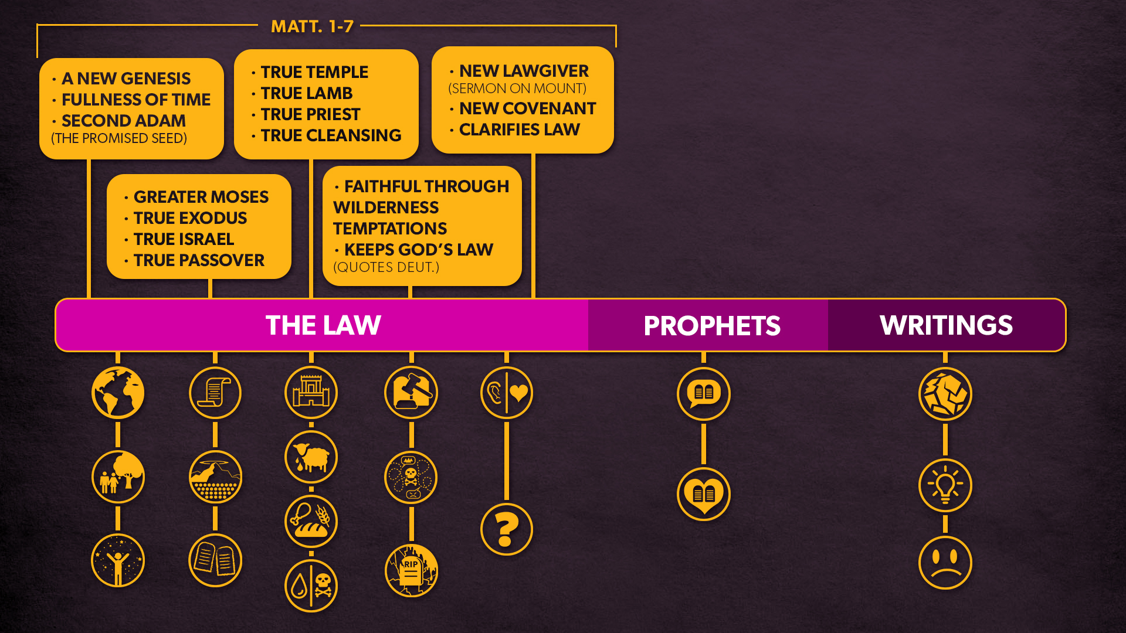

Slide 65
TAKEAWAY
All of this shows us how Jesus is the ultimate fulfillment of the Law (Torah) and all that it pointed to.

Slide 66
GROUP DISCUSSIONS
READ: Matthew 5:33-37 & 23:16-22
What does Matthew 23:16-22 tell you about the way that the Pharisees were abusing the law in regard to oaths?
How does Jesus correct this abuse according to Matthew 5:33-37?

Slide 67
VIDEO The Law (6:00)

Slide 69
2. THE GREATER JOSHUA JESUS FULFILLS THE CONQUEST OF THE LAND (Matthew 8-10)

Slide 70
2. THE GREATER JOSHUA
“...the name “Jesus” is a Grecized form of the Hebrew “Joshua,” recalling the successor of Moses and liberator of God’s people.”
(Craig Blomberg, “Commentary on the New Testament use of the Old Testament, p. 3)

Slide 71
2. THE GREATER JOSHUA
In this section, Matthew shows us God’s rule extending to:
the sick (8:14-17; 9:1-8)
the unclean (8:1-4)
the Gentiles (8:5-13)
the demonized (8:28-34; 9:32-33)
the dead (9:18-26)
the physical elements (8:23-27)
sinners (9:9-13)
beyond the bounds of the OT order (9:14-17)
the great harvest at the end of the age (9:35-38)
12 apostles commissioned to expand the Kingdom (chapter 10)

Slide 72
TAKEAWAY
This section shows us how Jesus fulfills the conquest and expansion of God’s Kingdom.

Slide 73
3. THE GREATER WISDOM JESUS FULFILLS THE WRITINGS (Matthew 11-13)

Slide 74
3. THE GREATER WISDOM
The next block of narrative (chapters 11-12) shows the growth of misunderstanding, misinterpretation and opposition to Jesus’ ministry and the following teaching block (chapter 13) has to do with parables expounding the mystery of the Kingdom.
Thus, the idea of wisdom verses lack of wisdom become prominent.

Slide 75
3. THE GREATER WISDOM
This section of Matthew is related to the theme of wisdom and folly in the OT Wisdom literature in these ways:
It has been given to Jesus’ disciples to know the mysteries, whereas it has been concealed from others (13:11).
The genre of parables (which we find many in this block) is similar to the essence of an OT proverb.
Matthew 13:34-35 explains Jesus’ teaching in parables by quoting from Psalm 78:2 - which is a sort of wisdom psalm telling Israel to learn wisdom from the lessons of history.

Slide 76
TAKEAWAY
This section shows how Jesus is truly the Wisdom of God. He is wisdom personified.
.

Slide 77
4. THE GREATER KING JESUS FULFILLS THE KINGDOM OF GOD (Matthew 14-18)

Slide 78
4. THE GREATER KING
Chapters 14-18 - Have something to do with the idea of shepherding or caring properly for God’s people. This idea of shepherd is invoked in 18:10-14.
This was what OT Israel’s Kings were supposed to be - shepherds of God’s people (see 2 Sam 5:2, 7:7).
So, these blocks have a relation to the OT figure of the Davidic Shepherd-King - which Jesus embodies as its fulfillment.

Slide 79
4. THE GREATER KING
In the narrative it is demonstrated clearly that Jesus is the true King and Shepherd of God’s people:
Jesus feeds them miraculously in 14:13-21 and 15:29-39.
He also says that he was sent to “the lost sheep of Israel” in 15:24, which is sandwiched between Jesus’ criticisms of the Pharisees as false shepherds in 15:1-20 and 16:1-12.
Peter’s confession in 16:13-20 highlights Jesus as the Christ, the Son of David.
And Jesus highlights that the Son of Man must undergo suffering for the sake of the flock (16:21-28).

Slide 80
TAKEAWAY
This fourth section of Matthew shows us how Jesus fulfills what the OT Kings and kingdom only foreshadowed. Jesus is the True King..

Slide 81
5. THE GREATER PROPHET JESUS FULFILLS THE PROPHETS (Matthew 19-25)

Slide 82
5. THE GREATER PROPHET
Chapters 19-25 are predominantly prophetic in nature.
Jesus speaks of the fall of Jerusalem, final judgment, and criteria for punishments and rewards.
The narrative section ends with Jesus’ prophetic sign of cursing the fig tree - which is reminiscent of the OT prophetic symbolic actions.

Slide 83
5. THE GREATER PROPHET
However, Jesus not only fulfills the prophetic ministry as a prophet, but also as the endpoint itself of what OT prophecy pointed towards!

Slide 84
ODDS OF 8 MESSIANIC PROPHECIES FULFILLED
Stoner and his students found that in considering these eight prophecies, the odds that they would be fulfilled by any man who has lived between the writing of the prophecies (no later than 400 BC) and today is 1 in 100,000,000,000,000,000 (or 100 quadrillion, expressed as 10¹⁷).

Slide 85
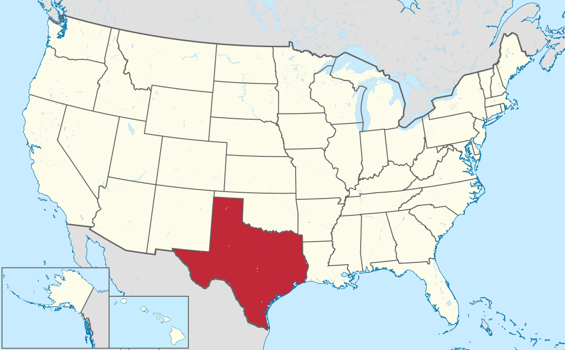

Slide 86
ODDS OF 8 MESSIANIC PROPHECIES FULFILLED
Suppose that we take 10¹⁷ silver dollars and lay them on the face of Texas. They will cover all of the state two feet deep. Now mark one of these silver dollars and stir the whole mass thoroughly, all over the state. Blindfold a man and tell him that he can travel as far as he wishes, but he must pick up one silver dollar and say that this is the right one. What chance would he have of getting the right one? Just the same chance that the prophets would have had of writing these eight prophecies and having them all come true in any one man, from their day to the present time, providing they wrote using their own wisdom.

Slide 87
ODDS OF 48 MESSIANIC PROPHECIES FULFILLED
1 in 10,000,000,000,000,000,000,000,000,000,000,000,000,000,000,000,000,000,000,000,000,000,000,000,000,000,000,000,000,000,000,000,000,000,000,000,000,000,000
(or 10¹⁵⁷)

Slide 88
JESUS & FULFILLED PROPHECY
MAIN POINT:
Any other explanation is impossible.
Jesus is the Messiah that the OT predicts.

Slide 89
TAKEAWAY
Jesus fulfills both the prophetic ministry of the OT and the OT prophecies.
Jesus is both the True Prophet of God - speaking God’s word to us - and what the Prophets spoke of.

Slide 90
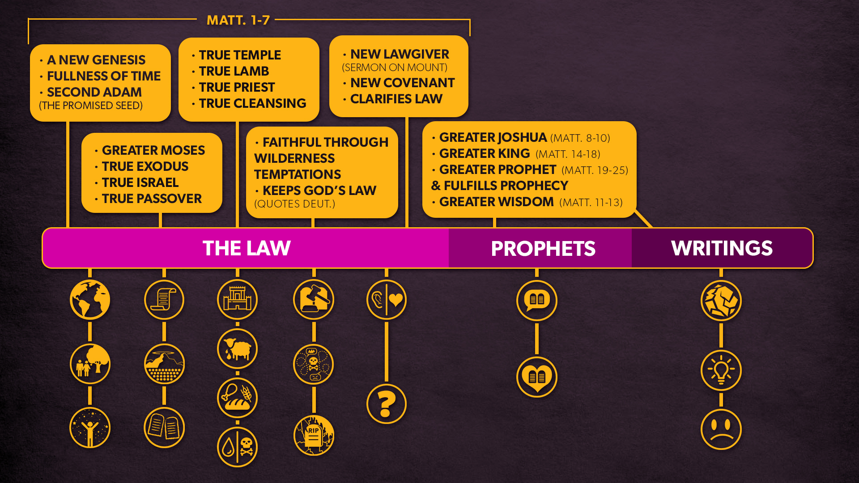

Slide 91
6. THE PASSION JESUS FULFILLS EVERYTHING (Matthew 26-27)

Slide 94
So, why is it important for us to know the OT law in light of its fulfillment in Christ?
Because part of the new covenant that Christ brings to us is that the Law is written on our hearts.
How can you know the content of what is “written on your heart” unless we know both the OT Law’s requirements and what its purpose and meaning are?

Slide 97
7. THE RESURRECTION & GREAT COMMISSION (Matthew 28)

Slide 98
7. RESURRECTION & COMMISSION
From our first session we saw - 3 Elements of God’s Covenantal Relationship with His people:
God’s Power
Divine Order
Personal Presence

Slide 99
7. RESURRECTION & COMMISSION
The end of the gospel of Matthew gives us the Great Commission which stresses:
God’s Power – Jesus has all authority
Divine Order – make disciples by teaching them to obey everything Jesus has commanded
Personal presence - I will be with you always

Slide 100
CLASS DISCUSSIONS
Open your Bibles to Matthew 5:17-20 & 28:18-20

Slide 101
FINAL COMMENTS
The Lord spoke to Moses, saying, “Speak to Aaron and his sons, saying, Thus you shall bless the people of Israel: you shall say to them,
The Lord bless you and keep you;
the Lord make his face to shine upon you and be gracious to you;
the Lord lift up his countenance upon you and give you peace.
So shall they put my name upon the people of Israel, and I will bless them.”
(Numbers 6:22-27)

Slide 102
FINAL COMMENTS
THE GREAT COMMISSION IS OUR COMMISSION
If Christ’s Name is upon us - which it is as Christians (which literally means little Christs) - then we must go make disciples of everyone, by baptizing them likewise into the Name and teaching them to obey all He has commanded us.

Slide 103
STOP & PRAY (Matthew 28:18-20)

Slide 104
ASSIGNMENTS FOR SESSION 6
READ
Acts 15:1-21
Galatians 5:1-6
The quote in your email
WATCH
Overview: Galatians
Should we obey Old Testament Law?
(Video links are in your email)

Slide 105
ASSIGNMENTS FOR SESSION 6
ASK
Given the role of circumcision in the history and life of Israel (see primer on circumcision above), why do you think there was such a heated debate over circumcision in Acts 15?
In Acts 15:5, how is circumcision related to the law of Moses?
In Acts 15:7-11, what is the gist of Peter's argument?

Slide 106
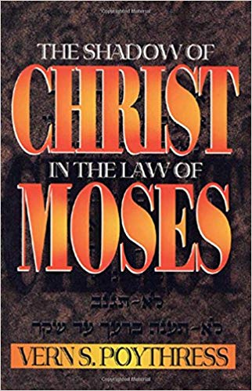
RECOMMENDED RESOURCE
The Shadow of Christ in the Law of Moses
by Vern S. Poythress

Slide 107
Thanks for coming! YOU ARE LOVED

