Slide 1
SESSION 6 THE EARLY CHURCH

Slide 2
CLASS SESSIONS
Here are the 8 sessions we’ll be going through in this class:
THE PENTATEUCH - The Patriarchs, Sinai Covenant & Decalogue
THE TORAH (Part 1) - Tabernacle, Sacrifices, Priests, Feasts and OT Worship
THE TORAH (Part 2) - Law & Covenant, Promised Land and Foreshadowing
THE PROPHETS & WRITINGS - OT Prophets, Psalms & Wisdom Literature
THE GOSPELS - Matthew, Mark, Luke & John
THE EARLY CHURCH - Acts & Galatians
THE PAULINE LETTERS - The rest of the letters of Paul
THE GENERAL EPISTLES - The rest of the NT letters

Slide 4
1. CIRCUMCISION The Early Conflict (Acts 15:1-21)
Role of Circumcision in the life of Israel:
Circumcision is a symbolic act that functions as a powerful image throughout the Bible. It was the sign of the covenant between God and Israel (Gen 17:11) whereby he had chosen them and given them the promise “[I will] be God to you and to your descendants after you” (Gen 17:7 RSV; cf. Deut 7:7–9).
Circumcision as Membership or Covenant: Before the establishment of a central sanctuary, circumcision served as the main symbol of God’s covenant with Israel and as a symbol, in turn, of Israel’s commitment to keep his covenant. Dire consequences attended those who failed to comply (Ex 4:24–26). It was the sine qua non of membership in the covenant community (Gen 17:14), perhaps even a test of loyalty (Gen 34). It could express a powerful recommitment (Josh 5:2–8).
Ryken, L., Dictionary of biblical imagery, p. 148-149

Slide 5
1. CIRCUMCISION The Early Conflict (Acts 15:1-21)
*Every “comic” graphic was taken from READ SCRIPTURE by The Bible Project

Slide 6
1. CIRCUMCISION The Early Conflict (Acts 15:1-21)
DISCUSS IN GROUPS:
Read Acts 15:1-21 Given the role of circumcision in the history and life of Israel, why do you think there was such a heated debate over circumcision in Acts 15?
In Acts 15:5, how is circumcision related to the law of Moses?
In Acts 15:7-11, what is the gist of Peter's argument?

Slide 7
THE EARLY CHURCH
CIRCUMCISION: The Early Conflict (Acts 15:1-21)

Slide 8
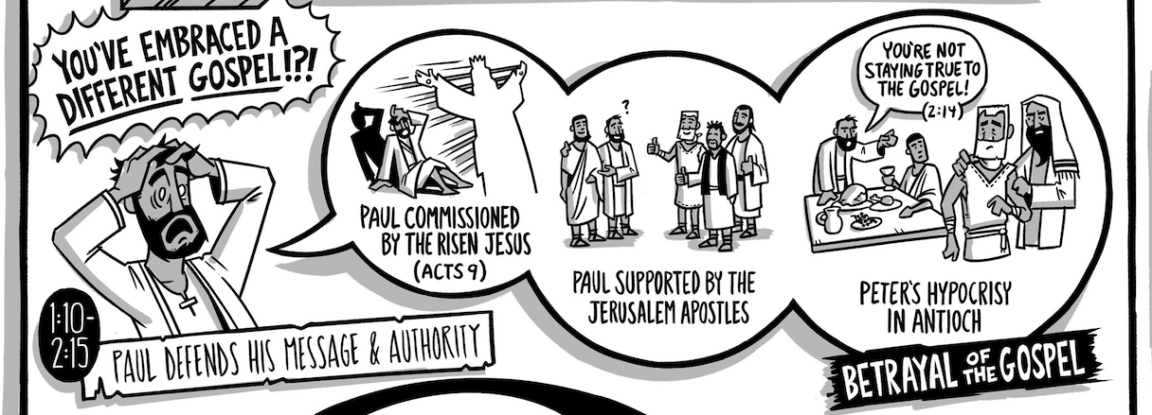
2. THE SEQUEL “Not in step with the truth of the gospel”(Gal 2:7-14)

Slide 9
2. THE SEQUEL “Not in step with the truth of the gospel”(Gal 2:7-14)
⁷ On the contrary, when they saw that I had been entrusted with the gospel to the uncircumcised, just as Peter had been entrusted with the gospel to the circumcised ⁸ (for he who worked through Peter for his apostolic ministry to the circumcised worked also through me for mine to the Gentiles), ⁹ and when James and Cephas and John, who seemed to be pillars, perceived the grace that was given to me, they gave the right hand of fellowship to Barnabas and me, that we should go to the Gentiles and they to the circumcised. ¹⁰ Only, they asked us to remember the poor, the very thing I was eager to do.

Slide 10
2. THE SEQUEL “Not in step with the truth of the gospel”(Gal 2:7-14)
¹¹ But when Cephas came to Antioch, I opposed him to his face, because he stood condemned. ¹² For before certain men came from James, he was eating with the Gentiles; but when they came he drew back and separated himself, fearing the circumcision party. ¹³ And the rest of the Jews acted hypocritically along with him, so that even Barnabas was led astray by their hypocrisy. ¹⁴ But when I saw that their conduct was not in step with the truth of the gospel, I said to Cephas before them all, “If you, though a Jew, live like a Gentile and not like a Jew, how can you force the Gentiles to live like Jews?”

Slide 11
THE EARLY CHURCH
CIRCUMCISION: The Early Conflict (Acts 15:1-21)
THE SEQUEL: “Not in step with the truth of the gospel” (Gal 2:7-14)

Slide 12
3. JUSTIFICATION By grace & through faith, not works (Gal 2:15-21)
DISCUSS IN GROUPS:
Read Gal 2:15-16 How is one justified? How is one NOT justified? What does it mean to be justified?
Read Gal 2:21 What role does God’s grace play in our justification?

Slide 13
3. JUSTIFICATION By grace & through faith, not works (Gal 2:15-21)
¹⁵ We ourselves are Jews by birth and not Gentile sinners; ¹⁶ yet we know that a person is not justified by works of the law but through faith in Jesus Christ, so we also have believed in Christ Jesus, in order to be justified by faith in Christ and not by works of the law, because by works of the law no one will be justified.

Slide 14
3. JUSTIFICATION By grace & through faith, not works (Gal 2:15-21)
New City Catechism

Slide 15
3. JUSTIFICATION By grace & through faith, not works (Gal 2:15-21)
¹⁷ But if, in our endeavor to be justified in Christ, we too were found to be sinners, is Christ then a servant of sin? Certainly not! ¹⁸ For if I rebuild what I tore down, I prove myself to be a transgressor. ¹⁹ For through the law I died to the law, so that I might live to God. ²⁰ I have been crucified with Christ. It is no longer I who live, but Christ who lives in me. And the life I now live in the flesh I live by faith in the Son of God, who loved me and gave himself for me. ²¹ I do not nullify the grace of God, for if righteousness were through the law, then Christ died for no purpose.

Slide 16
THE EARLY CHURCH
CIRCUMCISION: The Early Conflict (Acts 15:1-21)
THE SEQUEL: “Not in step with the truth of the gospel” (Gal 2:7-14)
JUSTIFICATION: By grace & through faith, not works (Gal 2:15-21)

Slide 17
4. BY FAITH Spirit-receivers and Sons of Abraham (Gal 3:1-9)
O foolish Galatians! Who has bewitched you? It was before your eyes that Jesus Christ was publicly portrayed as crucified. ² Let me ask you only this: Did you receive the Spirit by works of the law or by hearing with faith? ³ Are you so foolish? Having begun by the Spirit, are you now being perfected by the flesh? ⁴ Did you suffer so many things in vain—if indeed it was in vain? ⁵ Does he who supplies the Spirit to you and works miracles among you do so by works of the law, or by hearing with faith— ⁶ just as Abraham “believed God, and it was counted to him as righteousness”?

Slide 18
4. BY FAITH Spirit-receivers and Sons of Abraham (Gal 3:1-9)
⁷ Know then that it is those of faith who are the sons of Abraham. ⁸ And the Scripture, foreseeing that God would justify the Gentiles by faith, preached the gospel beforehand to Abraham, saying, “In you shall all the nations be blessed.” ⁹ So then, those who are of faith are blessed along with Abraham, the man of faith.

Slide 19
THE EARLY CHURCH
CIRCUMCISION: The Early Conflict (Acts 15:1-21)
THE SEQUEL: “Not in step with the truth of the gospel” (Gal 2:7-14)
JUSTIFICATION: By grace & through faith, not works (Gal 2:15-21)
BY FAITH: Spirit-receivers and sons of Abraham (Gal 3:1-9)

Slide 20
5. CHRIST Fulfilled the law by his active and passive obedience (Gal 3:10-14)
DISCUSS IN GROUPS:
Read Gal 3:10-12 Why is it cursed to rely on works of the law?
Read Gal 3:13-14 How did Christ redeem us from the curse of the law?

Slide 21
5. CHRIST Fulfilled the law by his active and passive obedience (Gal 3:10-14)
¹⁰ For all who rely on works of the law are under a curse; for it is written, “Cursed be everyone who does not abide by all things written in the Book of the Law, and do them.” ¹¹ Now it is evident that no one is justified before God by the law, for “The righteous shall live by faith.” ¹² But the law is not of faith, rather “The one who does them shall live by them.” ¹³ Christ redeemed us from the curse of the law by becoming a curse for us—for it is written, “Cursed is everyone who is hanged on a tree”— ¹⁴ so that in Christ Jesus the blessing of Abraham might come to the Gentiles, so that we might receive the promised Spirit through faith.

Slide 22
5. CHRIST Fulfilled the law by his active and passive obedience (Gal 3:10-14)
Active Obedience – Jesus fulfilling the precepts of God’s law “Cursed be everyone who does not abide by all things written in the Book of the Law, and do them.” – v10b
Passive Obedience – Jesus suffering the penalties of God’s law ”Christ redeemed us from the curse of the law by becoming a curse for us” – v13a

Slide 23
5. CHRIST Fulfilled the law by his active and passive obedience (Gal 3:10-14)
“Those whom God effectually calls, He also freely justifies, not by infusing righteousness into them, but by pardoning their sins, and by accounting and accepting their persons as righteous; not for anything wrought in them, or done by them, but for Christ’s sake alone; not by imputing faith itself, the act of believing, or any other evangelical obedience to them, as their righteousness; but by imputing Christ’s active obedience unto the whole law, and passive obedience in His death for their whole and sole righteousness, they receiving and resting on Him and His righteousness by faith, which faith they have not of themselves; it is the gift of God.”
1689 London Baptist Confession of Faith – Chapter 11: Of Justification

Slide 24
THE EARLY CHURCH
CIRCUMCISION: The Early Conflict (Acts 15:1-21)
THE SEQUEL: “Not in step with the truth of the gospel” (Gal 2:7-14)
JUSTIFICATION: By grace & through faith, not works (Gal 2:15-21)
BY FAITH: Spirit-receivers and sons of Abraham (Gal 3:1-9)
CHRIST: Fulfilled the law by his active and passive obedience (Gal 3:10-14)

Slide 25
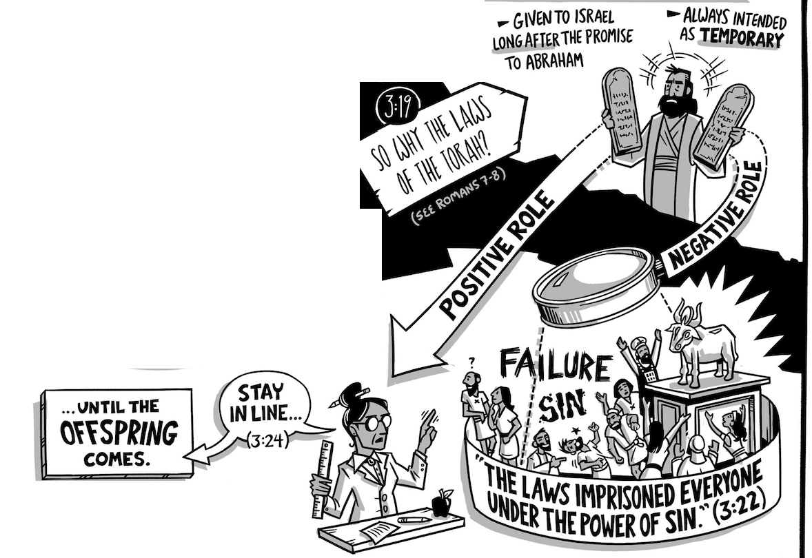
6. THE LAW Prison and Guardian (Gal 3:15-24)

Slide 26
6. THE LAW Prison and Guardian (Gal 3:15-24)
¹⁹ Now we know that whatever the law says it speaks to those who are under the law, so that every mouth may be stopped, and the whole world may be held accountable to God. ²⁰ For by works of the law no human being will be justified in his sight, since through the law comes knowledge of sin.
Rom 3:19-20

Slide 27
6. THE LAW Prison and Guardian (Gal 3:15-24)

Slide 28
6. THE LAW Prison and Guardian (Gal 3:15-24)
²¹ Is the law then contrary to the promises of God? Certainly not! For if a law had been given that could give life, then righteousness would indeed be by the law. ²² But the Scripture imprisoned everything under sin, so that the promise by faith in Jesus Christ might be given to those who believe.
²³ Now before faith came, we were held captive under the law, imprisoned until the coming faith would be revealed. ²⁴ So then, the law was our guardian until Christ came, in order that we might be justified by faith.

Slide 29
THE EARLY CHURCH
CIRCUMCISION: The Early Conflict (Acts 15:1-21)
THE SEQUEL: “Not in step with the truth of the gospel” (Gal 2:7-14)
JUSTIFICATION: By grace & through faith, not works (Gal 2:15-21)
BY FAITH: Spirit-receivers and sons of Abraham (Gal 3:1-9)
CHRIST: Fulfilled the law by his active and passive obedience (Gal 3:10-14)
THE LAW: Prison and Guardian (Gal 3:15-24)

Slide 30
7. SONS OF GOD Adopted and Indwelt by his Spirit (Gal 3:25-4:7)
²⁵ But now…
DISCUSS IN GROUPS:
Read Gal 4:4-7 In light of our captivity under the law, why is our adoption so monumental? Why is the Spirit’s indwelling so monumental?

Slide 31
7. SONS OF GOD Adopted and Indwelt by his Spirit (Gal 3:25-4:7)
²⁵ But now that faith has come, we are no longer under a guardian, ²⁶ for in Christ Jesus you are all sons of God, through faith. ²⁷ For as many of you as were baptized into Christ have put on Christ. ²⁸ There is neither Jew nor Greek, there is neither slave nor free, there is no male and female, for you are all one in Christ Jesus. ²⁹ And if you are Christ’s, then you are Abraham’s offspring, heirs according to promise.

Slide 32
7. SONS OF GOD Adopted and Indwelt by his Spirit (Gal 3:25-4:7)
4 I mean that the heir, as long as he is a child, is no different from a slave, though he is the owner of everything, ² but he is under guardians and managers until the date set by his father. ³ In the same way we also, when we were children, were enslaved to the elementary principles of the world. ⁴ But when the fullness of time had come, God sent forth his Son, born of woman, born under the law, ⁵ to redeem those who were under the law, so that we might receive adoption as sons. ⁶ And because you are sons, God has sent the Spirit of his Son into our hearts, crying, “Abba! Father!” ⁷ So you are no longer a slave, but a son, and if a son, then an heir through God.

Slide 33
THE EARLY CHURCH
CIRCUMCISION: The Early Conflict (Acts 15:1-21)
THE SEQUEL: “Not in step with the truth of the gospel” (Gal 2:7-14)
JUSTIFICATION: By grace & through faith, not works (Gal 2:15-21)
BY FAITH: Spirit-receivers and sons of Abraham (Gal 3:1-9)
CHRIST: Fulfilled the law by his active and passive obedience (Gal 3:10-14)
THE LAW: Prison and Guardian (Gal 3:15-24)
SONS OF GOD: Adopted and Indwelt by his Spirit (Gal 3:25 – 4:7)

Slide 34
8. FREEDOM New Covenant Reality (Gal 4:8-31)
Pastoral exhortation (4:8-20)
Hagar vs Sarah…Old covenant vs New Covenant…children of slavery vs children of promise (4:21-30)
Now the Lord is the Spirit, and where the Spirit of the Lord is, there is freedom.
2 Cor 3:17

Slide 35
THE EARLY CHURCH
CIRCUMCISION: The Early Conflict (Acts 15:1-21)
THE SEQUEL: “Not in step with the truth of the gospel” (Gal 2:7-14)
JUSTIFICATION: By grace & through faith, not works (Gal 2:15-21)
BY FAITH: Spirit-receivers and sons of Abraham (Gal 3:1-9)
CHRIST: Fulfilled the law by his active and passive obedience (Gal 3:10-14)
THE LAW: Prison and Guardian (Gal 3:15-24)
SONS OF GOD: Adopted and Indwelt by his Spirit (Gal 3:25 – 4:7)
FREEDOM: New Covenant reality (Gal 4:8-31)

Slide 36
9. CIRCUMCISION AS YOKE Severed from Christ (Gal 5:1-12)
5 For freedom Christ has set us free; stand firm therefore, and do not submit again to a yoke of slavery.
² Look: I, Paul, say to you that if you accept circumcision, Christ will be of no advantage to you. ³ I testify again to every man who accepts circumcision that he is obligated to keep the whole law. ⁴ You are severed from Christ, you who would be justified by the law; you have fallen away from grace. ⁵ For through the Spirit, by faith, we ourselves eagerly wait for the hope of righteousness. ⁶ For in Christ Jesus neither circumcision nor uncircumcision counts for anything, but only faith working through love.

Slide 37
9. CIRCUMCISION AS YOKE Severed from Christ (Gal 5:1-12)
…¹¹ But if I, brothers, still preach circumcision, why am I still being persecuted? In that case the offense of the cross has been removed. ¹² I wish those who unsettle you would emasculate themselves!

Slide 38
THE EARLY CHURCH
CIRCUMCISION: The Early Conflict (Acts 15:1-21)
THE SEQUEL: “Not in step with the truth of the gospel” (Gal 2:7-14)
JUSTIFICATION: By grace & through faith, not works (Gal 2:15-21)
BY FAITH: Spirit-receivers and sons of Abraham (Gal 3:1-9)
CHRIST: Fulfilled the law by his active and passive obedience (Gal 3:10-14)
THE LAW: Prison and Guardian (Gal 3:15-24)
SONS OF GOD: Adopted and Indwelt by his Spirit (Gal 3:25 – 4:7)
FREEDOM: New Covenant reality (Gal 4:8-31)
CIRCUMCISION AS YOKE: Severed from Christ (Gal 5:1-12)

Slide 39
10. LAW OF CHRIST Fulfilled by walking in step with the Spirit (5:13-6:10)
¹³ For you were called to freedom, brothers. Only do not use your freedom as an opportunity for the flesh, but through love serve one another. ¹⁴ For the whole law is fulfilled in one word: “You shall love your neighbor as yourself.” … ¹⁶ But I say, walk by the Spirit, and you will not gratify the desires of the flesh. ¹⁷ For the desires of the flesh are against the Spirit, and the desires of the Spirit are against the flesh, for these are opposed to each other, to keep you from doing the things you want to do. ¹⁸ But if you are led by the Spirit, you are not under the law…

Slide 40
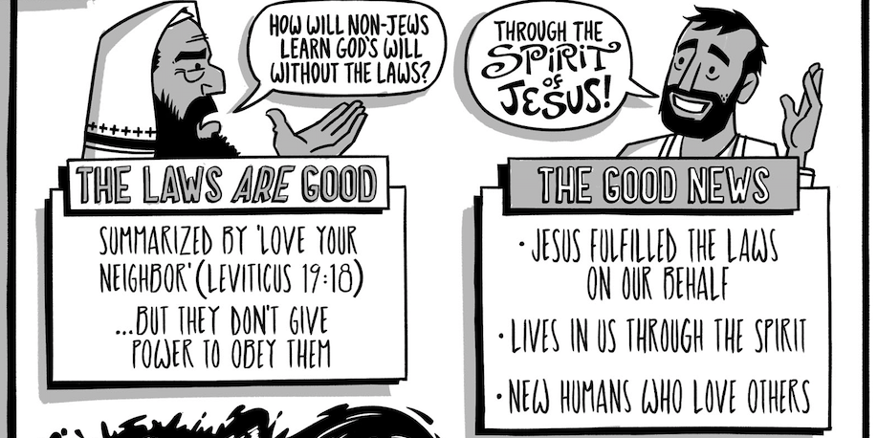
10. LAW OF CHRIST Fulfilled by walking in step with the Spirit (5:13-6:10)

Slide 41
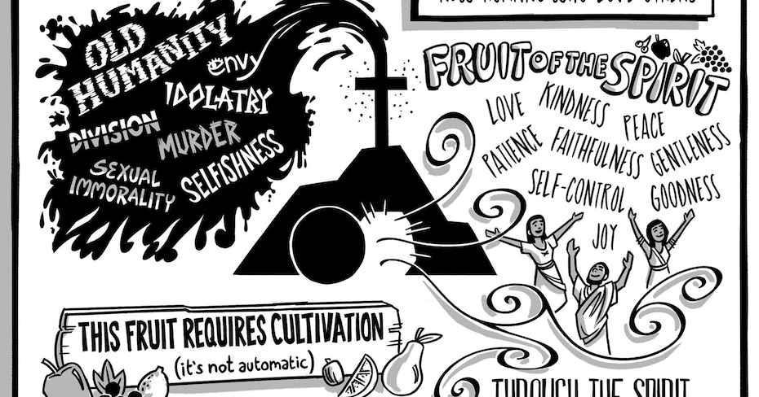
10. LAW OF CHRIST Fulfilled by walking in step with the Spirit (5:13-6:10)

Slide 42
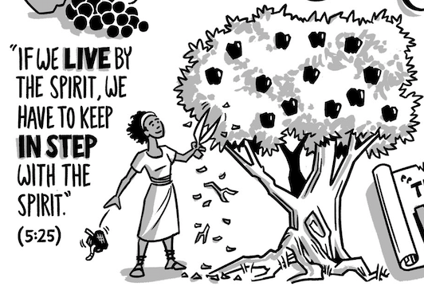
10. LAW OF CHRIST Fulfilled by walking in step with the Spirit (5:13-6:10)

Slide 43
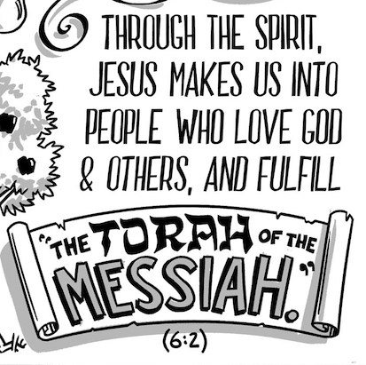
10. LAW OF CHRIST Fulfilled by walking in step with the Spirit (5:13-6:10)
6 Brothers, if anyone is caught in any transgression, you who are spiritual should restore him in a spirit of gentleness. Keep watch on yourself, lest you too be tempted... ² Bear one another’s burdens, and so fulfill the law of Christ… ¹⁰ So then, as we have opportunity, let us do good to everyone, and especially to those who are of the household of faith.

Slide 44
THE EARLY CHURCH
CIRCUMCISION: The Early Conflict (Acts 15:1-21)
THE SEQUEL: “Not in step with the truth of the gospel” (Gal 2:7-14)
JUSTIFICATION: By grace & through faith, not works (Gal 2:15-21)
BY FAITH: Spirit-receivers and sons of Abraham (Gal 3:1-9)
CHRIST: Fulfilled the law by his active and passive obedience (Gal 3:10-14)
THE LAW: Prison and Guardian (Gal 3:15-24)
SONS OF GOD: Adopted and Indwelt by his Spirit (Gal 3:25 – 4:7)
FREEDOM: New Covenant reality (Gal 4:8-31)
CIRCUMCISION AS YOKE: Severed from Christ (Gal 5:1-12)
LAW OF CHRIST: Fulfilled by walking in step with the Spirit (Gal 5:13-6:10)

Slide 45
GROUP PRAYER
For freedom Christ has set us free; stand firm therefore, and do not submit again to a yoke of slavery.
Gal 5:1
Jesus, I praise you for setting me free from ________ [“my past sinful life”, “my past legalistic life”…]

Slide 46
GROUP PRAYER
For freedom Christ has set us free; stand firm therefore, and do not submit again to a yoke of slavery.
Gal 5:1
Father, strengthen me to stand firm against the boasting in my works of ________ [“religious rituals”,“church attendance ”]

Slide 47
Thanks for coming! YOU ARE LOVED

