Slide 1
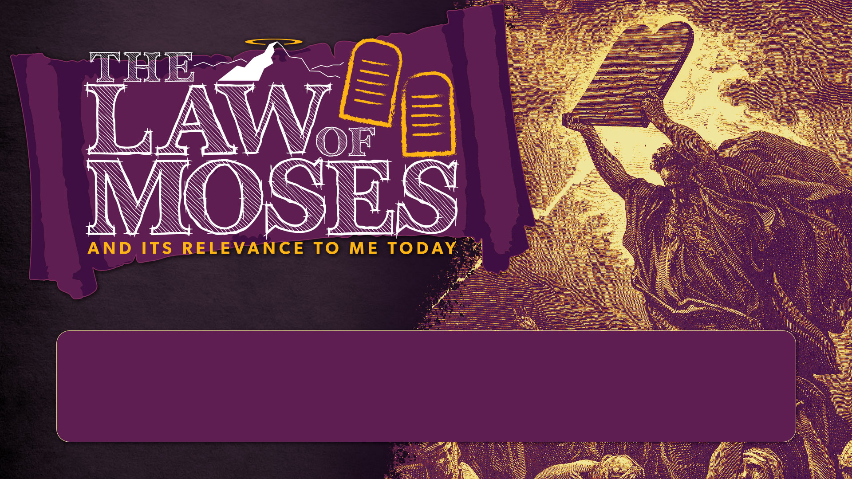
SESSION 7
THE PAULINE LETTERS

Slide 2
CLASS SESSIONS
Here are the 8 sessions we’ll be going through in this class:
THE PENTATEUCH - The Patriarchs, Sinai Covenant & Decalogue
THE TORAH (Part 1) - Tabernacle, Sacrifices, Priests, Feasts and OT Worship
THE TORAH (Part 2) - Law & Covenant, Promised Land and Foreshadowing
THE PROPHETS & WRITINGS - OT Prophets, Psalms & Wisdom Literature
THE GOSPELS - Matthew, Mark, Luke & John
THE EARLY CHURCH - Acts & Galatians
THE PAULINE LETTERS - The rest of the letters of Paul
THE GENERAL EPISTLES - The rest of the NT letters

Slide 3
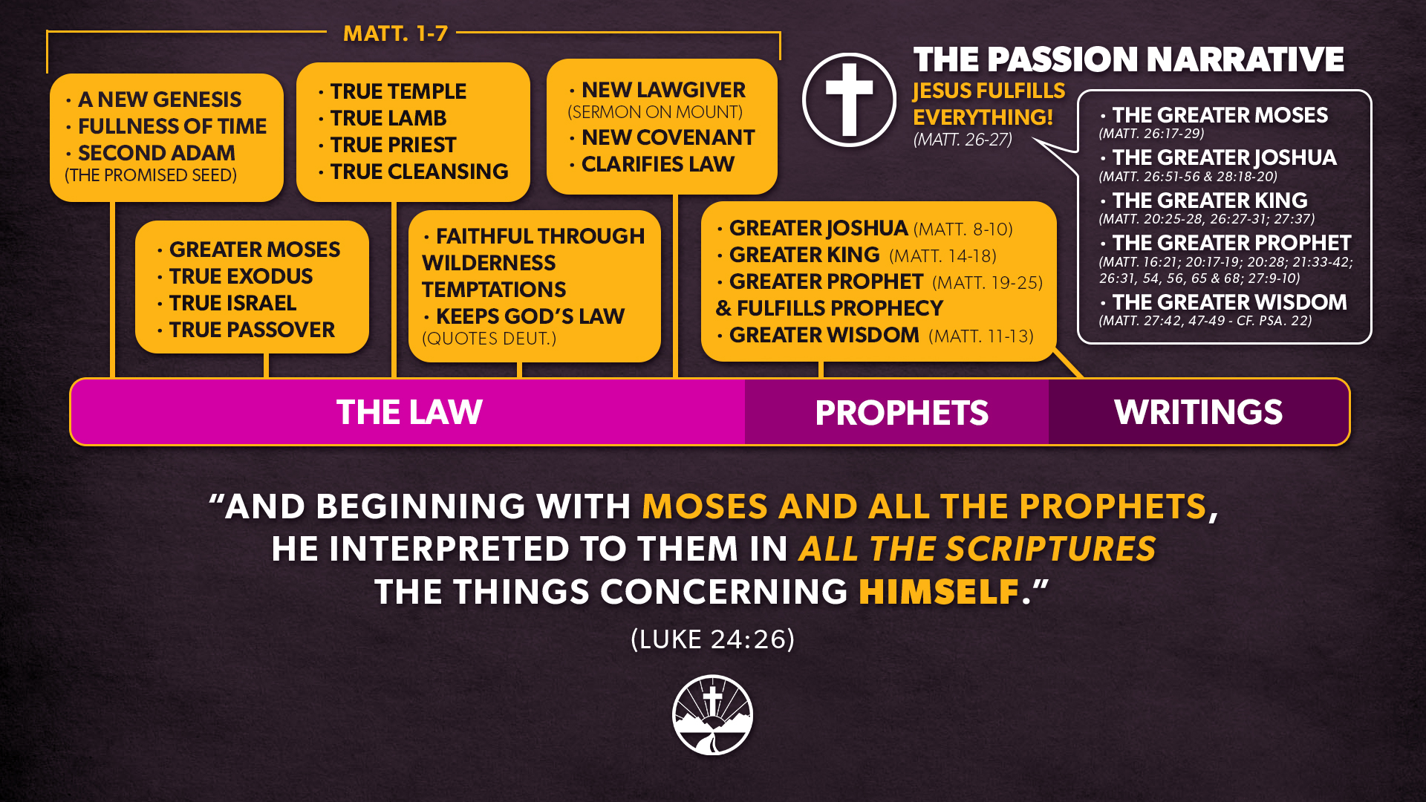

Slide 4
THE EARLY CHURCH
CIRCUMCISION: The Early Conflict (Acts 15:1-21)
THE SEQUEL: “Not in step with the truth of the gospel” (Gal 2:7-14)
JUSTIFICATION: By grace & through faith, not works (Gal 2:15-21)
BY FAITH: Spirit-receivers and sons of Abraham (Gal 3:1-9)
CHRIST: Fulfilled the law by his active and passive obedience (Gal 3:10-14)
THE LAW: Prison and Guardian (Gal 3:15-24)
SONS OF GOD: Adopted and Indwelt by his Spirit (Gal 3:25 – 4:7)
FREEDOM: New Covenant reality (Gal 4:8-31)
CIRCUMCISION AS YOKE: Severed from Christ (Gal 5:1-12)
LAW OF CHRIST: Fulfilled by walking in step with the Spirit (Gal 5:13-6:10)
Notes:
We were on the ground, living this struggle out with the first disciples

Slide 5
OLD COVENANT THROUGH NEW LENS

Slide 6
OLD COVENANT THROUGH NEW LENS
DESIGN OF MOSAIC COVENANT: Temporary

Slide 7
1. DESIGN OF MOSAIC COVENANT
Temporary
The Mosaic Covenant Was Established by God Only for a Temporary Period
Why then the law? It was added because of transgressions, until the offspring should come to whom the promise had been made. (Gal. 3:19)
“The law was our guardian until Christ came, … but now that faith has come, we are no longer under a guardian” (Gal. 3:24–25).

Slide 8
1. DESIGN OF MOSAIC COVENANT
Temporary
The Mosaic Law Could Not Impart Spiritual Life or Empower People to Obey It
Is the law then contrary to the promises of God? Certainly not! For if a law had been given that could give life, then righteousness would indeed be by the law. (Gal. 3:21)

Slide 9
1. DESIGN OF MOSAIC COVENANT
Temporary
The Mosaic Law Could Not Impart Spiritual Life or Empower People to Obey It
For the law of the Spirit of life has set you free in Christ Jesus from the law of sin and death. For God has done what the law, weakened by the flesh, could not do. By sending his own Son in the likeness of sinful flesh and for sin, he condemned sin in the flesh, in order that the righteous requirement of the law might be fulfilled in us, who walk not according to the flesh but according to the Spirit. (Rom. 8:2–4)

Slide 10
1. DESIGN OF MOSAIC COVENANT
Temporary
Therefore, the Mosaic Covenant was Fulfilled by Christ
Do not think that I have come to abolish the Law or the Prophets; I have not come to abolish them but to fulfill them. For truly, I say to you, until heaven and earth pass away, not an iota, not a dot, will pass from the Law until all is accomplished. (Matt. 5:17–18)
Christ is the end of the law for righteousness to everyone who believes (Rom. 10:4)

Slide 11
1. DESIGN OF MOSAIC COVENANT
Temporary
Therefore, the Mosaic Covenant was Fulfilled by Christ
  Jesus “fulfilled” the Old Testament law in several ways. He perfectly obeyed it, never once committing any violation of its laws (see Luke 4:13; John 8:46; Rom. 8:3; 2 Cor. 5:21; Heb. 4:15; 1 Pet. 2:22; 1 John 3:5).
Excerpted from ”Christian Ethics” by Wayne Grudem

Slide 12
1. DESIGN OF MOSAIC COVENANT
Temporary
Therefore, the Mosaic Covenant was Fulfilled by Christ
  In another sense, he “fulfilled” many of the Old Testament laws by actions that showed the true spiritual purpose for which they were intended. He fulfilled the sacrificial laws by becoming the perfect sacrifice. He fulfilled the laws and regulations about priests by becoming our Great High Priest. He fulfilled the law about circumcision by the “circumcision of Christ,” which gives us new hearts that are responsive to God’s will (see Col. 2:11). He fulfilled the Sabbath law by bringing us eternal spiritual rest (see Matt. 11:28; Heb. 4:9–10). And he fulfilled the Old Testament laws for civil government by establishing for himself a kingdom that is not of this world (John 18:36; see also Phil. 3:20).
Excerpted from ”Christian Ethics” by Wayne Grudem

Slide 13
In what areas of the law has Christ’s fulfillment changed how we are live as Christians?

Slide 14
OLD COVENANT THROUGH NEW LENS
DESIGN OF MOSAIC COVENANT: Temporary
SPECIFIC MOSAIC COVENANT OBLIGATIONS NO LONGER REQUIRED OF CHRISTIANS:
  CIRCUMCISION
  OT SACRIFICES
  OT FOOD LAWS
  OT SABBATH AND OT FESTIVALS
  OT LAWS REGULATING THE CIVIL GOVERNMENT OF ISRAEL

Slide 15
2. SPECIFIC MOSAIC COVENANT OBLIGATIONS NO LONGER REQUIRED OF CHRISTIANS
Circumcision
Christians no longer must be circumcised
Look: I, Paul, say to you that if you accept circumcision, Christ will be of no advantage to you. I testify again to every man who accepts circumcision that he is obligated to keep the whole law. You are severed from Christ, you who would be justified by the law; you have fallen away from grace. (Gal. 5:2–4)

Slide 16
2. SPECIFIC MOSAIC COVENANT OBLIGATIONS NO LONGER REQUIRED OF CHRISTIANS
OT Sacrifices
Christians no longer must offer OT Sacrifices
Hebrews 7-10 gives an extensive argument that now there is
A new High Priest (Jesus)
A new Sacrifice (Jesus’ sacrifice of himself)
A new Temple (the temple in heaven)
To offer sacrifices for sin at the Jerusalem temple would publicly reject Christ’s sacrifice
Adapted from ”Christian Ethics” by Wayne Grudem

Slide 17
2. SPECIFIC MOSAIC COVENANT OBLIGATIONS NO LONGER REQUIRED OF CHRISTIANS
OT Food Laws
Christians no longer must follow the OT Food Laws
  And he said to them, “Then are you also without understanding? Do you not see that whatever goes into a person from outside cannot defile him, since it enters not his heart but his stomach, and is expelled?” (Thus he declared all foods clean.) And he said, “What comes out of a person is what defiles him. (Mark 7:18-20)

Slide 18
2. SPECIFIC MOSAIC COVENANT OBLIGATIONS NO LONGER REQUIRED OF CHRISTIANS
OT Food Laws
Christians no longer must follow the OT Food Laws
  I know and am persuaded in the Lord Jesus that nothing is unclean in itself…Do not, for the sake of food, destroy the work of God. Everything is indeed clean, but it is wrong for anyone to make another stumble by what he eats. (Rom. 14:20)

Slide 19
2. SPECIFIC MOSAIC COVENANT OBLIGATIONS NO LONGER REQUIRED OF CHRISTIANS
OT Food Laws
Christians no longer must follow the OT Food Laws
  Therefore let no one pass judgment on you in questions of food and drink, or with regard to a festival or a new moon or a Sabbath. These are a shadow of the things to come, but the substance belongs to Christ. (Col. 2:16–17)

Slide 20
2. SPECIFIC MOSAIC COVENANT OBLIGATIONS NO LONGER REQUIRED OF CHRISTIANS
OT Food Laws
Christians no longer must follow the OT Food Laws
  Therefore let no one pass judgment on you in questions of food and drink, or with regard to a festival or a new moon or a Sabbath. These are a shadow of the things to come, but the substance belongs to Christ. (Col. 2:16–17)
  Discuss in groups:
  What does Col 2:17 say about the nature of food and drink, festivals and the Sabbath? What does it mean that "the substance belongs to Christ"?
  Col 2:16 starts with the word, "Therefore", indicating that v16-17 hinge on a previous grounding truth. What is that truth?

Slide 21
2. SPECIFIC MOSAIC COVENANT OBLIGATIONS NO LONGER REQUIRED OF CHRISTIANS
OT Sabbath and Festivals
Christians no longer must observe OT Sabbath and other OT Festivals
  Therefore let no one pass judgment on you in questions of food and drink, or with regard to a festival or a new moon or a Sabbath. These are a shadow of the things to come, but the substance belongs to Christ. (Col. 2:16–17)

Slide 22
2. SPECIFIC MOSAIC COVENANT OBLIGATIONS NO LONGER REQUIRED OF CHRISTIANS
OT Sabbath and Festivals
Christians no longer must observe OT Sabbath and other OT Festivals
  One person esteems one day as better than another, while another esteems all days alike. Each one should be fully convinced in his own mind. (Rom. 14:5)
  You observe days and months and seasons and years! I am afraid I may have labored over you in vain. (Gal. 4:10–11)

Slide 23
2. SPECIFIC MOSAIC COVENANT OBLIGATIONS NO LONGER REQUIRED OF CHRISTIANS
CIVIL LAWS
Christians no longer must follow OT laws regulating the Civil Government of Israel
  In the new covenant age, Christians of all nations are commanded to be subject to civil governments (Rom 13:1-7, 2 Pet 2:13-14, 17)
  Thielman rightly observes that Paul’s “admonitions to submit to the Roman government (Rom. 13:1–7) implied the abrogation of the … civil parts of the law.”
Adapted and Excerpted from ”Christian Ethics” by Wayne Grudem

Slide 24
2. SPECIFIC MOSAIC COVENANT OBLIGATIONS NO LONGER REQUIRED OF CHRISTIANS
OT Sacrifices
Christians no longer must follow OT laws regulating the Civil Government of Israel
  The notion that the civil laws for Israel should continue to function as the rules for nation-states today represents a fundamental misreading of the Scriptures. Believers are no longer under the law, for the law was given to Israel, which functioned as both a political and ecclesiastical community. No nation today occupies the place of Israel, for no nation can claim to be God’s chosen nation.
  - Dr. Tom Schreiner

Slide 25
BOARD ILLUSTRATION
Inadequate solution: Everything Not Cancelled by the New Testament is Still Required
Why? NT authors were not trying to give exhaustive “law mapping”

Slide 26
OLD COVENANT THROUGH NEW LENS
DESIGN OF MOSAIC COVENANT: Temporary
SPECIFIC MOSAIC COVENANT OBLIGATIONS NO LONGER REQUIRED OF CHRISTIANS:
  CIRCUMCISION
  OT SACRIFICES
  OT FOOD LAWS
  OT SABBATH AND OT FESTIVALS
  OT LAWS REGULATING THE CIVIL GOVERNMENT OF ISRAEL
MOSAIC COVENANT HAS COME TO AN END: ALL, NOT JUST A PART

Slide 27
3. MOSAIC COVENANT HAS COME TO AN END
All, not just a Part
“The law was our guardian until Christ came, … but now that faith has come, we are no longer under a guardian” (Gal. 3:24–25).
Likewise, my brothers, you also have died to the law through the body of Christ, so that you may belong to another, to him who has been raised from the dead, in order that we may bear fruit for God…But now we are released from the law … so that we serve in the new way of the Spirit and not in the old way of the written code” (Rom. 7:6).

Slide 28
3. MOSAIC COVENANT HAS COME TO AN END
All, not just a Part
In speaking of a new covenant, he makes the first one obsolete. And what is becoming obsolete and growing old is ready to vanish away. (Heb. 8:13)

Slide 29
3. MOSAIC COVENANT HAS COME TO AN END
All, not just a Part
Frank Thielman argues persuasively for this conclusion:
The entire law is obsolete, moreover, and not simply the portion of the law that regulates the priesthood and the sacrifices.… In [Hebrews] 9:15–22 he makes the term “first covenant” synonymous with “every commandment spoken by Moses according to the law” (9:19).… The entire Mosaic covenant, therefore, and not merely a part of it, has been superseded by the new covenant: the change in priesthood has required not merely a change in some laws pertaining to the priesthood, but a different law entirely (7:12)
Adapted and Excerpted from ”Christian Ethics” by Wayne Grudem

Slide 30
BOARD ILLUSTRATION
Inadequate solution: Nothing is Required Except What the New Testament Reaffirms
Why? 2 Tim 3:16

Slide 31
OLD COVENANT THROUGH NEW LENS
DESIGN OF MOSAIC COVENANT: Temporary
SPECIFIC MOSAIC COVENANT OBLIGATIONS NO LONGER REQUIRED OF CHRISTIANS:
  CIRCUMCISION
  OT SACRIFICES
  OT FOOD LAWS
  OT SABBATH AND OT FESTIVALS
  OT LAWS REGULATING THE CIVIL GOVERNMENT OF ISRAEL
MOSAIC COVENANT HAS COME TO AN END: ALL, NOT JUST A PART
HOW WE CAN VIEW THE OLD, MOSAIC COVENANT TODAY:
NOT OUR COVENANT, BUT STILL OUR SCRIPTURES

Slide 32
NOT OUR COVENANT,
BUT STILL OUR SCRIPTURES
All Scripture is breathed out by God and profitable for teaching, for reproof, for correction, and for training in righteousness, that the man of God may be complete, equipped for every good work. (2 Tim 3:16-17)
David Dorsey: “Legally, none of the 613 stipulations of the Sinaitic covenant are binding upon NT Christians, including the so-called moral laws, while in a revelatory and pedagogical sense all 613 are binding upon us, including all the ceremonial and civic laws.”

Slide 33
BOARD ILLUSTRATION
Inadequate solution: Nothing is Required Except What the New Testament Reaffirms
Why? 2 Tim 3:16

Slide 34
NOT OUR COVENANT,
BUT STILL OUR SCRIPTURES
Key Takeaway: Delight in ALL the LAW
The law of the Lord is perfect, reviving the soul;
the testimony of the Lord is sure, making wise the simple;
the precepts of the Lord are right, rejoicing the heart;
the commandment of the Lord is pure, enlightening the eyes;
Psalm 19:7-8

Slide 35
NOT OUR COVENANT,
BUT STILL OUR SCRIPTURES
Key Takeaway: Delight in ALL the LAW (Psalm 1)
The law of the Lord is perfect, reviving the soul;
the testimony of the Lord is sure, making wise the simple;
the precepts of the Lord are right, rejoicing the heart;
the commandment of the Lord is pure, enlightening the eyes;
Psalm 19:7-8
Not our covenant….so DELIGHT in the LIFE-GIVING NEW COVENANT (more on this and the law of Christ next week!)
But still our Scriptures…so DELIGHT in the WISDOM-GIVING OLD COVENANT

Slide 36
Reflect and discuss
Even looking at the OT obligations no longer required of us, we find God-breathed Scripture. What do the following practices reveal about God? In what ways do they make Christ look glorious?
  CIRCUMCISION
  OT SACRIFICES
  OT FOOD LAWS
  OT SABBATH AND OT FESTIVALS
  OT LAWS REGULATING THE CIVIL GOVERNMENT OF ISRAEL

Slide 37
Thanks for coming!
YOU ARE LOVED

