Slide 1
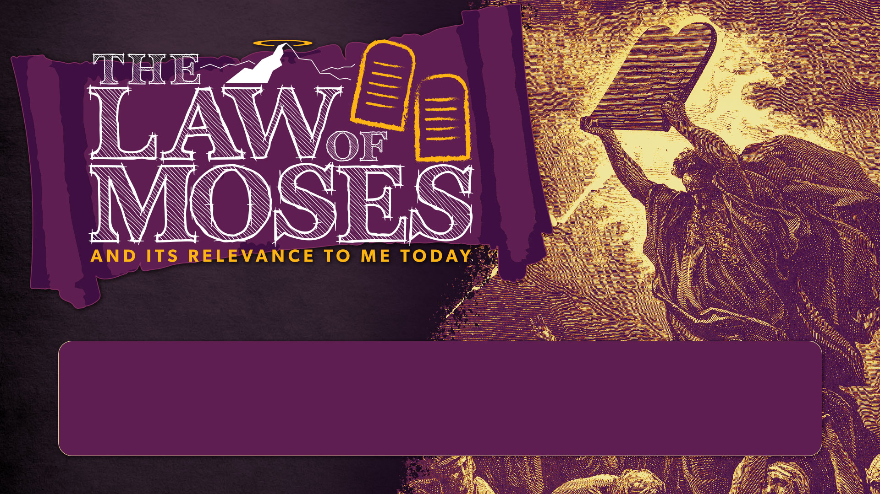
SESSION 8
THE GENERAL EPISTLES

Slide 2
CLASS SESSIONS
Here are the 8 sessions we’ll be going through in this class:
THE PENTATEUCH - The Patriarchs, Sinai Covenant & Decalogue
THE TORAH (Part 1) - Tabernacle, Sacrifices, Priests, Feasts and OT Worship
THE TORAH (Part 2) - Law & Covenant, Promised Land and Foreshadowing
THE PROPHETS & WRITINGS - OT Prophets, Psalms & Wisdom Literature
THE GOSPELS - Matthew, Mark, Luke & John
THE EARLY CHURCH - Acts & Galatians
THE PAULINE LETTERS - The rest of the letters of Paul
THE GENERAL EPISTLES - The rest of the NT letters

Slide 3
GROUP DISCUSSION: THE FULL PORTRAIT OF HEBREWS
How is the new covenant superior to the old covenant in the following areas: priesthood, sacrifice, intercession, temple?

Slide 4
THE GENERAL EPISTLES
JESUS IS THE NEW RADIANT REVELATION

Slide 5
1. JESUS IS THE NEW RADIANT REVELATION
Long ago, at many times and in many ways, God spoke to our fathers by the prophets, but in these last days he has spoken to us by his Son, whom he appointed the heir of all things, through whom also he created the world. He is the radiance of the glory of God and the exact imprint of his nature, and he upholds the universe by the word of his power. After making purification for sins, he sat down at the right hand of the Majesty on high, having become as much superior to angels as the name he has inherited is more excellent than theirs.
Heb 1:1-4

Slide 6
THE GENERAL EPISTLES
JESUS IS THE NEW RADIANT REVELATION
JESUS IS THE NEW ETERNAL HIGH PRIEST

Slide 7
2. JESUS IS THE NEW ETERNAL HIGH PRIEST
Human High Priests: Some upside, huge downside
For every high priest chosen from among men is appointed to act on behalf of men in relation to God, to offer gifts and sacrifices for sins. He can deal gently with the ignorant and wayward, since he himself is beset with weakness. Because of this he is obligated to offer sacrifice for his own sins just as he does for those of the people.
Heb 5:1-3

Slide 8
2. JESUS IS THE NEW ETERNAL HIGH PRIEST
Human High Priests: Some upside, huge downside
The former priests were many in number, because they were prevented by death from continuing in office,
Heb 7:23

Slide 9
2. JESUS IS THE NEW ETERNAL HIGH PRIEST
Jesus as High Priest: Massive upside, no downside
i) ETERNAL: Forever Interceding
The former priests were many in number, because they were prevented by death from continuing in office, but he holds his priesthood permanently, because he continues forever. Consequently, he is able to save to the uttermost those who draw near to God through him, since he always lives to make intercession for them.
Heb 7:23-25

Slide 10
2. JESUS IS THE NEW ETERNAL HIGH PRIEST
Jesus as High Priest: Massive upside, no downside
ii) PERFECT: No need for own sacrifice
For it was indeed fitting that we should have such a high priest, holy, innocent, unstained, separated from sinners, and exalted above the heavens. He has no need, like those high priests, to offer sacrifices daily, first for his own sins and then for those of the people, since he did this once for all when he offered up himself. For the law appoints men in their weakness as high priests, but the word of the oath, which came later than the law, appoints a Son who has been made perfect forever.
Heb 7:26-28

Slide 11
2. JESUS IS THE NEW ETERNAL HIGH PRIEST
Jesus as High Priest: Massive upside, no downside
iii) SYMPATHETIC
Since then we have a great high priest who has passed through the heavens, Jesus, the Son of God, let us hold fast our confession. For we do not have a high priest who is unable to sympathize with our weaknesses, but one who in every respect has been tempted as we are, yet without sin. Let us then with confidence draw near to the throne of grace, that we may receive mercy and find grace to help in time of need.
Heb 4:14-16

Slide 12
THE GENERAL EPISTLES
JESUS IS THE NEW RADIANT REVELATION
JESUS IS THE NEW ETERNAL HIGH PRIEST
JESUS IS THE NEW ONCE-FOR-ALL SACRIFICE

Slide 13
3. JESUS IS THE NEW ONCE-FOR-ALL SACRIFICE
NOT by blood of animals, but by ‘his own blood’
But when Christ appeared as a high priest of the good things that have come, then through the greater and more perfect tent (not made with hands, that is, not of this creation) he entered once for all into the holy places, not by means of the blood of goats and calves but by means of his own blood, thus securing an eternal redemption. For if the blood of goats and bulls, and the sprinkling of defiled persons with the ashes of a heifer, sanctify for the purification of the flesh, how much more will the blood of Christ, who through the eternal Spirit offered himself without blemish to God, purify our conscience from dead works to serve the living God.
Heb 9:11-14

Slide 14
3. JESUS IS THE NEW ONCE-FOR-ALL SACRIFICE
NOT in man-made temple, but perfect tent in heaven
But when Christ appeared as a high priest of the good things that have come, then through the greater and more perfect tent (not made with hands, that is, not of this creation) he entered once for all into the holy places, not by means of the blood of goats and calves but by means of his own blood, thus securing an eternal redemption. For if the blood of goats and bulls, and the sprinkling of defiled persons with the ashes of a heifer, sanctify for the purification of the flesh, how much more will the blood of Christ, who through the eternal Spirit offered himself without blemish to God, purify our conscience from dead works to serve the living God.
Heb 9:11-14

Slide 15
3. JESUS IS THE NEW ONCE-FOR-ALL SACRIFICE
NOT in man-made temple, but perfect tent in heaven
Thus it was necessary for the copies of the heavenly things to be purified with these rites, but the heavenly things themselves with better sacrifices than these. For Christ has entered, not into holy places made with hands, which are copies of the true things, but into heaven itself, now to appear in the presence of God on our behalf.
Heb 9:23-24

Slide 16
3. JESUS IS THE NEW ONCE-FOR-ALL SACRIFICE
NOT through repeated sacrifices, but once-for-all sacrifice
Nor was it to offer himself repeatedly, as the high priest enters the holy places every year with blood not his own, for then he would have had to suffer repeatedly since the foundation of the world. But as it is, he has appeared once for all at the end of the ages to put away sin by the sacrifice of himself.
Heb 9:25-26

Slide 17
3. JESUS IS THE NEW ONCE-FOR-ALL SACRIFICE
NOT through repeated sacrifices, but once-for-all sacrifice
For since the law has but a shadow of the good things to come instead of the true form of these realities, it can never, by the same sacrifices that are continually offered every year, make perfect those who draw near. Otherwise, would they not have ceased to be offered, since the worshipers, having once been cleansed, would no longer have any consciousness of sins? But in these sacrifices there is a reminder of sins every year. For it is impossible for the blood of bulls and goats to take away sins.
Heb 10:1-4

Slide 18
GROUP DISCUSSION
Read Heb 10:11-18
This passage serves as an excellent summary. Circle the places in the passage where you see
New sacrifice
New tent/temple
New High Priest
New Covenant
Do these rich truths move you to deeper worship? How so?

Slide 19
LIFE APPLICATION
DRAW NEAR with new CONFIDENCE, not just new CONVENIENCES
Therefore, brothers, since we have confidence to enter the holy places by the blood of Jesus, by the new and living way that he opened for us through the curtain, that is, through his flesh, and since we have a great priest over the house of God, let us draw near with a true heart in full assurance of faith, with our hearts sprinkled clean from an evil conscience and our bodies washed with pure water
Heb 10:19-22

Slide 20
THE GENERAL EPISTLES
JESUS IS THE NEW RADIANT REVELATION
JESUS IS THE NEW ETERNAL HIGH PRIEST
JESUS IS THE NEW ONCE-FOR-ALL SACRIFICE
JESUS FREES US TO OBEY HIS LAW

Slide 21
GROUP DISCUSSION
Read Rom 6:1-6
Rom 6:1 asks the question: If we are justified by grace, not merit and by faith, not works, then doesn't that give us license we just keep on sinning? How does Paul address this question in verses 2-6?

Slide 22
4. JESUS FREES US TO OBEY HIS LAW
REDEMPTION language: We are freed slaves
What shall we say then? Are we to continue in sin that grace may abound? By no means! How can we who died to sin still live in it? Do you not know that all of us who have been baptized into Christ Jesus were baptized into his death? We were buried therefore with him by baptism into death, in order that, just as Christ was raised from the dead by the glory of the Father, we too might walk in newness of life.
Rom 6:1-4

Slide 23
4. JESUS FREES US TO OBEY HIS LAW
REDEMPTION language: We are freed slaves
For if we have been united with him in a death like his, we shall certainly be united with him in a resurrection like his. We know that our old self was crucified with him in order that the body of sin might be brought to nothing, so that we would no longer be enslaved to sin. For one who has died has been set free from sin. Now if we have died with Christ, we believe that we will also live with him.
Rom 6:5-8

Slide 24
4. JESUS FREES US TO OBEY HIS LAW
KINGDOM language: We are free citizens of a heavenly country
But as it is, they desire a better country, that is, a heavenly one. Therefore God is not ashamed to be called their God, for he has prepared for them a city.
Heb 11:16
But our citizenship is in heaven, and from it we await a Savior, the Lord Jesus Christ,
Phil 3:20

Slide 25
4. JESUS FREES US TO OBEY HIS LAW
KINGDOM language: We are free citizens of a heavenly country
But the one who looks into the perfect law, the law of liberty, and perseveres, being no hearer who forgets but a doer who acts, he will be blessed in his doing.
James 1:25

Slide 26
4. JESUS FREES US TO OBEY HIS LAW
KINGDOM language: We are free citizens of a heavenly country
If you really fulfill the royal law according to the Scripture, “You shall love your neighbor as yourself,” you are doing well.
James 2:8

Slide 27
4. JESUS FREES US TO OBEY HIS LAW
REDEMPTION language: We are freed slaves
KINGDOM language: We are free citizens of a heavenly country (Heb 11:16)
FULL CIRCLE BACK TO SINAI

Slide 28
FULL CIRCLE BACK TO SINAI
When Moses came down from Mount Sinai, with the two tablets of the testimony in his hand as he came down from the mountain, Moses did not know that the skin of his face shone because he had been talking with God. Aaron and all the people of Israel saw Moses, and behold, the skin of his face shone, and they were afraid to come near him. But Moses called to them, and Aaron and all the leaders of the congregation returned to him, and Moses talked with them. Afterward all the people of Israel came near, and he commanded them all that the Lord had spoken with him in Mount Sinai. ³³ And when Moses had finished speaking with them, he put a veil over his face.
Ex 34:29–33

Slide 29
Reflect and discuss
What was my attitude towards “God’s Law” before I started this class?
How has my attitude been changed, sharpened and refined in the past few weeks?

Slide 30
Thanks for coming!
YOU ARE LOVED

