Slide 2
TWO MYTHS
Myth 1 The Bible is difficult to understand and only scholars can understand it
Myth 2 The Bible is boring

Slide 3
TWO MYTHS
Myth 1 The Bible is difficult to understand and only scholars can understand it
The Bible was written in the common languages of its day, not in fancy high-sounding language, so that it could be understood by everyone.
Notes:
The original languages of the Bible were the most accessible languages to the original readers. In the OT, Hebrew was the native language of the people of Israel – spoken everyday. Likewise, in the NT, it is written in a form of Greek called koine, which simply means “common.” It was the common Greek spoken on the street corners and marketplaces.
But wait, I don’t speak Hebrew or Greek. That’s OK. We are blessed to have many great translations in English which convey the meaning of the text to us accurately.
But wait, I don’t live in the ancient world – what if I don’t know about the customs of the time? That’s OK also. We have Study Bibles and Commentaries that can help us understand that too.
If we can read a news article or blog, we can read the Bible. In fact, there may be more difficult concepts expressed on the frontpage of a Newspaper than in the Bible!

Slide 4
TWO MYTHS
Myth 2 The Bible is boring
We don’t need to make the Bible come alive – it is living and active (Hebrews 4:12)
Instead, we need God’s Word to make US come alive!
Notes:
The problem is not that the Word of the God of the Universe is impotent. The problem is that we are dull of hearing. We fill our appetites with all sorts of junk food distractions and frivolous entertainments that we don’t have space for meat of God’s Word.
“We fail in our duty to study God’s Word not so much because it is difficult to understand, not so much because it is dull and boring, but because it is work.” R.C. Sproul
Yes, we may need to do a little work to understand God’s Word properly – but is there any more important message to make sure you get it right?
[click]
God’s word is already alive. We are the ones who need to be made alive.
Jesus said, “ It is the Spirit who gives life; the flesh is no help at all. The words that I have spoken to you are spirit and life.” (John 6:63)

Slide 5
LET’S PRAY
We need the LORD to make us come alive to His Word!
For the word of God is living and active, sharper than any two-edged sword, piercing to the division of soul and of spirit, of joints and of marrow, and discerning the thoughts and intentions of the heart. (Hebrews 4:12)
All Scripture is breathed out by God and profitable for teaching, for reproof, for correction, and for training in righteousness, that the man of God may be complete, equipped for every good work. (2 Timothy 3:16-17)
Notes:
Oh God, would you make US come alive to your word!
Psalm 119:130 says that “The unfolding of your words gives light; it imparts understanding to the simple.” God would you give us light to see what’s there. God would you impart understanding and wisdom to us!

Slide 6
BIBLE TRANSLATIONS
English Standard Version (ESV)
word-for-word
Christian Standard Bible (CSB)
thought-for-thought
ESV Study Bible
Excellent resource to help you understand

Slide 7
JESUS IS THE POINT OF THE BIBLE
“You search the Scriptures because you think that in them you have eternal life; and it is they that bear witness about me, yet you refuse to come to me that you may have life.” (John 5:39-40)
Notes:
This doesn’t mean that we have to go looking for Jesus under every rock or behind every bush in every verse of Scripture. Rather, it means that all of Scripture is meant to point us to Jesus Christ.
Scripture either helps prepare our anticipation to look forward to His fulfilment of it or reminds us of what He has done.
The problem with the Pharisees was that they thought the Scriptures were the point.
Scripture isn’t the end point in and of itself alone. It is meant to point us to a particular object and goal.
All of Scripture is meant to increase our awe, affections, and anticipation of knowing and experiencing fulness of who Jesus Christ is.
So read scripture with that goal in mind. That is how we ‘come to Jesus’ that we may have life.

Slide 8
HOW TO STUDY THE BIBLE
Today we’ll focus on 2 techniques of Bible reading
DEVOTIONAL This is an example of what you can do in your morning devotions. It is meant to be responsive, brief and clear.
INDUCTIVE BIBLE STUDY This is an example of what Bible Study can look like in your personal life or in a small group.

Slide 9
HOW TO STUDY THE BIBLE
There is a proper method to studying the Bible.
ALWAYS START WITH PRAYER!
OBSERVE
INTERPRET
APPLY
Notes:
We must follow this method of moving from Observation, to Interpretation and then to Application.
Many of the times where someone goes wrong in their reading and understanding of Scripture, it is because they have either gotten this order wrong or not spent enough time on each step.

Slide 10
1. OBSERVE
The focus of this stage is to be curious about the text.
Only ask questions that arise from the text itself.
SATURATE Get familiar with the passage and the book of the Bible that it’s in. Read it a few times over. Be familiar with how it fits into the Bible’s big story.
SETTING / CONTEXT Context is KING! Write out your questions. Ask: Who wrote this? Who was it written to? Why? When? Where?
Notes:
Let your questions come from the text.
As you read the text – slow down – notice things that are unusual, repeated, emphasized, important concepts or themes, thoughts that are connected. Underline or highlight them.
Write out some of your questions.
What are some things about the text that you don’t yet understand?
Don’t answer them yet – just make good observations.
How do you do this?
SATURATE yourself with the text.
Pay attention to the SETTING or CONTEXT of the text.
You may need to use a Study Bible to help you understand the context.
Remember that we want to understand what was originally meant by the author to their original audience – not just what it means to me.
Let us respect authors and keep the golden rule of reading, "do unto authors as you would have them do unto you."[John Piper, Think, 45]
Think of it like you’re a crime scene investigator gathering evidence.

Slide 11
2. INTERPRET
The focus of this stage is to answer our questions from the text itself.
Move from Big to Small.
PARAGRAPHS What is the genre? Is the material arranged a certain way?
SENTENCES What does the grammar tell me? What is the main verb? Are there linking words?
WORDS What are the possible meanings for a word? What makes most sense in the context? Why?
Notes:
When we believe what we think the Bible is saying, and not what it is actually saying—it is not the Bible we are believing, but rather ourselves.
Don’t come to the text assuming you know what it means already. Let the text speak for itself.
At this point, look at some of the questions you wrote down from the previous section and try to answer them from clues in the text itself first instead of jumping to something outside of it.
If you still can’t answer the questions from the text, then start to move gradually outward to seek answers: first to the surrounding context, then to the book it’s in, then to the Bible as a whole.
Let Scripture interpret Scripture.
Move from BIG units of thought, to smaller units.
If you don’t understand the big, overall idea, you’re sure to misinterpret the smaller things (like a difficult word or phrase).

Slide 12
3. APPLY
If we don’t apply God’s Word to our lives, it can:
Lead to self-deception (James 1:22)
Lead to ruin (Matthew 7:2)
Reveal that we are not truly saved (Luke 6:46; James 2:14; John 10:27)
Notes:
James 1:22 says, “But be doers of the word, and not hearers only, deceiving yourselves.”
If we only hear God’s Word we can become self-deceived.
Jesus says in Matthew 7:2 that, “everyone who hears these words of mine AND acts on them is like a wise man who built his house on a rock.”
Not acting on God’s word can lead to ruin!
In Luke 6:46, Jesus says of those who are rejected on Judgment Day, “Why do you call me ‘Lord, Lord’ but not DO what I say?” And James 2:14 says that faith that does not produce works is not true saving faith.
If we are unmoved by God’s Word, it can reveal that we are not even truly saved.
This last point is very important! We must cultivate our hearts to be attentive to be God’s Word, but we must also discipline our lives to act in accordance to God’s Word.

Slide 13
3. APPLY
The focus of this stage is to be moved by the text.
It is dangerous to be only a ‘hearer’ and not a ‘doer’ of the Word.
SUMMARIZE In your own words, what was the main point(s) of the text? How would I explain it to a child or non-Christian?
SIGNIFICANCE BELIEF – about myself, our relationships with others, or about God? ACTION – to do or not do something? AFFECTIONS – move me to feel (love, hate, worship, mourn, etc) in response? PRAY – how can I respond in prayer?

Slide 14
HOW TO STUDY THE BIBLE
A simple method to studying the Bible.
ALWAYS START WITH PRAYER!
OBSERVE
INTERPRET
APPLY
Be curious about the text.
Saturate
Pay attention to the Setting and Context
Answer from the text.
Move from big to small:
Paragraphs
Sentences
Words
Be moved by the text.
Summarize
Significance

Slide 15
LET’S STUDY TOGETHER!
DEVOTIONAL – Psalm 139
INDUCTIVE (Narrative) – Luke 9:18-36
INDUCTIVE (Letter) – Titus 2:11-3:9
BONUS: Romans 6 or Psalm 2

Slide 16
ANY QUESTIONS?
Notes:
This doesn’t mean that we have to go looking for Jesus under every rock or behind every bush in every verse of Scripture. Rather, it means that all of Scripture is meant to point us to Jesus Christ.
Scripture either helps prepare our anticipation to look forward to His fulfilment of it or reminds us of what He has done.
The problem with the Pharisees was that they thought the Scriptures were the point.
Scripture isn’t the end point in and of itself alone. It is meant to point us to a particular object and goal.
All of Scripture is meant to increase our awe, affections, and anticipation of knowing and experiencing fulness of who Jesus Christ is.
So read scripture with that goal in mind. That is how we ‘come to Jesus’ that we may have life.

Slide 17
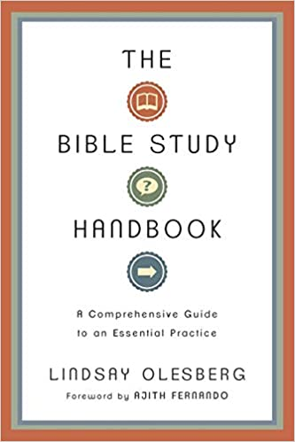
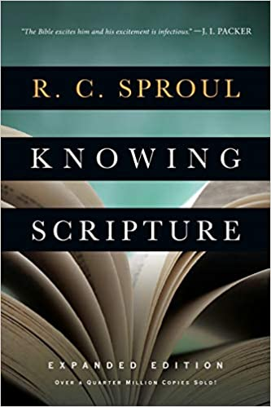
FURTHER RESOURCES
Training in handling God’s Word: resources to help you become a better reader & interpreter of scripture.
HOPECHURCHTW.CA/LEARN
Do your best to present yourself to God as one approved, a worker who has no need to be ashamed, rightly handling the word of truth. (2 Timothy 2:15)
Notes:
Just as it is important for you to invest to grow in a skill for your career, it is even more important to invest in your handling of God’s Word!
What is the BEST that you can do to help prepare and train yourself to rightly handle the Word of Truth?

Slide 18
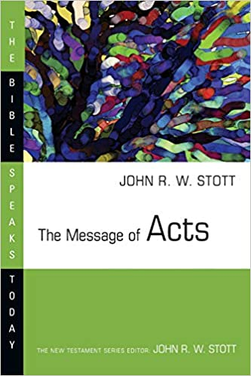
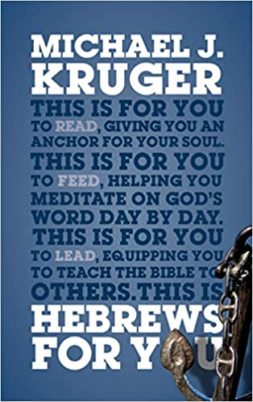
FURTHER RESOURCES
Devotional Bible Commentaries: not super dense and meant to help you in your daily devotions.
God’s Word for You commentary series
Christ-Centered Exposition commentary series
The Bible Speaks Today commentary series

Slide 19
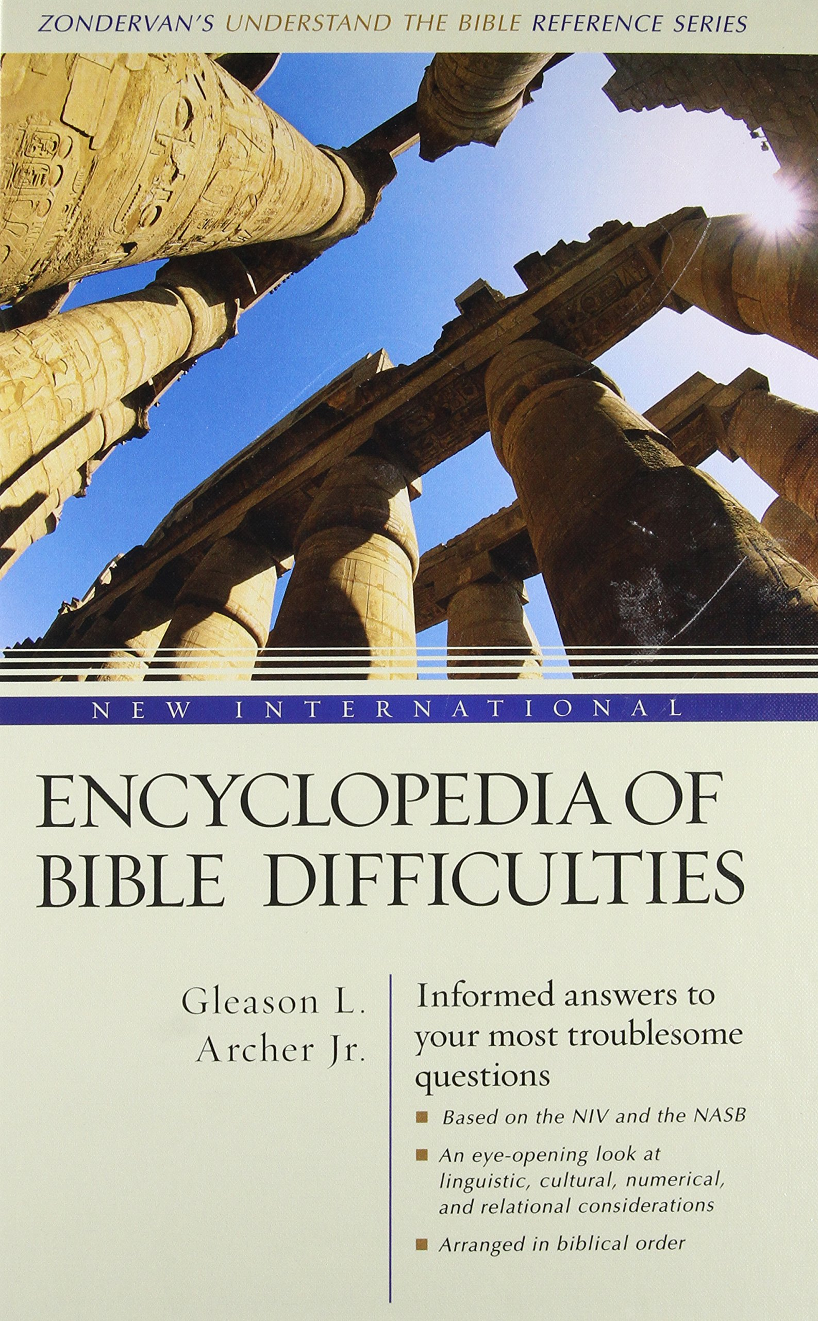
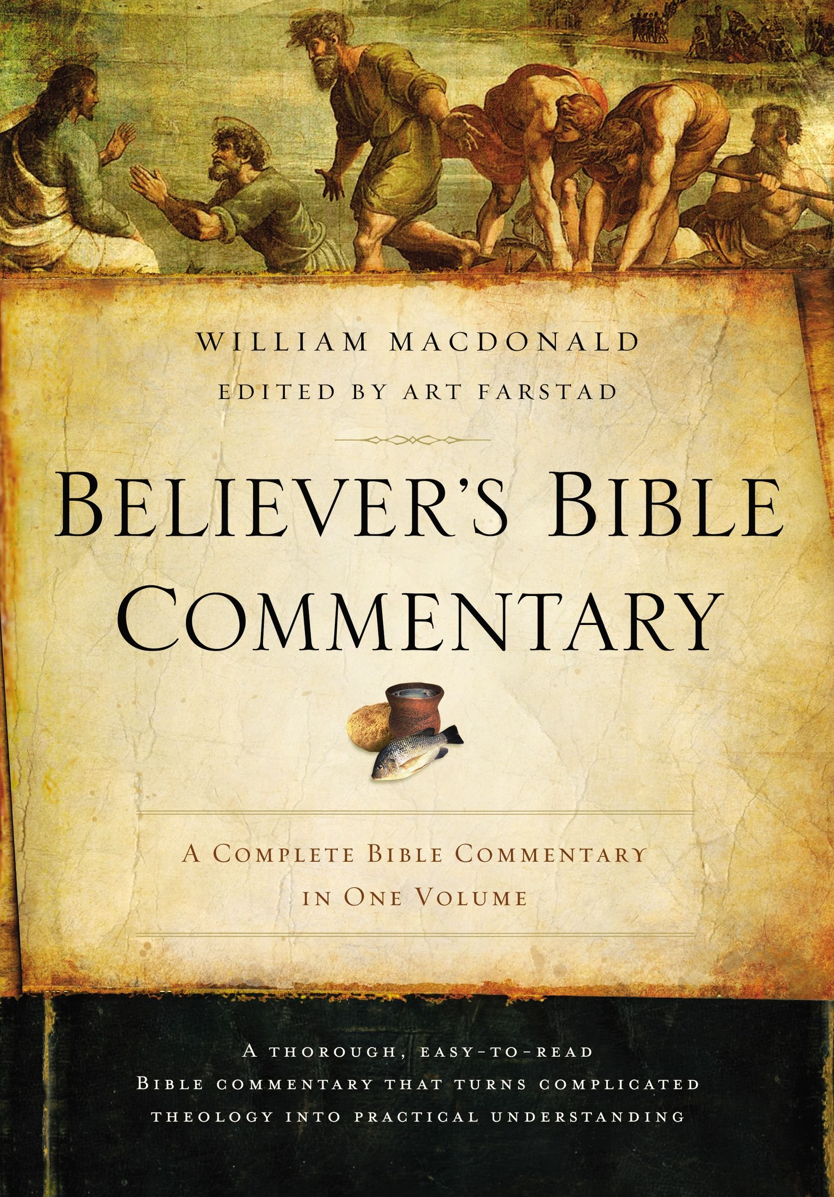
FURTHER RESOURCES
Bible Reference Books: sometimes we get stuck on a difficult passage – there are good resources from Bible scholars to help us.
Notes:
It is important to go to solid and reputable sources. There are many BAD SOURCES of theology out there. Especially on the internet!
Prefer printed/published sources from reputable publishers (e.g. Crossway, The Good Book Company, IVP, P&R, Zondervan, etc) – because they have a reputation to maintain.
Ask your pastors and church leaders for recommendations.

Slide 20
UPCOMING CLASSES
Sign up at
HOPECHURCHTW.CA

Slide 21
THANKS FOR COMING!
YOU ARE LOVED!

