Slide 2
CLASS SESSIONS
Intro & Canon
Inspiration & Authority
Necessity & Sufficiency
Clarity & Interpretation
Inerrancy & Apologetic Challenges
OUTLINE OF TOPICS

Slide 3
INTRODUCTION
The Great Danger: Truth Abandoned (2 Tim 4)
The Great Stakes: Treasure Lost (Ps 19)
Pray: “Long for Pure Spiritual Milk” (1 Pet 2:2)
Why is the doctrine of the Word important?

Slide 4
INTRODUCTION
The Great Danger: Truth Abandoned (2 Tim 4)
The Great Stakes: Treasure Lost (Ps 19)
Pray: “Long the for Pure Spiritual Milk” (1 Pet 2:2)
Why is the doctrine of the Word important?

Slide 5
THE GREAT DANGER: TRUTH ABANDONDED (2 Tim 4)
I charge you in the presence of God and of Christ Jesus, who is to judge the living and the dead, and by his appearing and his kingdom: preach the word; be ready in season and out of season; reprove, rebuke, and exhort, with complete patience and teaching.

Slide 6
OUR FIRST PILLAR
“Proclaiming the authority of God’s Word without apology”
“Preach the word; be ready in season and out of season; reprove, rebuke, and exhort, with complete patience and teaching.”
2 Timothy 4:2

Slide 7
THE GREAT DANGER: TRUTH ABANDONED (2 Tim 4)
For the time is coming when people will not endure sound teaching, but having itching ears they will accumulate for themselves teachers to suit their own passions, and will turn away from listening to the truth and wander off into myths. As for you, always be sober-minded, endure suffering, do the work of an evangelist, fulfill your ministry.

Slide 8
INTRODUCTION
The Great Danger: Truth Abandoned (2 Tim 4)
The Great Stakes: Treasure Lost (Ps 19)
Pray: “Long for the Pure Spiritual Milk” (1 Pet 2:2)
Why is the doctrine of the Word important?

Slide 9
THE GREAT STAKES: TREASURE LOST (Ps 19)
The law of the Lord is perfect,
reviving the soul;
the testimony of the Lord is sure,
making wise the simple;
the precepts of the Lord are right,
rejoicing the heart;
the commandment of the Lord is pure,
enlightening the eyes;
the fear of the Lord is clean,
enduring forever;

Slide 10
THE GREAT STAKES: TREASURE LOST (Ps 19)
the rules of the Lord are true,
and righteous altogether.
More to be desired are they than gold,
even much fine gold;
sweeter also than honey
and drippings of the honeycomb.
Moreover, by them is your servant warned;
in keeping them there is great reward.

Slide 11
INTRODUCTION
The Great Danger: Truth Abandoned (2 Tim 4)
The Great Stakes: Treasure Lost (Ps 19)
Pray: “Long for the Pure Spiritual Milk” (1 Pet 2:2)
Why is the doctrine of the Word important?

Slide 12
1 Pet 2:2

Slide 13
Pray in Groups: Long for Pure Spiritual Milk
Like newborn infants, long for the pure spiritual milk, that by it you may grow up into salvation — if indeed you have tasted that the Lord is good.
- 1 Pet 2:2 -
Let’s turn to Ps 19 and pray:
“We praise you because your word is _______________ [e.g. perfect, sure…]”
“We long for your word to __________________ [e.g. revive our soul, make us wise …]”

Slide 14
THE CANON OF SCRIPTURE
Definition & Importance
Old Testament
New Testament
Recognizing the Canon
Discussion and Q&A
SECTION OUTLINE

Slide 15
1. DEFINITION & IMPORTANCE
DEFINITION
The term ‘canon’ - from the Greek word κανών (kanṓn).
It simply means “measuring rod, standard”. It refers to the standard by which you assess something, or determine the limits of something.
The Canon of Scripture is the list of books which are divinely authoritative and deserve to be in our Bibles.

Slide 16
“The canon is an artifact of revelation, not an object of revelation itself. It is known infallibly to God by necessity and to man with a certainty directly related to God’s purpose in giving the Word to the church. The canon exists because God has inspired some writings, not all writings.”
SCRIPTURE ALONE, p. 101
James R. White

Slide 17
Why is it important to have a Canon of Scripture?
We are commanded not to add to or take away from God’s Word.

Slide 18
DEUTERONOMY 4:2
“You shall not add to the word which I command you, nor take from it; that you may keep the commandments of the LORD your God which I command you.”

Slide 19
REVELATION 22:18-19
“I warn everyone who hears the words of the prophecy of this book: if anyone adds to them, God will add to him the plagues described in this book, and if anyone takes away from the words of the book of this prophecy, God will take away his share in the tree of life and in the holy city, which are described in this book.”

Slide 20
“To add to or subtract from God’s words would be to prevent God’s people from obeying him fully, for commands that were subtracted would not be known to the people, and words that were added might require extra things of the people which God had not commanded.”
SYSTEMATIC THEOLOGY, p.54
Wayne Grudem

Slide 21
Why is it important to have a Canon of Scripture?
We are commanded not to add to or take away from God’s Word.
God superintended what was written earlier by the biblical authors so that it was not just for them and their audience in their time, but also for us and His people throughout time.

Slide 22
ROMANS 15:4
“Whatever was written in earlier times was written for our instruction, so that through perseverance and the encouragement of the Scriptures we might have hope.” (See also 1 Cor. 10:11)

Slide 23
THE CANON
What’s at stake here?
What is at stake here in the doctrine of the canon of scripture is nothing less than what God requires of us to be saved!
III. We must know what books are scripture in order to know what we must believe.

Slide 24
THE CANON OF SCRIPTURE
Definition & Importance
Old Testament
New Testament
Recognizing the Canon
Discussion and Q&A

Slide 25
Graphic courtesy A Visual Theology Guide to the Bible by Tim Challies & Josh Byers

Slide 26
2. OLD TESTAMENT CANON
The earliest collection of written words from God actually comes from the hand of God Himself on Mount Sinai!
And he gave to Moses, when he had made an end of speaking with him upon Mount Sinai, the two tablets of the testimony, tablets of stone, written with the finger of God” (Ex. 31:18).
(See also Ex. 32:16; cf. Deut. 4:13; 10:4)

Slide 27
2. OLD TESTAMENT CANON
Thus, from very early in God’s formation of His people, He intended that they would be
‘a people of the book’
and that they would keep and treasure His Word.

Slide 28
2. OLD TESTAMENT CANON
A. The Close of the OT Canon

Slide 29
“...after approximately 435 B.C. there were no further additions to the Old Testament canon. The subsequent history of the Jewish people was recorded in other writings, such as the books of the Maccabees, but these writings were not thought worthy to be included with the collections of God’s words from earlier years.”
SYSTEMATIC THEOLOGY, p.55-56
Wayne Grudem

Slide 30
Titus Flavius JOSEPHUS (37-100 AD)
“From Artaxerxes to our own times a complete history has been written, but has not been deemed worthy of equal credit with the earlier records, because of the failure of the exact succession of the prophets.” (Against Apion, 1.41)

Slide 31
“...In the New Testament, we have no record of any dispute between Jesus and the Jews over the extent of the canon. Apparently there was full agreement between Jesus and his disciples, on the one hand, and the Jewish leaders or Jewish people, on the other hand, that additions to the Old Testament canon had ceased after the time of Ezra, Nehemiah, Esther, Haggai, Zechariah, and Malachi.”
SYSTEMATIC THEOLOGY, p.56-57
Wayne Grudem

Slide 32
The Hebrew Canon
The TaNaK – Law | Prophets | Writings

Slide 33
2. OLD TESTAMENT CANON
The Close of the OT Canon
The Apocrypha

Slide 34
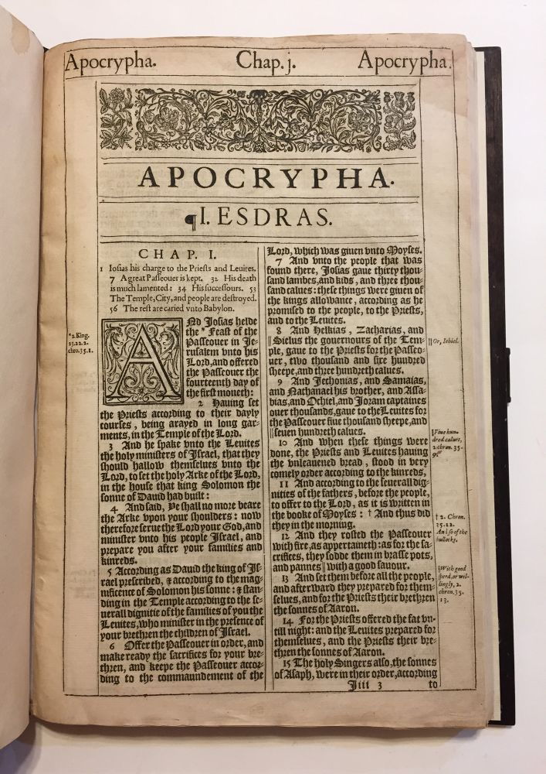
B. The Apocrypha
“Apocrypha” means “hidden”.
7 Books of the Apocrypha:
Tobit, Judith, Wisdom, Ecclesiasticus, Baruch and 1 & 2 Maccabees.
It also includes additional sections of the books of Esther and Daniel.

Slide 35
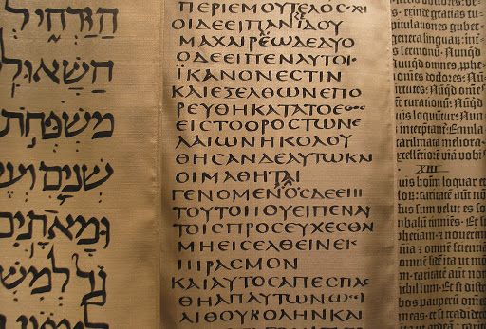
How did the Apocryphal books get into the Roman Catholic Bible?
Notes:
This is a story of translation.

Slide 36
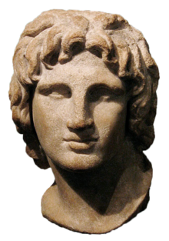
Jerome translates
Latin Vulgate from
Greek Septuagint
Translation of
Greek Septuagint
Ministry of
Jesus & Apostles
Last book of OT written
Alexander
the Great
HEBREW OT
GREEK
LATIN
APOCRYPHA (c. 400-200 BC)
THE ROMAN EMPIRE (27 BC – c. 1453 AD)
356-323 BC
27 BC
132 BC
c. 435 BC
c.27 – 100 AD
c.347-420 AD
Notes:
The Jews Lived in Turbulent Times During This Period: Their Writings Reflected Hope for Something Better
The period between the two testaments was a turbulent one for the Jews. They were under the authority of a number of different… Much of their literature that was written during this period reflected their struggle. With evil all around them, and many religious and political struggles, there were hopes for better days when the promised Messiah would come and bring them into a new golden age of peace.
In addition, they filled the gaps of Jewish history with stories of heroism during difficult times. Since there was not much literature produced by the Jews during this time in their history, the people cherished whatever written works they possessed.

Slide 37
“Beginning in the second century after Christ, a Latin translation of the entire Bible was undertaken, reflecting the shift from Greek to Latin as the universal language of the Roman Empire. The version of the Old Testament originally translated was the Septuagint, not the Hebrew Bible. As the church began to adopt Latin as its language, the Latin translation including the Apocrypha became its Bible.”
HISTORICAL THEOLOGY, p.48
Gregg R. Allison

Slide 38
Jerome (347 – 420 AD)
Eusebius Sophronius Hieronymus

Slide 39
Jerome (c. 347-420 AD)
“As then the church reads Judith, Tobit, and the books of Maccabees, but does not admit them among the canonical Scriptures, so let it read these two volumes for the edification of the people, not to give authority to doctrines of the church.”

Slide 40
“Elsewhere, Jerome indicated his rejection of Baruch, and though he did translate the additional stories in Daniel of the LXX, he placed them in an appendix to the book. Thus, he relegated the Apocrypha to secondary status in comparison with canonical Scripture.”
HISTORICAL THEOLOGY, p.48-49
Gregg R. Allison

Slide 41
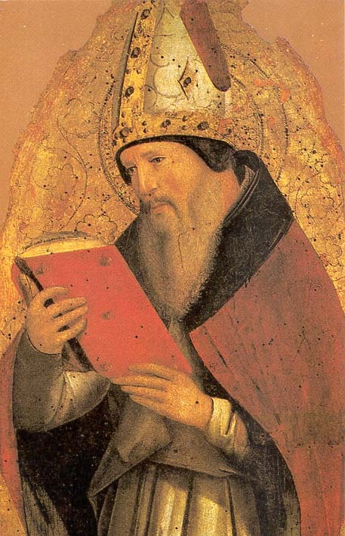
Why did Jerome include the Apocrypha in his Latin Vulgate translation?
“Unlike Jerome, Augustine could not read Hebrew—he was not overly skilled in Greek either—and he mistakenly thought the Jews had likewise embraced those books as canonical.” (James R. White, Scripture Alone, 115–116)

Slide 42
B. The Apocrypha
For over a thousand years, the Latin Vulgate including the Apocrypha would be used as the Bible in churches until the Reformation in the 1500s.
During the Reformation, the motto “ad fontes” - meaning “back to the sources” - drove the Reformers to go back to the original Hebrew texts and realize that they weren’t originally part of the OT and the translator (Jerome) himself recognized that distinction.

Slide 43
LET’S DISCUSS
What Roman Catholic teaching do you see based in 2 Maccabees 12:39-45?

Slide 44
2 Maccabees 12:39-45
The noble Judas exhorted the people to keep themselves free from sin... He also took up a collection… and sent it to Jerusalem to provide for a sin offering. In doing this he acted very well and honorably, taking account of the resurrection. For if he were not expecting that those who had fallen would rise again, it would have been superfluous and foolish to pray for the dead. But if he was looking to the splendid reward that is laid up for those who fall asleep in godliness, it was a holy and pious thought. Therefore he made atonement for the dead, so that they might be delivered from their sin.

Slide 45
2. OLD TESTAMENT CANON
The Close of the OT Canon
The Apocrypha
The Reformation & the Vulgate

Slide 46
2C. The Reformation & the Vulgate
During the Reformation, the Protestant Reformers critiqued the use of the Apocrypha in the church for three main reasons:
The Development of Unbiblical Practices (e.g. prayer for the dead, purgatory, etc.)

Slide 47
2C. The Reformation & the Vulgate
During the Reformation, the Protestant Reformers critiqued the use of the Apocrypha in the church for three main reasons:
The Development of Unbiblical Practices
Poor Translation of Certain Passages

Slide 48
“For example, the Vulgate version of Jesus’ evangelistic preaching (Matt. 4:17) had “do penance.” This command of the Lord was used as the biblical foundation of the church’s sacrament of penance, a means of receiving God’s grace after sinning by praying, giving to the poor, forgoing certain physical pleasures, and so forth.”
HISTORICAL THEOLOGY, p.50-51
Gregg R. Allison
Notes:
Bad translation of the Greek μετάνοια

Slide 49
2C. The Reformation & the Vulgate
During the Reformation, the Protestant Reformers critiqued the use of the Apocrypha in the church for three main reasons:
The Development of Unbiblical Practices
Poor Translation of Certain Passages
Inconsistency within Roman Catholicism over the Apocrypha

Slide 50
The Council of Trent (1545-1563)
“If anyone does not receive, as sacred and canonical, these books, with all their parts, as they have been read in the Catholic Church and as they are contained in the old Latin Vulgate edition, and knowingly and deliberately rejects the above mentioned traditions, let him be anathema [cursed].”

Slide 51
“Ironically even a pope has rejected the apocrypha - Pope Gregory the Great. Gregory cited an incident from 1 Maccabees 6:46 and specifically said Maccabees was “not canonical.” And the New Catholic Encyclopedia pointedly confirms his rejection of the canonicity of Maccabees.”
SCRIPTURE ALONE, p.114
James R. White

Slide 52
“...even Cardinal Ximenes, in his introduction to the first printed edition of the Greek New Testament, presented the same rejection of full canonical status to the apocrypha that Cardinal Cajetan documented, and yet Pope Leo X still approved the publication of the work. It is simply beyond controversy that at the beginning of the Reformation, the dogmatic stance taken at the Council of Trent was not the view of the best read and scholarly Roman Catholic leaders of the communion.”
SCRIPTURE ALONE, p.115
James R. White

Slide 53
Wayne Grudem
Grudem concludes that the books of the Apocrypha should not be regarded as Scripture because:
They do not claim for themselves the same kind of authority as the Old Testament writings
They were not regarded as God’s words by the Jewish people from whom they originated
They were not considered to be Scripture by Jesus or the New Testament authors;
They contain teachings inconsistent with the rest of the Bible.
Notes:
However, the books of the Apocrypha are not evil in themselves. They are simply not canonical – that is, not to be considered as scripture. They do have some value to us as works of history to help us gain insight into the culture of the day. They also give us some beautiful examples of Jewish piety and religious devotion.
In fact – the Christmas hymn, “It came upon a midnight clear” takes inspiration from a book from the Apocrypha called the Wisdom of Solomon. And there are other Christian hymns which also borrow language from parts of the Apocrypha.
The books of the Apocrypha then are to be viewed simply as Jewish writings of that time – not scriptural – just as we would view books by Christian authors of our day. We don’t think of them as scripture, but rather judge their value and validity by scripture.

Slide 54
THE CANON OF SCRIPTURE
Definition & Importance
Old Testament
New Testament
Recognizing the Canon
Discussion and Q&A

Slide 55
Graphic courtesy A Visual Theology Guide to the Bible by Tim Challies & Josh Byers

Slide 56
Why were new books added to the Canon after the OT?
After the close of the OT Canon, there was a period of about 400 years of silence, as far as divinely inspired writings are concerned.
Many other books were written during this ‘intertestamental’ period (like the Apocrypha), but none of them were ever recognized by the Jews as inspired scripture.

Slide 57
2. NEW TESTAMENT CANON
The NT is Foreshadowed by the OT
The Old Testament ends with the words of Malachi, expecting the promised Messiah to come (see Mal. 3:1-4; 4:1-6). So, it makes sense that there would be no further Scripture written until the next stage in redemptive history occurs.

Slide 58
2. NEW TESTAMENT CANON
The NT is Foreshadowed by the
Jesus equipped his apostles & disciples to write the NT
Jesus himself promised the gift of the Holy Spirit to his apostles and disciples which would teach and bring to their remembrance all things, guiding them into all truth (see John 14:26; 16:13-14). This is why the New Testament primarily is comprised of the writings of the apostles and disciples of Jesus.

Slide 59
2. NEW TESTAMENT CANON
The NT is Foreshadowed by the
Jesus equipped his apostles & disciples to write the NT
The apostles claimed the authority to write Scripture

Slide 60
The apostles claimed the authority to write Scripture
Peter encourages his readers to remember “the commandment of the Lord and Savior through your apostles” (2 Peter 3:2).
Paul tells the Corinthians that, “If any one thinks that he is a prophet, or spiritual, he should acknowledge that what I am writing to you is a command of the Lord” (1 Cor. 14:37). (See also 2 Cor. 13:3; Rom. 2:16; Gal. 1:8–9; 1 Thess. 2:13; 4:8, 15; 5:27; 2 Thess. 3:6, 14)

Slide 61
The Apostles & early church recognized their writings as Scripture early on
Peter says, “So also our beloved brother Paul wrote to you according to the wisdom given him, speaking of this as he does in all his letters. There are some things in them hard to understand, which the ignorant and unstable twist to their own destruction, as they do the other scriptures.” (2 Peter 3:15–16).
Peter clearly considers Paul’s writings as scripture.

Slide 62
The Apostles & early church recognized their writings as Scripture early on
Paul says, “Let the elders who rule well be considered worthy of double honor, especially those who labor in preaching and teaching; for the scripture says, “You shall not muzzle an ox when it is treading out the grain,’ and, “The laborer deserves his wages.’” (1 Timothy 5:17-18)
Paul quotes Deut. 25:4 and Luke 10:7 both as scripture.

Slide 63
2. NEW TESTAMENT CANON
The NT is Foreshadowed by the
Jesus equipped his apostles & disciples to write the NT
The apostles had the authority to write Scripture
The Early Church attested to their inclusion in the Canon

Slide 64
Tertullian (155-220 AD)
“The law and the prophets she [the church] unites in one volume with the writings of the evangelists and apostles; from which she drinks in [receives] her faith.”

Slide 65
Irenaeus (130 – 202 AD)
“I have pointed out the truth, and shown the preaching of the church, which the prophets proclaimed but which Christ brought to perfection, and the apostles have handed down.”

Slide 66
THE CANON OF SCRIPTURE
Definition & Importance
Old Testament
New Testament
Recognizing the Canon
Discussion and Q&A

Slide 67
How do we recognize the Canon?
The Roman Catholic view of the canon believes that it is the papal magisterium which pronounces certain books as canonical and gives them scriptural status.
However, this puts the church over the Bible instead of God’s Word over the church.
Notes:
This type of model makes it impossible to reform the church by His Word, because if the church determines what His word is, then it cannot be reformed by that which it gets to define.

Slide 68
“…the church is “built on the foundation of the apostles and prophets” (Eph. 2:20); thus, Scripture preceded the church, and it cannot owe its existence to church authority.
The church recognized and affirmed the divinely inspired writings that God intended for placement in the canon, but it did not create or determine the canon of Scripture.”
HISTORICAL THEOLOGY, p.53
Gregg R. Allison

Slide 69
Therefore the question of canon isn’t one of
“How did the church MAKE these books canonical?”
But rather, “How did the church RECOGNIZE the books which are canonical?

Slide 70
4. RECOGNIZING THE CANON
There are three features which helped the church recognize canonical books:
Divine Qualities
Apostolic Origins
Corporate Reception

Slide 71
4A. Divine Qualities
Prophecy
One of the ways scripture shows its Divine Qualities is through fulfilled prophecy.
Only the Sovereign Lord of history can ‘declare the end from the beginning’ (cf. Isa. 46:10). There are hundreds upon hundreds of prophecies and fulfillments bearing record of this in God’s Word.
By various estimates, Jesus Christ fulfilled over 300 specific prophecies about the Messiah in his birth, life, death and resurrection.

Slide 72
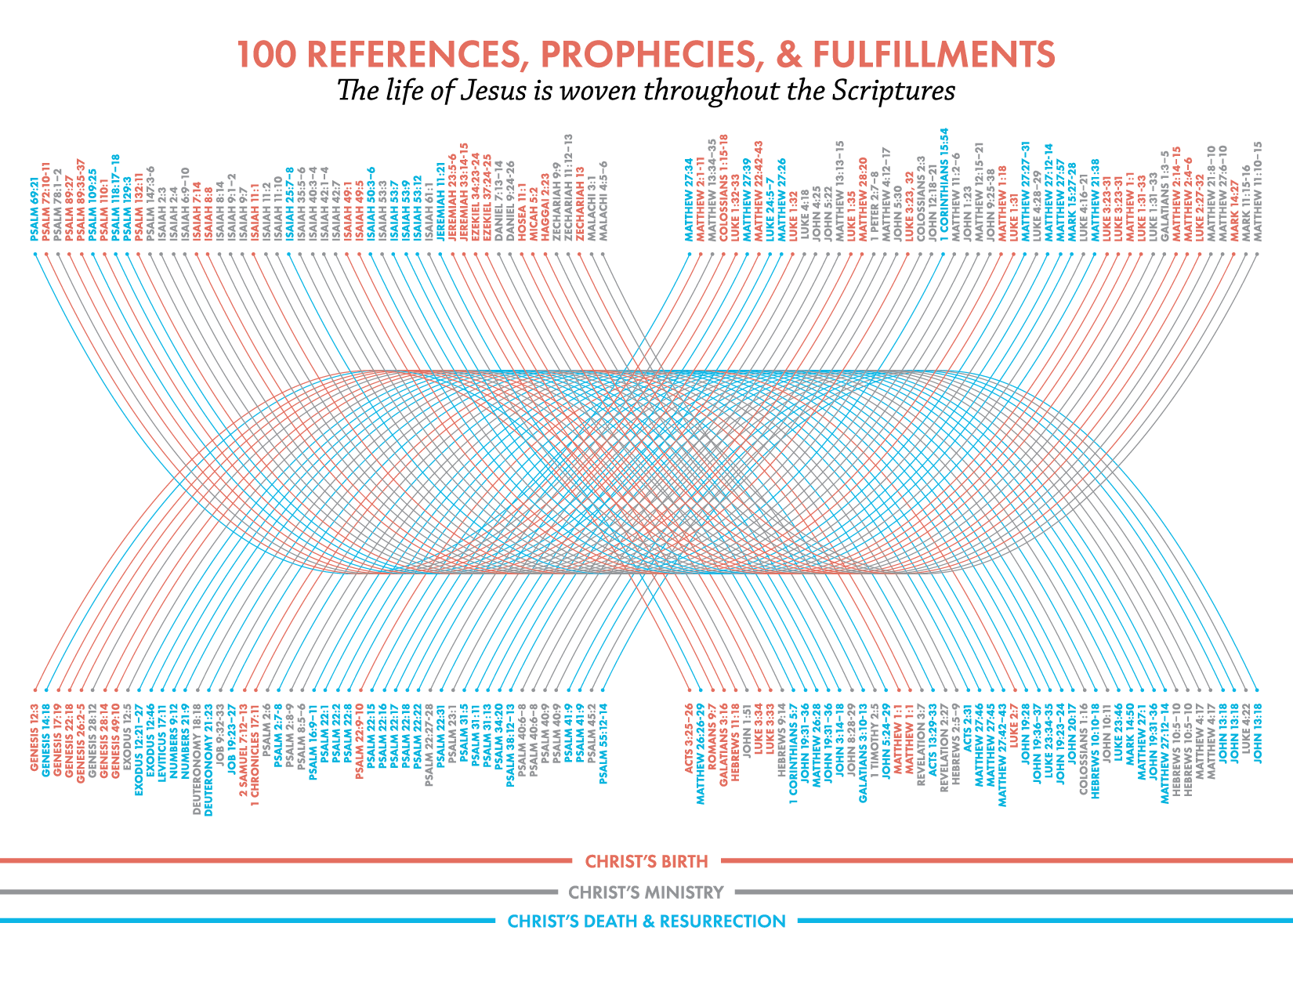
Graphic courtesy A Visual Theology Guide to the Bible by Tim Challies & Josh Byers

Slide 73
The Great Isaiah Scroll
Dated between 100 – 356 BC
Notes:
Found in 1947 by some Bedouin shepherds. Contains exactly the Messianic prophecy about Jesus in Isaiah 53. The scroll was dated between 100 to 350 years before Christ’s birth – conclusively proving that Isaiah did indeed write this prophecy before Jesus’ time.

Slide 74
Messianic Prophecy
Dr. Peter Stoner calculated the odds of one person fulfilling even only 8 Messianic prophecies as an astronomical - 1 x 10²⁸ or 1 in 10,000,000,000,000,000,000,000,000,000.
Clearly, just taking the Bible’s Messianic prophecies over hundreds of years, we see compelling evidence of the Divine Quality of Scripture.

Slide 75
4A. Divine Qualities
Prophecy
Majesty
The Scriptures reflect the majesty of their Author.
They reveal the incomparable, sovereign beautiful and Majestic God.
They reveal the wonder of His grace, mercy, love & goodness.
They reveal God’s perfection, purity, holiness and justice.
They reveal their consistency across all their scope and the Grand Narrative of Redemptive History.

Slide 76
4A. Divine Qualities
Prophecy
Majesty
Power
The Scriptures show their power to convert sinners and transform lives.
They comfort, build-up, rebuke and sanctify the believer (2 Tim. 3:16-17), bring wisdom (Ps. 119:98; 2 Tim. 3:16), give joy to the heart (Neh. 8:8–12; Ps. 119:111), provide “light” to the dark paths (Ps. 119:105), give understanding (Ps. 119:144), give peace and comfort (Ps. 119:50), expose sin and guilt (2 Kings 22:11–13; Acts 2:34–37; Heb. 4:12–13), and lead to prosperity and blessing (Ps. 1:1–3).
Notes:
These 3 features – Prophecy, Majesty and Power – made Jonathan Edwards say this of scripture’s divine qualities as self-attesting to their truth:

Slide 77
Jonathan Edwards (1703-1758)
“The gospel of the blessed God does not go abroad a-begging for its evidence, so much as some think: it has its highest and most proper evidence in itself...”

Slide 78
John 10:27
“My sheep hear my voice, and I know them, and they follow me.”

Slide 79
4. RECOGNIZING THE CANON
There are three features which helped the church recognize canonical books:
Divine Qualities
Apostolic Origins
Corporate Reception

Slide 80
Michael J. Kruger (NT Scholar)
Not only did the apostles themselves write many of these New Testament documents, but, in a broader sense, they presided over the transmission of the apostolic deposit and labored to make sure that the message of Christ was firmly and accurately preserved for future generations, through the help of the Holy Spirit… Thus, the New Testament canon is not so much a collection of writings by apostles, but a collection of apostolic writings—writings that bear the authoritative message of the apostles and derive from the foundational apostolic era (even if not directly from their hands).

Slide 81
Clement (c. 96 AD)
“The Apostles received the Gospel for us from the Lord Jesus Christ, Jesus the Christ was sent from God. The Christ, therefore, is from God and the Apostles from the Christ.”
(1 Clement 42:1-2)

Slide 82
Irenaeus (c. 130-202 AD)
“We have learned from none others the plan of our salvation, than from those through whom the Gospel has come down to us, which they did at one time proclaim in public, and, at a later period, by the will of God, handed down to us in the Scriptures, to be the ground and pillar of our faith.”
(Irenaeus, Against Heresies 3.1.1)

Slide 83
4. RECOGNIZING THE CANON
There are three features which helped the church recognize canonical books:
Divine Qualities
Apostolic Origins
Corporate Reception

Slide 84
The role of the church in recognizing the canon is more like a thermometer than a thermostat.

Slide 85
The Muratorian Fragment (c. 170AD)
Lists 22 out of 27 NT books

Slide 86
Graphic courtesy A Visual Theology Guide to the Bible by Tim Challies & Josh Byers
Notes:
Clearly with a canon like this – one can get the major essentials of the Christian faith and Gospel!

Slide 87
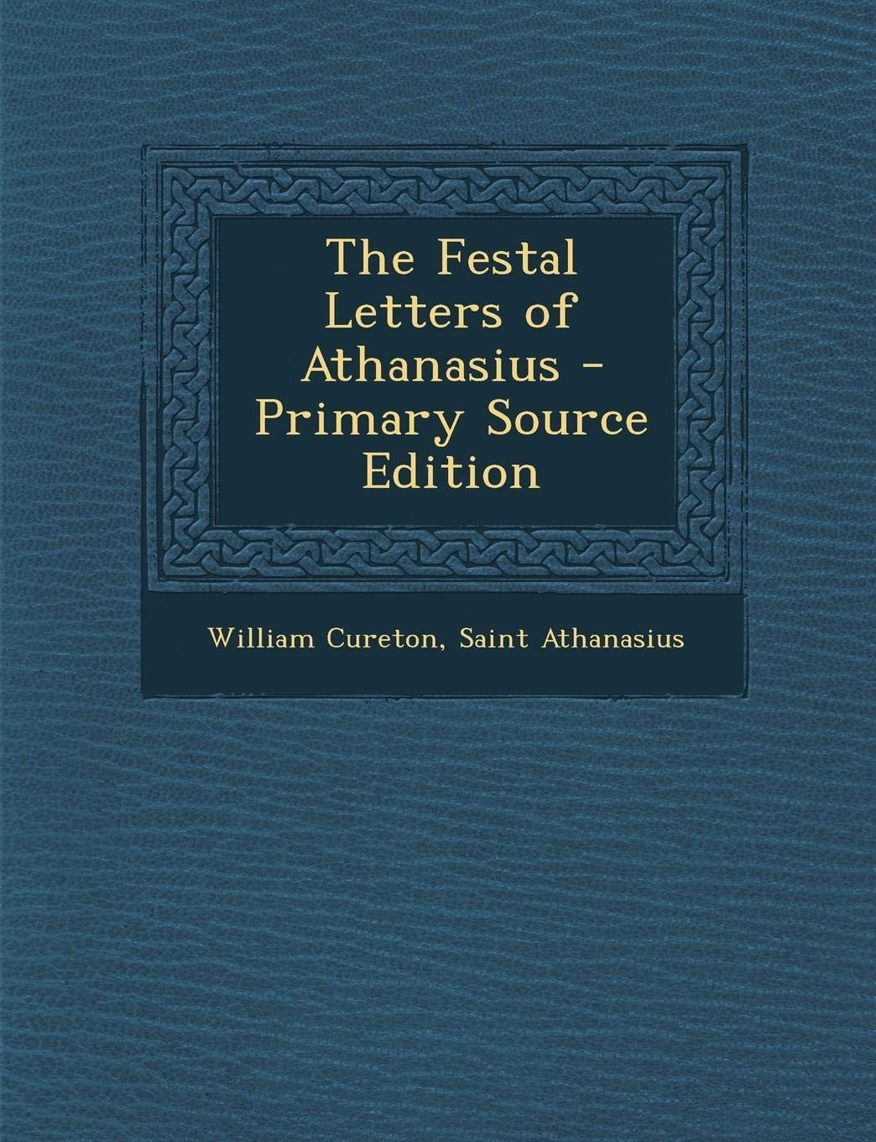
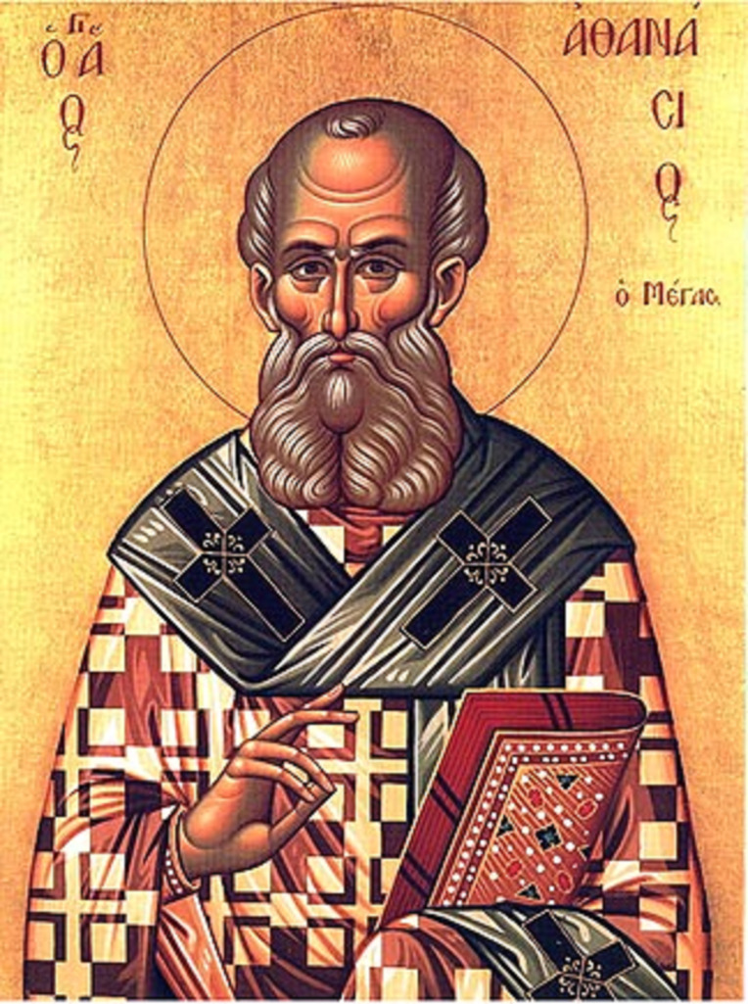
Athanasius’s Festal Letter (c. 367 AD)
Complete list of the OT & NT Canon

Slide 88
Graphic courtesy A Visual Theology Guide to the Bible by Tim Challies & Josh Byers
Notes:
By the fourth century – the NT canon was universally settled as the books we have today.

Slide 89
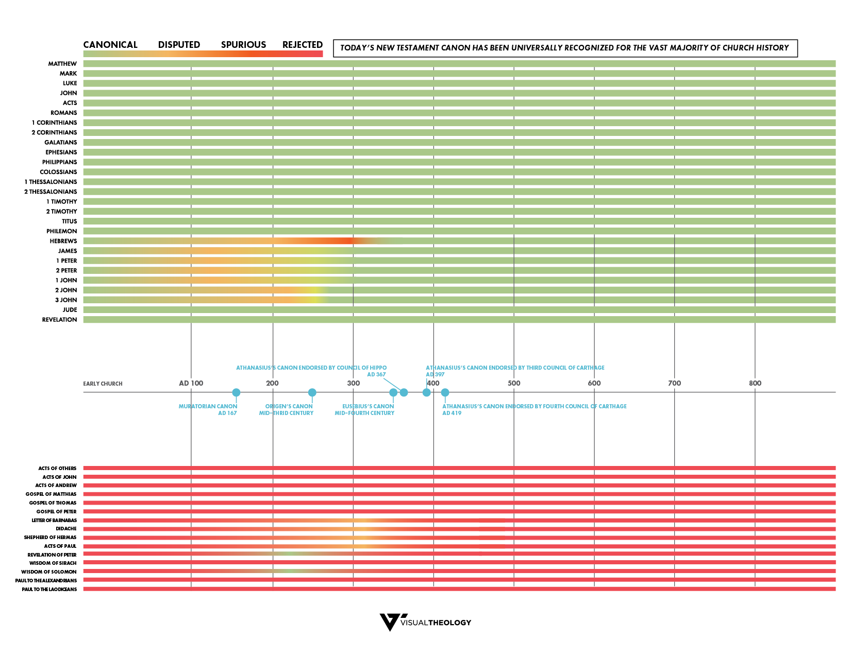
Graphic courtesy A Visual Theology Guide to the Bible by Tim Challies & Josh Byers
Notes:
We can see here that a majority of the books of the NT enjoyed continuous use and acceptance.
The ones which struggled for a little bit are mainly the shorter, personal letters – such as 1, 2 & 3 John… which makes sense… and Hebrews because its authorship was unknown. But eventually it did gain widespread acceptance.
This reluctance though shows us that the early church was trying to be discerning in what they received as scripture.

Slide 90
Are there any other candidates for the Canon of Scripture?
Today there exist no strong candidates for addition to the canon and no strong objections to any book presently in the canon.
Two quick illustrations:
Early Church Fathers expressly stated that their own writings were not to be viewed as authoritative.

Slide 91
Augustine of Hippo (354-430 AD)
“Let us treat scripture like scripture, like God speaking…
So if anybody reads my book, let him pass judgment on me. If I have said something reasonable, let him follow, not me, but reason itself; if I’ve proved it by the clearest divine testimony, let him follow, not me, but the divine scripture.”

Slide 92
Are there any other candidates for the Canon of Scripture?
Today there exist no strong candidates for addition to the canon and no strong objections to any book presently in the canon.
Two quick illustrations:
Early Church Fathers expressly stated that their own writings were not to be viewed as authoritative.
Other early writings contain unbiblical and absurd teachings that go against the rest of scripture.

Slide 93
The Shepherd of Hermas
Teaches unbiblical concepts such as the necessity of penance, that baptism forgives sins and a confusion about the orthodox doctrine of the Trinity. (See Oxford Dictionary of the Christian Church, p. 641).
The Gospel of Thomas Simon Peter said to them: “Let Mary go away from us, for women are not worthy of life.” Jesus said: “Lo, I shall lead her, so that I may make her a male, that she too may become a living spirit, resembling you males. For every woman who makes herself a male will enter the kingdom of heaven.” (logion 114)

Slide 94
Origen (184-253 AD)
“The church receives only four gospels; heretics have many, such as the gospel of the Egyptians, the Gospel of Thomas, etc. These we read, that we may not seem to be ignorant to those who think they know something extraordinary, if they are acquainted with those things which are recorded in these books.”

Slide 95
Graphic courtesy A Visual Theology Guide to the Bible by Tim Challies & Josh Byers
Notes:
By contrast we see that these ‘extra Gospels’ and apocryphal works after the close of the NT never gained widespread use and acceptance by the early church.

Slide 96
What if we found a ‘lost letter of Paul’ today?
It is exceptionally difficult to imagine what kind of historical data might be discovered that could convincingly demonstrate to the church as a whole that a letter lost for over 1,900 years was genuinely authored by Paul...

Slide 97
2 PETER 1:3
His divine power has granted to us all things that pertain to life and godliness, through the knowledge of him who called us to his own glory and excellence

Slide 98
“The entire idea of “lost scripture” requires us to believe that God would go through the work of inspiring His Word so as to provide for His church guidance and instruction and encouragement; but then, having inspired His Word, be shown incapable of protecting and preserving it and leading His church to recognize it for what it is.”
SCRIPTURE ALONE, p.110
James R. White

Slide 99
“Ultimately, the canon imposed itself on the church. The church recognized it, although it took longer for some books to receive acceptance than others. Behind this is the principle that only God can adequately attest the works of God, and so the canon, notwithstanding the many external evidences in support, is self-attesting.”
SYSTEMATIC THEOLOGY, p.189
Robert Letham

Slide 100
THE CANON OF SCRIPTURE
Definition & Importance
Old Testament
New Testament
Recognizing the Canon
Discussion and Q&A

Slide 101
DISCUSSION QUESTIONS
Why is it important to your Christian life to know which writings are God’s words and which are not?
Have you had doubts or questions about the canonicity of any of the books of the Bible? What caused those questions? What should one do to resolve them?
Mormons, Jehovah’s Witnesses, and others have claimed present-day revelations from God that they count equal to the Bible in authority. What reasons can you give to indicate the falsity of those claims?

Slide 102
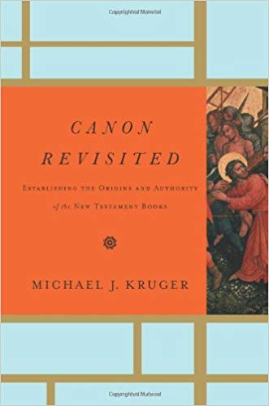
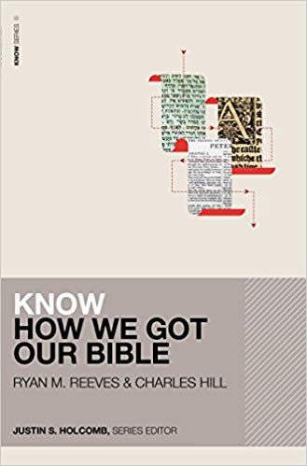
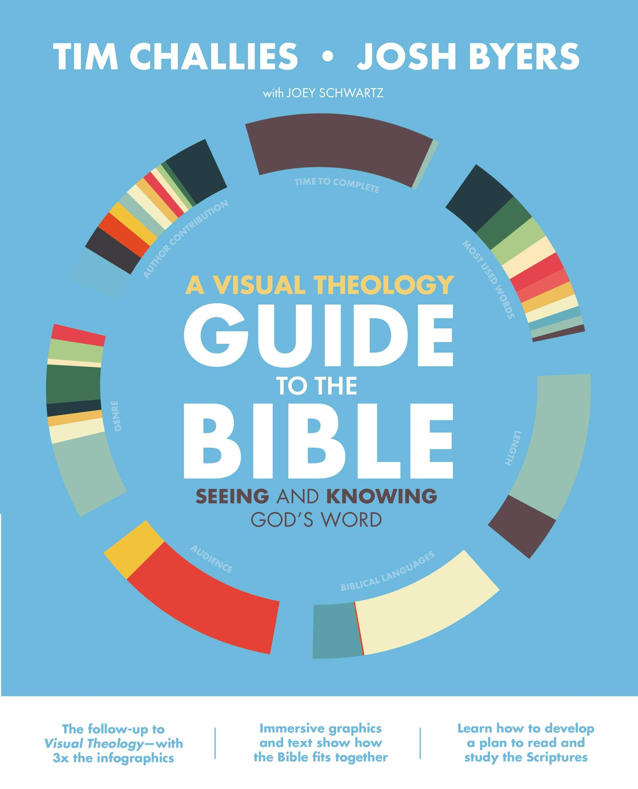
Canon Revisited: Establishing the Origins and Authority of the New Testament Books by Michael J. Kruger
Know How We Got Our Bible by Ryan Matthew Reeves
A Visual Theology Guide to the Bible by Tim Challies & Josh Byers

Slide 103
FOR NEXT SESSION
Read 2 Timothy 3
Read 2 Peter 1:16-21

Slide 104
Thanks for coming…
YOU ARE LOVED
See you next week!

