Slide 2
CLASS SESSIONS
Intro & Canon
Inspiration & Authority
Necessity & Sufficiency
Clarity & Interpretation
Inerrancy & Apologetic Challenges
OUTLINE OF TOPICS

Slide 3
Jeremiah 23:23-40

Slide 4
Inspiration & Authority
When we speak of Scripture’s inspiration, we are speaking about the nature of Scripture - the basic, inherent feature of Scripture which is characteristic about it.
When we speak of Scripture’s authority, we are speaking of its right to govern, judge and shape all of a Christian’s life and beliefs.
The two concepts are vitally connected to one another, as we will explore today.

Slide 5
SCRIPTURE’S INSPIRATION
SECTION OUTLINE
PAUL
PETER
JESUS
Verbal Plenary Inspiration
Major Errors
Why is it important?

Slide 6
SCRIPTURE’S INSPIRATION
Why are these doctrines important?
“Those systems that do not begin with this belief in Scripture will exhibit a wide range of beliefs that will shift over time in light of the ever-changing whims and views of culture. Almost every single collapse involving denominations and churches in regard to historic Christian beliefs can be traced back to a degradation in that group’s view of the Bible as the inspired and inerrant revelation of God’s truth.” (James R. White, Scripture Alone, p.43)

Slide 7
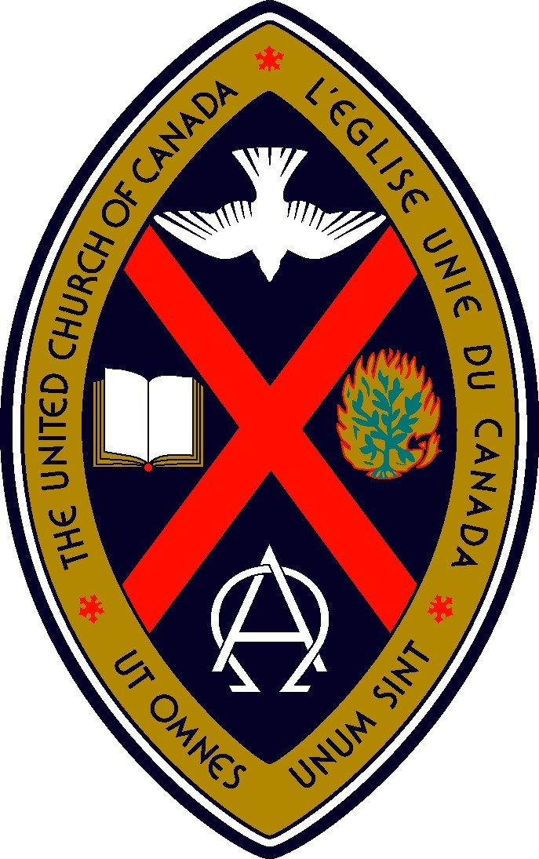
AN EXAMPLE TO US
The United Church of Canada
“The United Church was formed in 1925 by the merger of two large Canadian denominations, the Methodists and the Presbyterians, as well as the much smaller Congregationalists.“
Many United Churches bore names like “Knox” and “Wesley” and held deeply evangelical beliefs. In the 1930s to 1950s they held evangelistic revival campaigns to win people to Christ and supported figures like Billy Graham in Canada.
Their original statements of faith were solidly evangelical.

Slide 8
“ We receive the Holy Scriptures of the Old and New Testaments, given by inspiration of God, as containing the only infallible rule of faith and life, a faithful record of God’s gracious revelations, and as the sure witness of Christ.” (Article III)
Twenty Articles of Doctrine (1924)
The United Church of Canada

Slide 9
“We believe that, while God uttered His Word to man in many portions progressively, the whole is sufficient to declare His mind and will for our salvation...
We believe that in Holy Scripture God claims the complete allegiance of our mind and heart; that the full persuasion of the truth and authority of the Word of God contained in the Scripture is the work of the Holy Spirit in our hearts... So we acknowledge in Holy Scripture the true witness to God’s Word and the sure guide to Christian faith and conduct.” (Article IX)
Twenty Articles of Doctrine (1924)
The United Church of Canada

Slide 10
AN EXAMPLE TO US
The United Church of Canada
In 1964, a new Sunday school curriculum was released that taught adults and children to question the historical reliability of the Old Testament and the Gospels.
“New officials publicly rejected Billy Graham and the whole idea of evangelistic rallies. They also dropped the church’s opposition to premarital sex and lobbied the federal government to legalize abortion, reversing their traditional moral stances.”
“The time had come, they said, for the church to stop telling the world what to do, and instead listen to the world’s wisdom...”

Slide 11
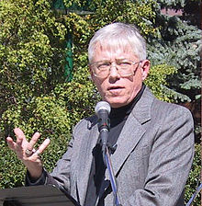
AN EXAMPLE TO US
The United Church of Canada
In 1997, for example, Moderator Bill Phipps told the Ottawa Citizen, “I don’t believe Jesus was God,” and “I don’t believe he rose from the dead as a scientific fact. It’s an irrelevant question.”
More recently, in 2001, Gretta Vosper - a minister at West Hill United Church publicly described herself as a “non-theist” and later adopted the term “atheist.”

Slide 12
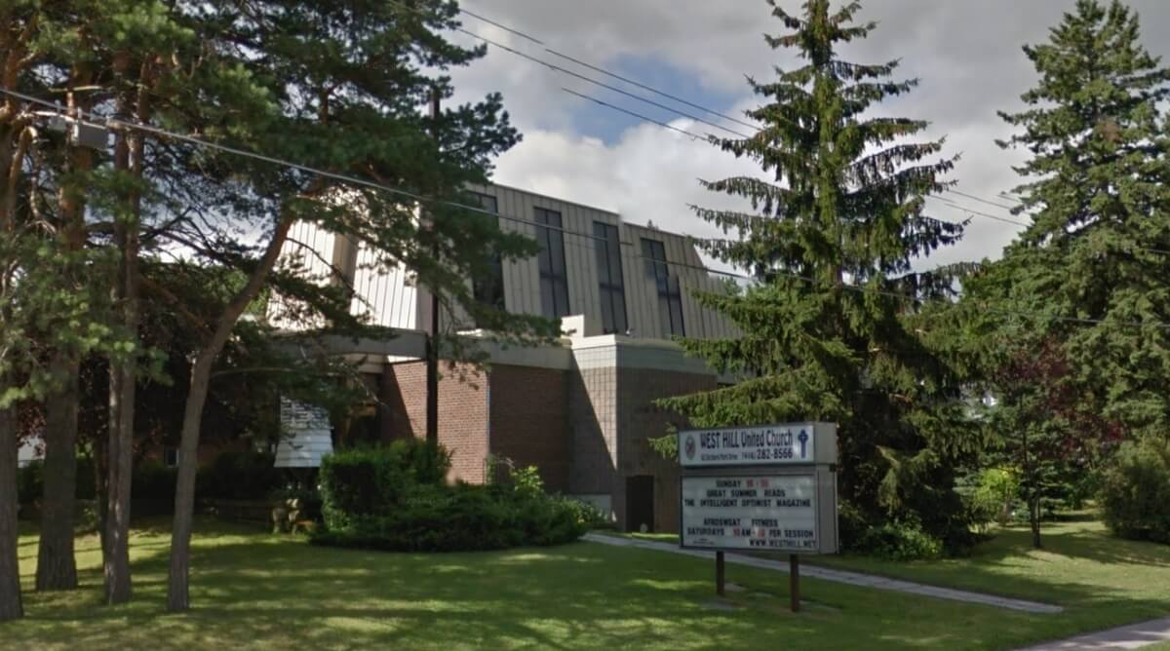
“The result? Between 1968 and 2009 the United Church lost over half its members, during a time in which the Canadian population grew by more than 50%.”

Slide 13
“We should not be quick to judge. I’ve met many kind, decent people in the United Church. Many of them genuinely want to follow Jesus’ commandment to love others as we love ourselves, and their commitment to helping the poor and disadvantaged is worth imitating.
Nevertheless, the story of the United Church is a sobering one. It’s a reminder that strategies formed out of human wisdom rarely work out the way we intend, especially when they leave behind “the faith once for all delivered to the saints” (Jude 3). That’s a faith worth contending for.”
(Kevin Flatt, TGC Canada Article: “The United Church of Canada: What you need to know”)

Slide 14
SCRIPTURE’S INSPIRATION
Why are these doctrines important?
At the root of every apostate denomination and church is a denial of scripture’s inspiration - as there is little worth in speaking about the usefulness, authority or sufficiency of a non-inspired, merely human, errant collection of ancient works.
This sort of view inevitably leads to a denial of the ability of the Bible to function as our sole infallible rule of faith for the church.

Slide 15
SCRIPTURE’S INSPIRATION
Why are these doctrines important?
It is no understatement to say that this is THE FUNDAMENTAL ISSUE when it comes to our doctrine of the Word of God:
Do we, or do we not, believe that it is Divinely inspired?

Slide 16
“Inspiration is the work of God, by His Holy Spirit, communicating His word to the writers of the Bible and enabling them to write that word without error, addition, or deletion. Thus, though fallible human penmen were employed, the Holy Spirit ensured the production of infallible writings, true in all respects, both as to their ideas and their words. These writings are, in the strictest sense, God’s word, and are therefore authoritative, the final rule of faith and practice.”
Dictionary of Theological Terms, p.237
Alan Cairns

Slide 17
A. PAUL: 2 Timothy 3:16-17
CONTEXT
Last recorded words of the apostle before his martyrdom.
Warning of “times of difficulty” for the church (v.1-7)
Paul is warning Timothy about false teachers among the people (v.8)
Paul guarantees the road ahead will be hard (v.12-13)
What is Paul’s admonition to Timothy in light of this dangerous threat to the early church?

Slide 18
2 Timothy 3:14-17
“But as for you, continue in what you have learned and have firmly believed, knowing from whom you learned it and how from childhood you have been acquainted with the sacred writings, which are able to make you wise for salvation through faith in Christ Jesus. All Scripture is breathed out by God and profitable for teaching, for reproof, for correction, and for training in righteousness, that the man of God may be complete, equipped for every good work.”

Slide 19
NOTE: v.15
If there ever was a time where Paul might have referred Timothy to some other kind of extra-biblical source to equip him, it would be here! The phrase “sacred writings” refers to the Old Testament writings with which Paul says Timothy has been already well acquainted.
Paul doesn’t point Timothy to something new, but rather something old, tried, and true - God’s trustworthy written Word. Unlike the false teachers who were going after new teachings, Paul reminds Timothy to continue in the firm foundation he had learned from his godly upbringing in the scriptures.

Slide 20
I. ALL SCRIPTURE
In the context, Paul is referring to the Old Testament scriptures.
However, as we saw from 2 Peter 3:15–16 and 1 Timothy 5:17-18, the New Testament writers considered their own writings as Scripture and early church recognized this.
So, when Paul says that “all scripture” is inspired by God, though he was referring to the OT, this same characteristic is true of the New Testament writings because they are also Scripture.

Slide 21
II. GOD-BREATHED θεόπνευστος
Paul says that all scripture is “theopneustos”: Some translations render the Greek word as “inspired by God” (NASB) or “God-breathed” (NIV) or “breathed out by God” (ESV).
What does this term mean?

Slide 22
B.B. Warfield (1851 – 1921)
“The Greek term has … nothing to say of inspiring or of inspiration: it speaks only of a ‘spiring’ or ‘spiration.’ What it says of Scripture is, not that it is ‘breathed into by God’ or is the product of the divine ‘inbreathing’ into its human authors, but that it is breathed out by God, ‘God-breathed,’ the product of the creative breath of God.” (B. B. Warfield, Inspiration and Authority of the Bible, p.133)

Slide 23
II. GOD-BREATHED θεόπνευστος
What this verse is saying with this word is not that God breathed “into” the scriptures, but rather that they are breathed out by God.
This term is saying that the Scriptures are not primarily human in their origin, but rather they are Divine in origin.

Slide 24
III. PROFITABLE TO MAKE US COMPLETE
What does it mean that scripture is profitable?

Slide 25
“The testimony of this passage is sometimes muted because people emphasize that something may be profitable without being sufficient for the task, as if Paul’s point here is that Scripture, like so many other things, is “an assistant” to one who teaches, sort of like crayons and a flannel board might be “useful” in teaching Sunday school for six-year-olds. This is not the apostle’s intention; Timothy didn’t need teaching aids, but encouragement about what God has provided for him to fulfill the ministry he was given in light of Paul’s soon departure.”
SCRIPTURE ALONE, p.51
James R. White

Slide 26
III. PROFITABLE TO MAKE US COMPLETE
The four phrases Paul uses - “teaching,” “reproof,” “correction” and “training in righteousness” - encompasses the whole of Christian discipleship and life.
Then to emphasize the point, the last phrase “equipped for every good work” makes it clear - there is no good work which scripture does not equip us for.
The Greek word ἄρτιος (artios) used means “fully qualified, proficient, fully ready, complete or capable.” This is what scripture is able to make us because it is God’s Word.

Slide 27
Why is it profitable to make us complete?
Because Scripture is God-breathed – God’s own words – His same powerful word that created the Universe (Gen 1) is able to completely accomplish what God sets it out to do.
Isaiah 55:11, “so shall my word be that goes out from my mouth; it shall not return to me empty, but it shall accomplish that which I purpose, and shall succeed in the thing for which I sent it.”
Philippians 1:6 – “He who began a good work in you will bring it to completion…”

Slide 28
B. PETER: 2 Peter 1:20-21
CONTEXT
Again, there is the threat of false teachers in the church (2:1-3).
He reassures the believers that they did not follow cleverly devised myths (v.16), but rather he and the other apostles were eyewitnesses themselves of God’s amazing revelation in Jesus Christ.
What does Peter go on to direct them to? - “the prophetic word more fully confirmed.”

Slide 29
I. A ‘MORE SURE’ PROPHETIC WORD
The adjective used here of this ‘prophetic word’ is βέβαιος (bebaios) is used “of something that can be relied on not to cause disappointment, reliable.” (BDAG) This is why the ESV translated it as ‘more fully confirmed’.
Peter is saying that this prophetic word which he is directing his readers towards is something reliable and having continuing validity so that you can be confident in your trust of it.
What is this more fully confirmed prophetic word? Is it some charismatic prophet? Is it traditions of the church or Jewish leaders?

Slide 30
2 Peter 1:20-21
“...knowing this first of all, that no prophecy of SCRIPTURE comes from someone’s own interpretation. For no prophecy was ever produced by the will of man, but men spoke from God as they were carried along by the Holy Spirit.”

Slide 31
II. THE ORIGIN OF SCRIPTURE
Many misinterpret these verses as focusing on the individual’s interpretation of these divine prophecies. However, the focus is on the origin and nature of the prophecies themselves.
The apostle Peter could have legitimately pointed to signs and wonders, instead redirect his readers to scripture because they are “more sure” and reliable. The reason for this type of certainty is because of the origin of the scriptures.

Slide 32
This word used for “interpretation” means “releasing, solving, explaining, interpreting. The word almost comes to mean inspiration.… The gen[itive] … here indicates source. Peter is talking about the divine origin of Scripture, not about its proper interpretation.” (p.584)
The New Linguistic Key to the Greek NT
Cleon L. Rogers

Slide 33
II. THE ORIGIN OF SCRIPTURE
Peter emphatically denies emphasis on the human origin of the prophetic word by saying, “No prophecy was ever made by an act of human will.”
The prophets did not just wake up one day and decide to write some prophecy.
The repeated phrase throughout many of the prophetic books is “the word of the Lord came to me.”
The origin of the word was not from within them, but from without them - from above - from God himself.

Slide 34
III. CARRIED ALONG BY THE SPIRIT
God carried the prophets and biblical authors along by His Spirit so that what they wrote was exactly what He wanted to say.
This did not override the human writer’s personalities and style, but rather it God worked through them, in concert with their humanity to produce something that was wholly from God.

Slide 35
“They spoke in their tongue, they spoke from their contexts, they spoke within their cultures, but what they spoke they spoke from God and only as they were carried along (or moved) by the Spirit. Here is the mysterious yet wondrous interface of the human and the divine in Scripture’s origination: While men are speaking, they are doing so under the power and direction of the Holy Spirit, so that the result of this divine miracle is, as Paul put it, God-breathed. It is not the men themselves who are “inspired” but the Scriptures, the result of this divine initiative in revelation.”
SCRIPTURE ALONE, p.59
James R. White

Slide 36
A TRUTH OF PRIMARY IMPORTANCE
This truth is of primary importance. Notice Peter’s words, “but know this first” or literally “knowing this first of all”.
If Peter’s readers don’t recognize this truth, they will easily fall prey to the false teachers that threaten them.
This is also true for us today. If we do not realize that it is scripture alone that is the “more fully confirmed” fully reliable word to us from God, then we may also be led astray by charismatic personalities and worldly wisdom.

Slide 37
C. JESUS: Matthew 22:29-32
CONTEXT
Here in Matthew 22, the Sadducees (who did not believe in the resurrection) approached Jesus with a question to try to trip him up.
They ask about a hypothetical woman who successively marries seven brothers, and after they all die - who’s wife would she be in heaven?

Slide 38
Matthew 22:29-32
But Jesus answered them, “You are wrong, because you know neither the Scriptures nor the power of God. For in the resurrection they neither marry nor are given in marriage, but are like angels in heaven. And as for the resurrection of the dead, have you not read what was said to you by God: ‘I am the God of Abraham, and the God of Isaac, and the God of Jacob’? He is not God of the dead, but of the living.”

Slide 39
Jesus’s view of Scripture
Jesus cites Exodus 3:6, which was written more than a thousand years before, yet Jesus says that they should have heard God speaking to them through it!
Jesus held them accountable to what they had heard read in the Scripture as if God Himself had spoken to them - because He had!
And it is the same with us: Scripture’s inspiration means that when Scripture speaks, God speaks to us.

Slide 40
If this is the view of scripture that Jesus held, then as followers of Jesus, we must hold the same view of scripture as Jesus!

Slide 41
D. Verbal Plenary Inspiration
These three passages illustrate for us what is technically called “the verbal plenary inspiration of Scripture.”
Verbal simply means it has to do with the words themselves. God inspired the very exact words which were used by the human authors to write Scripture.
Plenary is just a fancy way of saying “all of Scripture” as we saw from 2 Timothy 3:16-17. God inspired all of it. There are not some parts that are more inspired than others - yes, even the genealogies!

Slide 42
E. Major Errors about inspiration
I. The denial of Scripture’s divine origin
For example, the early church in Acts attributed the words of David recorded in Psalm 2:1-2 as being from God. They said, “Sovereign Lord… who through the mouth of our father David… said by the Holy Spirit…” (Acts 4:24-26)

Slide 43
E. Major Errors about inspiration
II. The denial of Scripture’s human authorship
This view sees the human authors of scripture as mechanically writing down what was dictating to them like some sort of robot without their own personalities and unique writing styles, cultures, etc.

Slide 44
Charles Hodge (1797 – 1878)
“Each sacred writer was by God specially formed, endowed, educated, providentially conditioned, and then supplied with knowledge naturally, supernaturally, or spiritually conveyed, so that he and he alone could, and freely would, produce his allotted part.”

Slide 45
B.B. Warfield (1851 – 1921)
"If God wished to give his people a series of letters like Paul's, he prepared a Paul to write them, and the Paul he brought to the task was a Paul who spontaneously would write just such letters.”
(Warfield, Inspiration, p.155)

Slide 46
The Dual-Nature of Scripture
“Inspiration is concursive: the Spirit and the human authors wrote together.” (Gregg R. Allison)
Similar to Jesus Christ - the Word of God who was truly God and truly man - the scriptures likewise have a dual-nature to them: human and divine.
The one does not eliminate the reality of the other. Just as Jesus has a true human nature which was weak and lowly yet free from sin, so also, Scripture is conceived without defect or stain.
The Scriptures are God’s Word to us in servant form.

Slide 47
E. Major Errors about inspiration
III. The denial of plenary inspiration
This view denies that ALL of scripture is inspired. It says that God’s Word is contained in the Bible - not that the Bible is God’s Word. It basically asserts that some parts of scripture are inspired, and some parts are not.
For example, some parts about gender roles are explained away as merely the product of the patriarchal culture of the ancient times and thus not really inspired or applicable for us today.

Slide 48
E. Major Errors about inspiration
III. The denial of plenary inspiration
The major problem with this view is the need for a reliable criteria by which to decide which parts are inspired and which are not. Who gets to decide that? And whoever that is, there is the true source of authority!
Not only that, but if parts of scripture are not inspired, then what confidence can we have that the parts which talk about our salvation and eternal hope are actually inspired?

Slide 49
If the whole Bible is not inspired, we can have no certainty that any of it is inspired.

Slide 50
E. Major Errors about inspiration
IV. The denial of verbal inspiration
This position denies that the inspiration of the Holy Spirit does not extend to the very exact words the biblical authors wrote. It does not see as important the languages they wrote in, or the specific way they phrased things, or the intentional usage of specific words.
This position fails to recognize scripture’s own claims - God inspired precisely and exactly the words He intended. That is why Jesus could appeal to the exact wording of scripture!

Slide 51
A Brief History of Inspiration
Full notes will be in the teacher’s notes on the resources page.

Slide 52
Clement of Rome
Jesus & Apostles
“You have searched the Scriptures, which are true, which were given by the Holy Spirit... Take up the epistle of the blessed Paul the apostle… Truly he wrote to you in the Spirit.” (Letter of the Romans to the Corinthians)
35-99 AD
c.27 – 100 AD
Notes:
The Jews Lived in Turbulent Times During This Period: Their Writings Reflected Hope for Something Better
The period between the two testaments was a turbulent one for the Jews. They were under the authority of a number of different… Much of their literature that was written during this period reflected their struggle. With evil all around them, and many religious and political struggles, there were hopes for better days when the promised Messiah would come and bring them into a new golden age of peace.
In addition, they filled the gaps of Jewish history with stories of heroism during difficult times. Since there was not much literature produced by the Jews during this time in their history, the people cherished whatever written works they possessed.

Slide 53
Clement of Rome
“they only spoke those things which they saw and heard, being filled with the Holy Spirit.” (Justin Martyr, Dialogue with Trypho, a Jew)
Jesus & Apostles
Justin Martyr
35-99 AD
100-165 AD
c.27 – 100 AD
Notes:
The Jews Lived in Turbulent Times During This Period: Their Writings Reflected Hope for Something Better
The period between the two testaments was a turbulent one for the Jews. They were under the authority of a number of different… Much of their literature that was written during this period reflected their struggle. With evil all around them, and many religious and political struggles, there were hopes for better days when the promised Messiah would come and bring them into a new golden age of peace.
In addition, they filled the gaps of Jewish history with stories of heroism during difficult times. Since there was not much literature produced by the Jews during this time in their history, the people cherished whatever written works they possessed.

Slide 54
Clement of Rome
Hippolytus
Jesus & Apostles
“For they [the apostles] did not speak of their own power (let there be no mistake as to that), neither did they declare what pleased themselves. But first of all they were endowed with wisdom by the Word, and then again were rightly instructed in the future by means of visions. Finally, when they were fully convinced themselves, they spoke those things which were revealed by God to them alone, and concealed from everyone else.” (Hippolytus, Treatise on Christ and Antichrist)
Justin Martyr
35-99 AD
170 - 235 AD
100-165 AD
c.27 – 100 AD
Notes:
The Jews Lived in Turbulent Times During This Period: Their Writings Reflected Hope for Something Better
The period between the two testaments was a turbulent one for the Jews. They were under the authority of a number of different… Much of their literature that was written during this period reflected their struggle. With evil all around them, and many religious and political struggles, there were hopes for better days when the promised Messiah would come and bring them into a new golden age of peace.
In addition, they filled the gaps of Jewish history with stories of heroism during difficult times. Since there was not much literature produced by the Jews during this time in their history, the people cherished whatever written works they possessed.

Slide 55
Clement of Rome
Hippolytus
“The Scripture, ‘inspired by God,’ as the apostle [Paul] calls it, is the Scripture of the Holy Spirit… Thus it is by the power of the Spirit that the holy men who are under divine influence are inspired, and every Scripture is for this reason said to be ‘inspired by God,’ because it is the teaching of the divine breath.” (Gregory of Nyssa, Against Eunomius)
Jesus & Apostles
Gregory
of Nyssa
Justin Martyr
35-99 AD
170 - 235 AD
100-165 AD
335 – 394 AD
c.27 – 100 AD
Notes:
The Jews Lived in Turbulent Times During This Period: Their Writings Reflected Hope for Something Better
The period between the two testaments was a turbulent one for the Jews. They were under the authority of a number of different… Much of their literature that was written during this period reflected their struggle. With evil all around them, and many religious and political struggles, there were hopes for better days when the promised Messiah would come and bring them into a new golden age of peace.
In addition, they filled the gaps of Jewish history with stories of heroism during difficult times. Since there was not much literature produced by the Jews during this time in their history, the people cherished whatever written works they possessed.

Slide 56
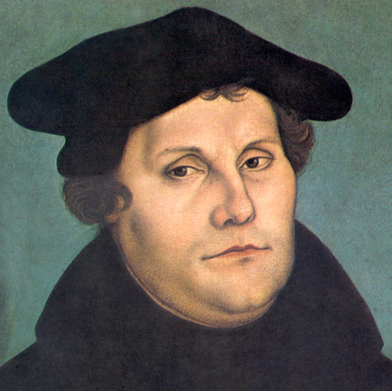
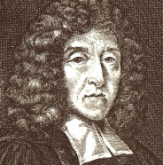
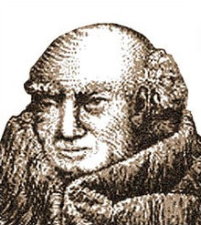
Clement of Rome
Hippolytus
Martin
Luther
Francis
Turretin
John Scotus
Eriugena
Thomas
Aquinas
John
Calvin
Jesus & Apostles
Gregory
of Nyssa
Justin Martyr
EARLY CHURCH
MIDDLE AGES
REFORMATION ONWARD
35-99 AD
1623 – 1687 AD
170 - 235 AD
815 - 877 AD
1483 – 1546 AD
100-165 AD
335 – 394 AD
1225 - 1274 AD
1509 - 1564 AD
c.27 – 100 AD
Notes:
The Jews Lived in Turbulent Times During This Period: Their Writings Reflected Hope for Something Better
The period between the two testaments was a turbulent one for the Jews. They were under the authority of a number of different… Much of their literature that was written during this period reflected their struggle. With evil all around them, and many religious and political struggles, there were hopes for better days when the promised Messiah would come and bring them into a new golden age of peace.
In addition, they filled the gaps of Jewish history with stories of heroism during difficult times. Since there was not much literature produced by the Jews during this time in their history, the people cherished whatever written works they possessed.

Slide 57
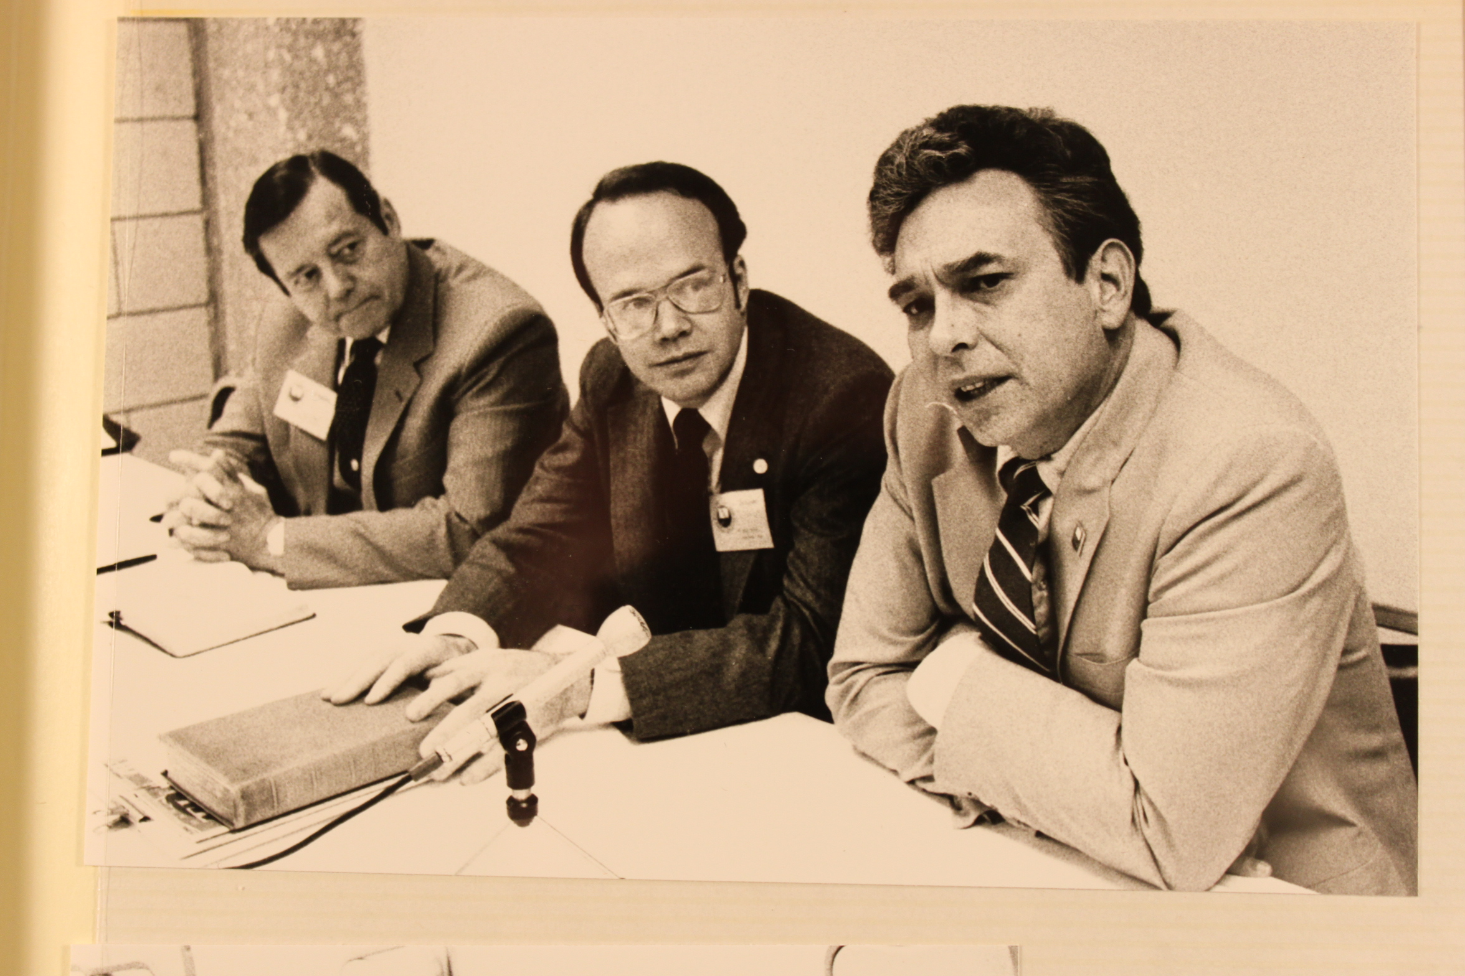
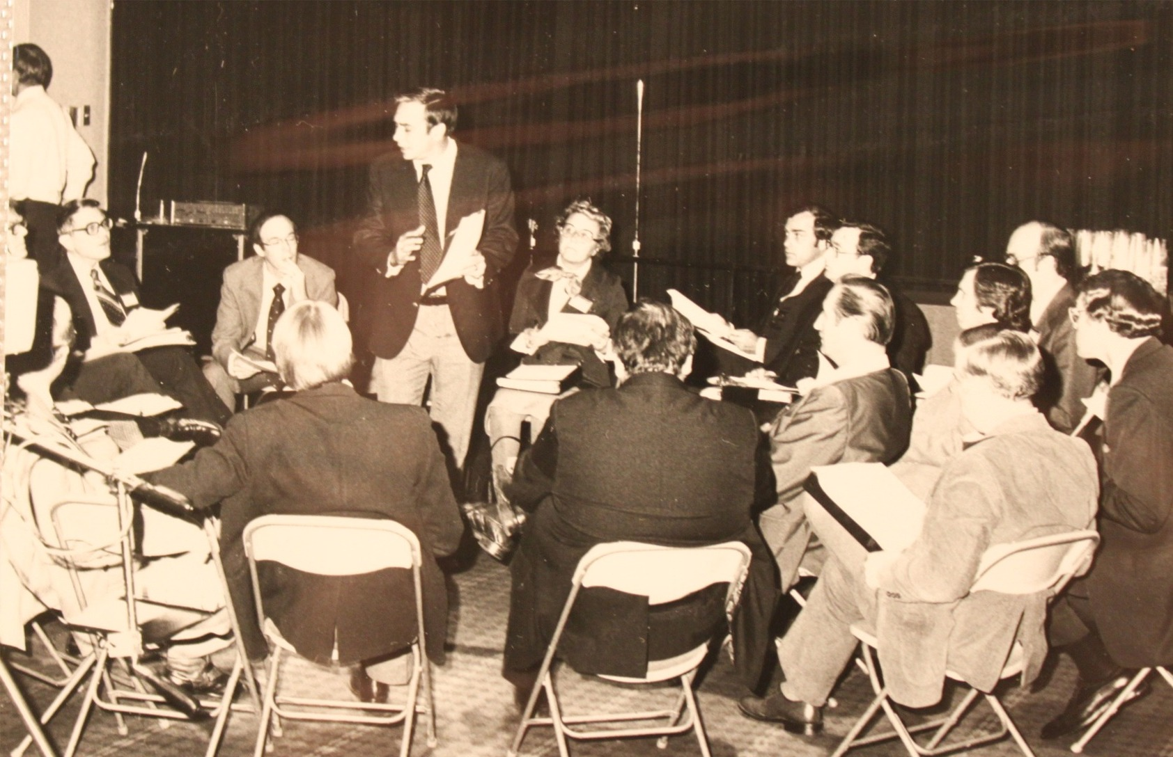
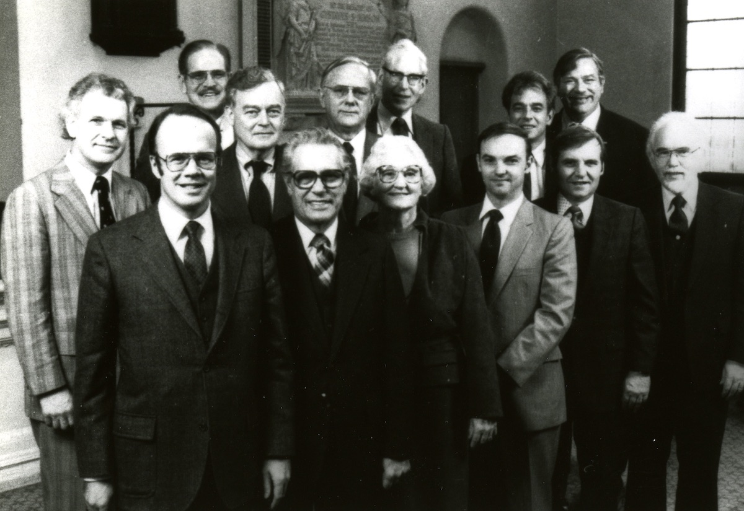
International Council on Biblical Inerrancy
Chicago, October 1978

Slide 58
The Chicago Statement on Inerrancy (1982)
”We affirm that the whole of Scripture and all its parts, down to the very words of the original, were given by divine inspiration. We deny that the inspiration of Scripture can rightly be affirmed of the whole without the parts, or of some parts but not the whole.” (Article 6)
“We affirm that God in His work of inspiration utilized the distinctive personalities and literary styles of the writers whom He had chosen and prepared. We deny that God, in causing these writers to use the very words that He chose, overrode their personalities.” (Article 8)

Slide 59
LET’S DISCUSS
Why is it important for us to understand and believe in BOTH the Divine and Human origins of scripture? What do you lose if you deny one or the other?
Have you ever heard the term “verbal plenary inspiration” before? Why is it important that all of scripture and all of the words of scripture are inspired?
How are these doctrines useful to us today in the church and life?

Slide 60
5 Minute Break
Stretch
Use the washroom

Slide 61
SCRIPTURE’S AUTHORITY
SECTION OUTLINE
Sola Scriptura
Biblical Case
Historical Support
2 Major Errors
What do we mean by ‘the Bible is authoritative’?

Slide 62
“The authority of Scripture means that all the words in Scripture are God’s words in such a way that to disbelieve or disobey any word of Scripture is to disbelieve or disobey God.”
SYSTEMATIC THEOLOGY, p.73
Wayne Grudem

Slide 63
A. SOLA SCRIPTURA
This doctrine of the authority of scripture was what was labeled in the Protestant Reformation the doctrine of “Sola Scriptura” - a Latin phrase meaning “Scripture Alone.”
It was called the “formal principle” of the Reformation. Scripture “formed” or was the foundation of the Reformers’ beliefs on Christian doctrines and practice.

Slide 64
Dr. James R. White
“The Bible claims to be the sole and sufficient infallible rule of faith for the Christian church. The Scriptures are not in need of any supplement; their authority comes from their nature as God-breathed revelation; their authority is not dependent upon man, church, or council. The Scriptures are self-consistent, self-interpreting, and self-authenticating. The Christian church looks to the Scriptures as the only infallible and sufficient rule of faith, and the church is always subject to the Word, and is constantly reformed thereby.” (James R. White, Scripture Alone, p. 28)

Slide 65
A. SOLA SCRIPTURA
Misunderstanding Sola Scriptura
It is NOT that we believe in reading and interpreting Scripture in isolation, or apart from the rest of God’s work in the church as a whole.
It is NOT the idea of “me and my Bible alone in my room and what I feel it means to me.”

Slide 66
Westminster Confession of Faith (1647)
“We may be moved and induced by the testimony of the Church of God to an high and reverent esteem of the Holy Scripture, and the heavenliness of the matter, the efficacy of the doctrine, the majesty of the style… the full discovery it makes of the only way of man’s salvation, the many other incomparable excellencies…
…yet, notwithstanding, our full persuasion and assurance of the infallible truth, and divine authority thereof, is from the inward work of the Holy Spirit bearing witness by and with the word in our hearts.”
(WCF 1:5)

Slide 67
A. SOLA SCRIPTURA
We affirm BOTH that Scriptures must be understood and read corporately in the Church and also that it is the testimony of the Holy Spirit through the Scriptures which helps us understand personally.
The Church aids us in our interpretation, appreciation, esteem and reverence of scripture (through pastors, theologians, etc).
Many Christians today don’t make use of the 2000 years of amazing church writers and theologians who have gained many insights into scripture and instead practically try to reinvent the wheel every time they approach scripture leading to new and erroneous interpretations.

Slide 68
R.C. Sproul (1939 – 2017)
Scripture is, as R.C. Sproul put it, the “norma normans non normata” - that is, Scripture is the rule of rules which cannot be ruled - it is the norm of norms.
All other ‘authorities’ (such as teachers, church confessions, books, etc) are only authoritative in so far as they point to the ultimate authority of God’s Word and clearly and accurately communicate its intended meaning.

Slide 69
B. THE BIBLICAL CASE
This is probably one of the most attested doctrines in scripture - and there would be too many references to do a thorough study here.
Hopefully a few case study examples will suffice to answer the question of “why do we believe the Bible is the ultimate authority?”

Slide 70
I. The Bible is God’s Word
The often used introductory phrase, “Thus says the Lord” appears hundreds of times.

Slide 71
“…when the prophets say, “Thus says the Lord,” they are claiming to be messengers from the sovereign King of Israel, namely, God himself, and they are claiming that their words are the absolutely authoritative words of God. When a prophet spoke in God’s name in this way, every word he spoke had to come from God, or he would be a false prophet (cf. Num. 22:38; Deut. 18:18–20; Jer. 1:9; 14:14; 23:16–22; 29:31–32; Ezek. 2:7; 13:1–16).”
SYSTEMATIC THEOLOGY, p.74
Wayne Grudem

Slide 72
I. The Bible is God’s Word
The often used introductory phrase, “Thus says the Lord” appears hundreds of times.
God speaks “through” the prophets (see 1 Kings 14:18; 16:12, 34; 2 Kings 9:36; 14:25; Jer. 37:2; Zech. 7:7, 12)
Everything the prophets say in God’s Name is what God says (see 1 Kings 13:26 with v. 21; 1 Kings 21:19 with 2 Kings 9:25–26; Hag. 1:12; cf. 1 Sam. 15:3, 18)
Therefore, to disbelieve or disobey what the prophet said is to disbelieve and disobey God himself (see Deut. 18:19; 1 Sam. 10:8; 13:13–14; 15:3, 19, 23; 1 Kings 20:35, 36)

Slide 73
I. The Bible is God’s Word
Jesus uses the Scriptures as the authoritative source in disputes with the Pharisees.
For example: Matthew 19:4-6 – Jesus quotes Genesis 2:24 to resolve the Pharisees’ question about marriage and the afterlife.

Slide 74
Matthew 19:4-6
He answered, “Have you not read that he who created them from the beginning made them male and female, and said, ‘Therefore a man shall leave his father and his mother and hold fast to his wife, and the two shall become one flesh’? So they are no longer two but one flesh. What therefore God has joined together, let not man separate.”

Slide 75
I. The Bible is God’s Word
Jesus uses the Scriptures as the authoritative source in disputes with the Pharisees.
Many other passages could be cited (see Luke 1:70; 24:25; John 5:45–47; Acts 3:18, 21; 4:25; 13:47; 28:25; Rom. 1:2; 3:2; 9:17; 1 Cor. 9:8–10; Heb. 1:1–2, 6–7)

Slide 76
II. The Bible is Truthful
God cannot lie or speak falsely. Our God never lies (Titus 1:2) and in fact, it is impossible for God to lie (Hebrews 6:18).
Our God is not like sinful humanity that He should lie (Numbers 23:19).
All His Words are true (2 Samuel 7:28).
Because the Bible is God’s Word, we are also assured that it is truthful since it is the ‘unlying’ God speaking. Every word of God proves true (Proverbs 30:5).

Slide 77
III. The Bible is our Final Authority
Written scripture is the final form of God’s authoritative word.

Slide 78
“It is important to realize that the final form in which Scripture remains authoritative is its written form. It was the words of God written on the tablets of stone that Moses deposited in the ark of the covenant. Later, God commanded Moses and subsequent prophets to write their words in a book. And it was written Scripture (γραφή, G1210) that Paul said was “God-breathed” (2 Tim. 3:16). Similarly, it is Paul’s writings that are “a command of the Lord” (1 Cor. 14:37) and that could be classified with “the other scriptures” (2 Peter 3:16).”
SYSTEMATIC THEOLOGY, p.84-85
Wayne Grudem

Slide 79
III. The Bible is our Final Authority
Written scripture is the final form of God’s authoritative word.
Even our Lord Jesus Christ himself, when tempted in the wilderness in Matthew 4, did not appeal to human words or traditions, nor did he even appeal to his own opinions or preferences (though he was the Son of God, the Word incarnate!). He instead appealed to the written word of God to rebuke the Devil three times by quoting from Deuteronomy!

Slide 80
C. HISTORICAL SUPPORT
A more thorough treatment can be found in chapter 4 of Gregg R. Allison’s book Historical Theology.

Slide 81
Justin Martyr (100-165 AD)
For Justin Martyr, the authority of Scripture was due to its divine authorship; indeed, Scripture demands to “be believed for its own nobility and for the confidence due to him who sends it. Now the word of truth is sent from God.… For being sent with authority, it were not fit that it should be required to produce proof of what is said; since neither is there any proof beyond itself, which is God.”
(Justin Martyr, Fragments of the Lost Work of Justin on the Resurrection, 1, in ANF, 1:294)

Slide 82
Clement of Alexandria (150 – 215 AD)
“He, then, who of himself believes the Scripture and the voice of the Lord, which by the Lord acts to the benefit of men, is rightly regarded [as] faithful. Certainly, we use it as a criterion in the discovery of things.… We are by the voice of the Lord trained up to the knowledge of the truth.”
(Clement of Alexandria, Stromata, 7.16, in ANF, 2:551)

Slide 83
Augustine of Hippo (354 – 430 AD)
Augustine said that truth is to be discovered “both by sure reason and authority of holy Scripture… not by human judgment, but by authority of divine Scripture.” Elsewhere he wrote that, “holy Scripture sets a rule to our teaching… Therefore, let it not be for me to teach you any other thing except to expound to you the words of the Teacher, and to treat them as the Lord will have given to me.”

Slide 84
The Cambridge Declaration (1996)
“Today the light of the Reformation has been significantly dimmed. The consequence is that the word “evangelical” has become so inclusive as to have lost its meaning. We face the peril of losing the unity it has taken centuries to achieve. Because of this crisis and because of our love of Christ, his gospel and his church, we endeavor to assert anew our commitment to the central truths of the Reformation and of historic evangelicalism. These truths we affirm not because of their role in our traditions, but because we believe that they are central to the Bible.”

Slide 85
STILL A THREAT TODAY
The Abandonment of Scripture’s Authority
The outright rejection or neglect or functional denial of Sola Scriptura is still a very real threat to the church today…

Slide 86
D. TWO MAJOR ERRORS
The rejection of the inspiration & authority of Scripture
The neglect or functional denial of Sola Scriptura

Slide 87
D. TWO MAJOR ERRORS
I. The Rejection of the inspiration & authority of Scripture
This position contradicts the testimony of scripture itself and hence cannot even be properly called “Christian”. If we reject God’s word - how can we say to be followers of Him? This view is held by ‘liberal Christians’ - however, this is a whole other religion to Christianity entirely.
To reject the inspiration and authority of the Bible is to invent some other religion than Christianity.

Slide 88
D. TWO MAJOR ERRORS
II. The neglect or functional denial of Sola Scriptura
Functional Denial - is to put some other authority alongside scripture and consider it either equally authoritative or more authoritative.
Neglect - This happens when we close our Bibles and function in the world without the light and guidance of God’s Word. It happens when we trust our instincts and gut more than we trust the wisdom of God’s revealed Word. It happens when we forget what God has said and replace it with what the world says or what our friends or family say or what our own personal preferences are.

Slide 89
ASK YOURSELF
Have you ever deferred to some other authority to settle a matter of faith and practice which was not based on or derived from the ultimate authority of Scripture?
Have you ever been persuaded by or uncritically accepted the opinion or teaching of someone on a topic of faith (even this teacher!) without seeing how they based it on the proper interpretation of Scripture?
If so, you may have slipped into functional denial of Scripture’s authority.

Slide 90
ASK YOURSELF
Is there an area of my life where I have not sought to apply the truth of God’s Word?
Is there an area of my beliefs or lifestyle where I do not know what God says about it?
Does my Bible stay unopened daily?
Do I forget to apply myself to the study and memorization of God’s Word?
If so, then you may have slipped into neglecting Scripture’s authority.

Slide 91
“Throughout the history of the church the greatest preachers have been those who have recognized that they have no authority in themselves and have seen their task as being to explain the words of Scripture and apply them clearly to the lives of their hearers. Their preaching has drawn its power not from the proclamation of their own Christian experiences or the experiences of others, nor from their own opinions, creative ideas, or rhetorical skills, but from God’s powerful words…
SYSTEMATIC THEOLOGY, p.82
Wayne Grudem

Slide 92
…Essentially they stood in the pulpit, pointed to the biblical text, and said in effect to the congregation, “This is what this verse means. Do you see that meaning here as well? Then you must believe it and obey it with all your heart, for God himself, your Creator and your Lord, is saying this to you today!” Only the written words of Scripture can give this kind of authority to preaching.”
SYSTEMATIC THEOLOGY, p.82
Wayne Grudem

Slide 93
Herman Bavinck (1854 – 1921)
"It was not only 'God-breathed' at the time it was written; it is 'God-breathing.' It was divinely inspired, not merely while it was written, God breathing through the writers; but also, whilst it is being read, God breathing through the Scripture," so that "divine inspiration, accordingly, is a permanent attribute of Holy Scripture." (Bavinck, Reformed Dogmatics, 1:385)

Slide 94
Why is this glorious?
The Lord delights in everyone who ‘trembles at His Word’ (Isa. 66:2).
God continues to speak to us in and through Scripture today.
So the question to us is - are we listening to God speaking to us through the Bible and do we tremble at His Word?

Slide 96
GROUP PRAYER TIME
Forgive me for _________________ your Word.
God help me to __________________ your Word.
Thank you for the _______________ of your Word.

Slide 97
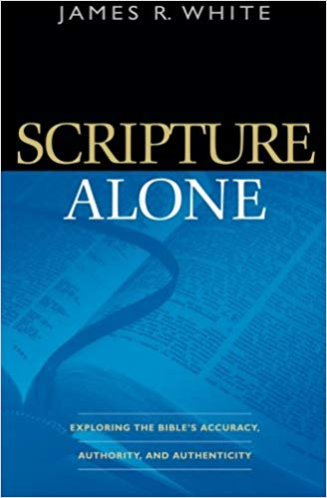
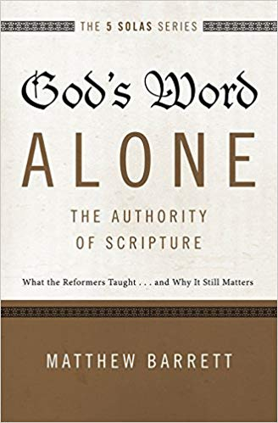
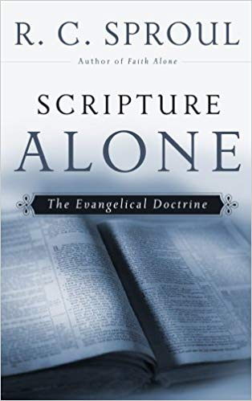
Scripture Alone: Exploring the Bible's Accuracy, Authority and Authenticity by James R. White
God's Word Alone: The Authority of Scripture: What the Reformers Taught...and Why It Still Matters by Matthew Barrett
Scripture Alone: The Evangelical Doctrine by R.C. Sproul

Slide 98
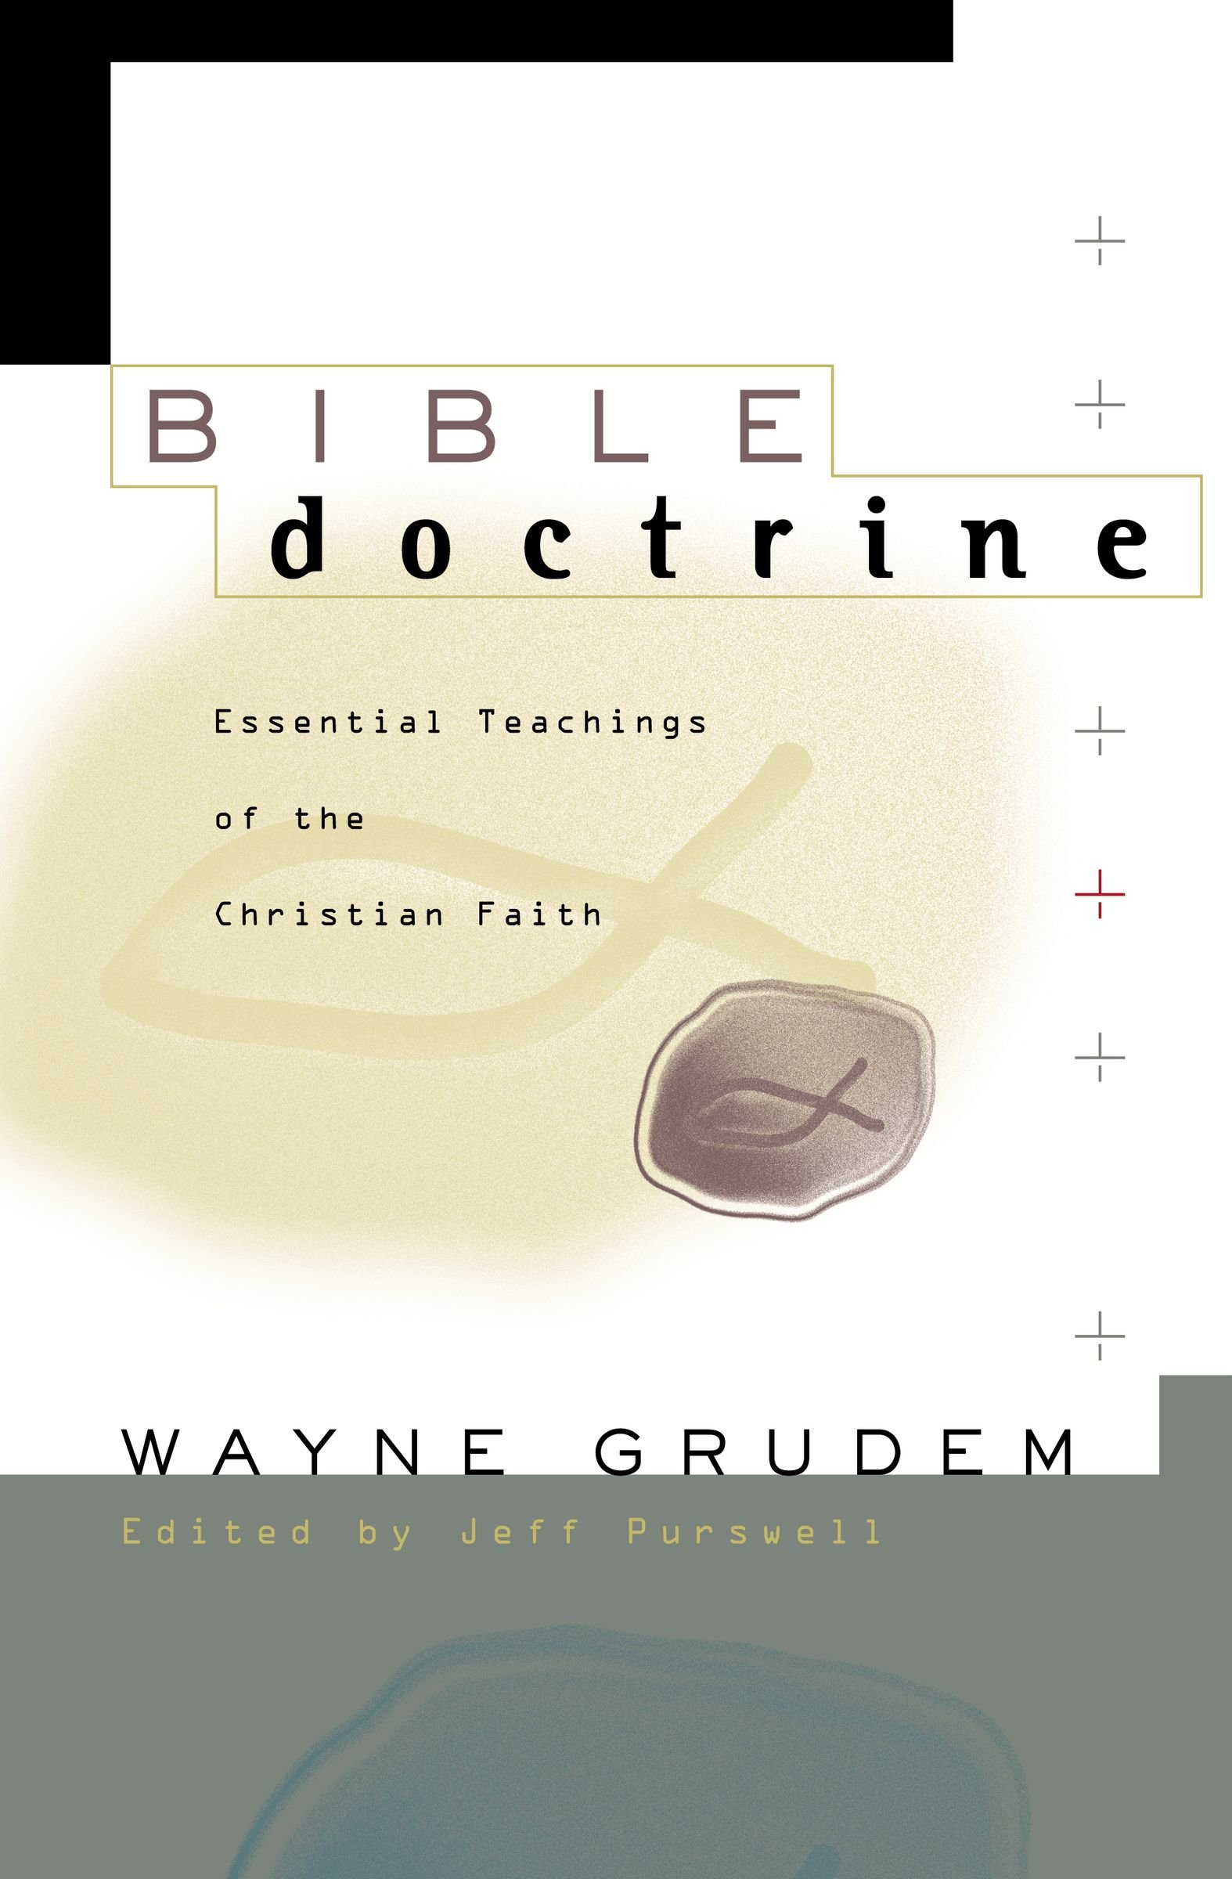
FOR NEXT SESSION
Read Grudem, Bible Doctrine, p.54-61 (if you own it)
If you don’t own it, read the teacher’s notes for this session which will be sent out via the class resources webpage. (link in your email)

Slide 99
Thanks for coming…
YOU ARE LOVED
See you next week!

