Slide 2
CLASS SESSIONS
Intro & Canon
Inspiration & Authority
Necessity & Sufficiency
Clarity & Interpretation
Inerrancy & Apologetic Challenges
OUTLINE OF TOPICS

Slide 3
CAN THE BIBLE BE UNDERSTOOD?

Slide 4
DEFINITION
“The clarity of Scripture means that the Bible is written in such a way that its teachings are able to be understood by all who will read it seeking God’s help and being willing to follow it.”
(Wayne A. Grudem, Bible Doctrine, pg 52)

Slide 5
SCRIPTURE’S CLARITY
SECTION OUTLINE
The Bible clearly affirms its own clarity
Prerequisites for right understanding
What about all the disagreements about what the Bible says?
How should we respond?
Can the Bible be understood?

Slide 6
DEFINITION
“The clarity of Scripture means that the Bible is written in such a way that its teachings are able to be understood by all who will read it seeking God’s help and being willing to follow it.”
(Wayne A. Grudem, Bible Doctrine, pg 52)

Slide 7
A. The Bible clearly affirms its own clarity

Slide 8
Deuteronomy 6:6-7
And these words that I command you today shall be on your heart. You shall teach them diligently to your children, and shall talk of them when you sit in your house, and when you walk by the way, and when you lie down, and when you rise.

Slide 9
Psalm 19:7
the testimony of the Lord is sure,
making wise the simple;

Slide 10
SCRIPTURE’S CLARITY
SECTION OUTLINE
The Bible clearly affirms its own clarity
Prerequisites for right understanding
What about all the disagreements about what the Bible says?
How should we respond?
Can the Bible be understood?

Slide 11
DEFINITION
“The clarity of Scripture means that the Bible is written in such a way that its teachings are able to be understood by all who will read it seeking God’s help and being willing to follow it.”
(Wayne A. Grudem, Bible Doctrine, pg 52)

Slide 12
1 Corinthians 2:14-16
The natural person does not accept the things of the Spirit of God, for they are folly to him, and he is not able to understand them because they are spiritually discerned. The spiritual person judges all things, but is himself to be judged by no one. “For who has understood the mind of the Lord so as to instruct him?” But we have the mind of Christ.

Slide 13
Thus, although the New Testament authors affirm that the Bible in itself is written clearly, they also affirm that it will not be understood rightly by those who are unwilling to receive its teachings. Scripture is able to be understood by all unbelievers who will read it sincerely seeking salvation, and by all believers who will read it while seeking God’s help in understanding it.
BIBLE DOCTRINE, p.51-52
Wayne Grudem

Slide 14
We can affirm that the Bible is written in such a way that all things necessary for our salvation and for our Christian life and growth are very clearly set forth in Scripture.
BIBLE DOCTRINE, p.52
Wayne Grudem

Slide 15
SCRIPTURE’S CLARITY
SECTION OUTLINE
The Bible clearly affirms its own clarity
Prerequisites for right understanding
What about all the disagreements about what the Bible says?
How should we respond?
Can the Bible be understood?

Slide 16
C. What about all the disagreements disagreements about what the Bible says?
I. The Bible is UNDERSTANDABLY clear, but not UNIFORMLY clear across all biblical topics

Slide 17
I. NOT UNIFORMLY CLEAR ACROSS ALL BIBLICAL TOPICS
Absolutes define the core beliefs of the Christian faith;
Convictions, while not core beliefs, may have significant impact on the health and effectiveness of the church;
Opinions are less-clear issues that generally are not worth dividing over;
Questions are currently unsettled issues.
Taken from ESV Study Bible, pg 2507

Slide 18
I. NOT UNIFORMLY CLEAR ACROSS ALL BIBLICAL TOPICS
How are issues categorized? 7 considerations:
biblical clarity
relevance to the character of God
relevance to the essence of the gospel
biblical frequency and significance (how often in Scripture it is taught, and what weight Scripture places upon it)
effect on other doctrines
consensus among Christians (past and present)
effect on personal and church life.
Taken from ESV Study Bible, pg 2507

Slide 19
I. NOT UNIFORMLY CLEAR ACROSS ALL BIBLICAL TOPICS
“The ability to rightly discern the difference between core doctrines and legitimately disputable matters will keep the church from either compromising important truth or needlessly dividing over peripheral issues.”
Taken from ESV Study Bible, pg 2507

Slide 20
II. ULTIMATELY, THE PROBLEM IS NOT SCRIPTURE…THE PROBLEM IS US
When we misunderstand the Bible, the problem lies with:
Our HEARTS
Our MINDS

Slide 21
OUR HEARTS (HEBREWS 3:15)
As it is said,
“Today, if you hear his voice,
do not harden your hearts as in the rebellion.”

Slide 22
OUR MINDS (2 PETER 3:15-16)
And count the patience of our Lord as salvation, just as our beloved brother Paul also wrote to you according to the wisdom given him, as he does in all his letters when he speaks in them of these matters. There are some things in them that are hard to understand, which the ignorant and unstable twist to their own destruction, as they do the other Scriptures.

Slide 23
SCRIPTURE’S CLARITY
SECTION OUTLINE
The Bible clearly affirms its own clarity
Prerequisites for right understanding
What about all the disagreements about what the Bible says?
How should we respond?
Can the Bible be understood?

Slide 24
I. BE EXPECTANT. THE BIBLE IS CLEAR!
the testimony of the Lord is sure,
making wise the simple;
Ps 19:7 -

Slide 25
II. FEAR GOD. THIS IS THE BEGINNING OF WISDOM
the testimony of the Lord is sure,
making wise the simple;
Ps 19:7 -
The fear of the LORD is the beginning of knowledge;
fools despise wisdom and instruction.
- Prov 1:7 -

Slide 26
II. FEAR GOD. THIS IS THE BEGINNING OF WISDOM.
The fear of the LORD is the beginning of knowledge;
fools despise wisdom and instruction.
- Prov 1:7 -
PRAY:
“HELP US TREMBLE BEFORE YOU
ESPECIALLY WHEN _____________”

Slide 27
III. WORK HARD TO RIGHTLY HANDLE GOD’S WORD
Do your best to present yourself to God as one approved, a worker who has no need to be ashamed, rightly handling the word of truth.
- 2 Tim 2:15 -

Slide 28
III. WORK HARD TO RIGHTLY HANDLE GOD’S WORD
The brothers immediately sent Paul and Silas away by night to Berea, and when they arrived they went into the Jewish synagogue. Now these Jews were more noble than those in Thessalonica; they received the word with all eagerness, examining the Scriptures daily to see if these things were so.
- Acts 17:10-11-

Slide 29
SCRIPTURE’S CLARITY
SECTION OUTLINE
The Bible clearly affirms its own clarity
Prerequisites for right understanding
What about all the disagreements about what the Bible says?
How should we respond?
Can the Bible be understood?

Slide 30
SCRIPTURE’S INTERPRETATION
SECTION OUTLINE
Why Study the Bible?
How to Study the Bible
Bible Study practice
How do we understand Scripture?

Slide 31
WHAT ARE WAYS TO MISINTERPRET SCRIPTURE?
What are some ways you have heard people misinterpret the Bible?

Slide 32
WHY WE MISUNDERSTAND SCRIPTURE
The problem is that sin/fallenness affects our:
HEARTS
MINDS

Slide 33
A. WHY STUDY THE BIBLE?
“Isn’t it amazing that almost everyone living in the West has an opinion to offer about the Bible, and yet so few have really studied it?” (R.C. Sproul)

Slide 34
R.C. Sproul (1939 – 2017)
“There is a great deal of difference between reading and studying. Reading is something we can do in a leisurely way, something that can be done strictly for entertainment in a casual manner. But study suggests labour, serious and diligent work. Here is the real problem of our negligence: We fail in our duty to study God’s Word not so much because it is difficult to understand, not so much because it is dull and boring, but because it is work. Our problem is not a lack of intelligence or a lack of passion. Our problem is that we are lazy.”

Slide 35
A. WHY STUDY THE BIBLE?
You cannot avoid theology.
Either you will be a bad theologian or a good one, but you cannot help but be a theologian.
The essential question is: “From where do you derive your theology?”

Slide 36
A. WHY STUDY THE BIBLE?
To Know God (1 Sam. 3:7)
To Know God’s Will (1 Thes 4:3 & 5:18)
To Grow in Godliness (2 Tim. 3:16 & Cor. 3:18)
To Defend Ourselves (Eph. 6:17)
To Be Fruitful (2 Tim. 3:17; Psa. 1:2-3; Matt. 13:23)
For Your Joy (Psa. 119:162)
To Fuel Your Prayers (1 John 4:14-15 & John 15:7-11)

Slide 37
A. WHY STUDY THE BIBLE?
Even though we may not fully understand every minute detail of Scripture, we can understand - through the use of ordinary means - the main things the Bible is meant to communicate to us.

Slide 38
CLARITY’S APPLICATION
Much of the method we will discuss today to approach studying the Bible will seem obvious and even simple - but that’s the point!
You can understand what God has said, because God is not an ineffective communicator.
He said something and He meant for us to understand what He has said.

Slide 39
“The idea that the Bible is clear does not obviate the need for interpretation but, on the contrary, makes the work of interpretation even more important. The clarity of Scripture means that understanding is possible, not that it is easy… The clarity of Scripture, in other words, does not mean that we will know everything there is to know about the text, but that we will know enough to be able, and responsible, to respond to its subject matter.”
Is There a Meaning in this Text? p.317
Kevin J. Vanhoozer

Slide 40
2 Timothy 2:15
“Do your best to present yourself to God as one approved, a worker who has no need to be ashamed, rightly handling the word of truth.”

Slide 41
“Rightly Handling” the Word
The Greek word translated “rightly handling” is the word ὀρθοτομοῦντα (orthotomounta).
It combines two words that mean “straight” (ortho) and “cut” (tomeō).
It means to make a straight cut.

Slide 42
“Rightly Handling” the Word
We must do our best to rightly handle the Word of God.
Use all the resources, intellect, and help that God has blessed you with access to so that you can rightly understand His Word.

Slide 43
B. HOW TO STUDY THE BIBLE
There is a right and a wrong way to study the Bible.

Slide 44
A DANGER TO AVOID
“NARCEGESIS”
“Narcegesis” happens when someone constantly reads themselves into the text of Scripture, or makes Scripture all about themselves, or reads it primarily through their own personal lens.
We don’t want to be doing ‘narcegesis’ because the Bible is not about you!

Slide 45
To be sure, the Bible is FOR you. But it is not primarily about you.
The Bible is all about God - and primarily about pointing us to Jesus Christ!

Slide 46
A DANGER TO AVOID
DON’T NARCEGETE SCRIPTURE
Before we get to “what does this passage mean to me” we must ask the primary question “what does this passage mean?”
What did it mean to the original author - what was their intent - what did they want their readers to understand?

Slide 47
“Hermeneutics is the science that teaches us the principles, laws, and methods of interpretation.”
Principles of Biblical Interpretation, p.11
Louis Berkhof

Slide 48
B. HOW TO STUDY THE BIBLE
OBSERVE: “What does the passage say?”
INTERPRET: “What does the passage mean?”
APPLY: “How does the passage transform us?”

Slide 49
I. OBSERVE
“The quality of your interpretation will always depend on the quality of your observation.” (Hendricks)
KEY for this section: MOVE FROM BIG TO SMALL
We observe by noticing and asking questions of the text.

Slide 51
I. OBSERVE
Your main focus at this stage is the text in front of you.
Note the characters, content and context.

Slide 52
I. OBSERVE
A. STRUCTURE (Paragraphs) - BIG
What is the tone of the passage?
What themes are repeated?
What structure can I see in the text? Is it grouped or arranged a certain way?
Are there transitions in the text? Does the focus shift or does the tone change?
What is this section telling me? Is it describing something or prescribing something to me? (indicative or imperative?)
Who are the characters in the text?

Slide 53
I. OBSERVE
B. SENTENCES (Verses) - MEDIUM
Is there anything of note about the order of words or how the sentence is constructed?
What do I observe about the grammar? What is the main verb? Who/what is the subject/object? Is anything modifying the verb (adverb)? What are the adjectives (descriptive words)?
What are the linking words? (conjunctions and prepositions - e.g. “and, or, but, then, therefore, so that, etc…”)
Are there any OT references, quotes or allusions in the text?

Slide 54
I. OBSERVE
C. WORDS (Phrases) - SMALL
What words stand out to me?
Are any words repeated - either exactly or in synonyms?
Are there any words that are equated to each other?
Are there words that are opposite to each other (antonyms)?
Are there any words I don’t understand?
Are there any words that might have multiple definitions/meanings?

Slide 55
I. OBSERVE
At this point you are simply making observations. You’re looking. Note down your observations. Note down things that are confusing, surprising, interesting, etc. Don’t try to interpret them as yet.
Think of it as a crime scene. In this phase you’re gathering evidence. You don’t yet know the solution to the puzzle. You’re dusting for fingerprints, interrogating the witnesses, and taking pictures of the scene.

Slide 56
II. INTERPRET
KEY for this section: CONTEXT IS KING
If we were to continue our detective analogy, in this phase, you’re investigating and examining the evidence you collected. You’re trying to put it together and figure out the big story that it makes sense within.

Slide 57
II. INTERPRET
Your main focus at this stage is the author’s intent.
How do the characters, content and context convey meaning?

Slide 58
D.A. Carson (Theologian & Professor)
"Careful handling of the Bible will enable us to 'hear' it a little better. It is all too easy to read the traditional interpretations we have received from others into the text of Scripture. Then we may unwittingly transfer the authority of Scripture to our traditional interpretations and invest them with a false, even idolatrous, degree of certainty. Because traditions are reshaped as they are passed on, after a while we may drift far from God's Word while still insisting all our theological opinions are 'biblical' and therefore true."

Slide 59
John Piper (Pastor & Author)
“…do unto authors as you would have them do unto you.”

Slide 60
II. INTERPRET
A. STRUCTURE (Paragraphs) - BIG
Where do these paragraphs occur in the book/letter? (e.g. 1 Cor. 13) How does this affect how we read it?
What is the genre of this section of Scripture? (e.g. poem vs. recipe)
What is the historical time period and cultural environment in which it was written? (e.g. Mark 14:4-5 – “300 denarii”)
Who was the original author and audience? Who wrote it and to whom was it written?

Slide 61
II. INTERPRET OBSERVATIONS
A. STRUCTURE (Paragraphs) - BIG
What is the tone of the passage? – rebuke, encouragement, joyful, sad, mourning, frustrated, concerned, serious, sarcastic, etc. - the tone can drastically change its intended meaning!
What themes are repeated? - this may be a marker to us that this is an important concept in this section of Scripture. So we direct our focus primarily to understand that concept.
Are there parallel thoughts/concepts? Is it grouped or arranged a certain way? Why is it arranged that way? - the author is trying to draw your attention to something specific or is arranging it in a way that is memorable.

Slide 62
II. INTERPRET OBSERVATIONS
A. STRUCTURE (Paragraphs) - BIG
Are there transitions in the text? Does the focus shift or does the tone change? - this helps us see when there is a change within the text that affects how we read that portion.
Is it describing something or prescribing something to me? - if we read indicatives like they are imperatives, we may end up thinking we have to do something when really the passage is telling us what’s already been done! Mixing up description with prescription turns theology upside down. Is it telling me to believe something or to do something?

Slide 63
II. INTERPRET OBSERVATIONS
B. SENTENCES (Syntax) - MEDIUM
What are the verse(s) immediately before and after a passage? - does this affect the way you read the sentence? What information does it give you to help make sense of that sentence?
Is there anything of note about the order of words or how the sentence is constructed? - perhaps the order of a list of things might indicate the order of importance or priority. Perhaps it is constructed oddly, is there a reason why?
OT references/quotes/allusions – how does the context of the OT quote inform the text we’re studying?

Slide 64
II. INTERPRET OBSERVATIONS
B. SENTENCES (Syntax) - MEDIUM
What do I observe about the grammar? What is the main verb? - A simple tip for finding the main verb (as it may not be as obvious in English) is to ask “what is the intended outcome or take-away of the sentence?”
What are the linking words? – How do the linking words relate the different clauses or ideas in the sentences? Do they oppose them to each other (but/on the other hand)? Do they connect them (and/also)? Does it build upon one another (additionally/furthermore)? Does one explain the other (because/for)? Does it state the purpose (in order that/so that)?

Slide 65
II. INTERPRET OBSERVATIONS
C. WORDS (Semantics) - SMALL
What words stand out to me?
Are any words repeated - either exactly or in synonyms? Are any words equated to each other? Why is this significant?
Are there any words that are antonyms? Why is this significant?
Are there any words I don’t understand? Look them up.
What are the possible range of meanings for this word? What makes the most sense in context?

Slide 66
II. INTERPRET OBSERVATIONS
SOME TIPS:
Trouble with words - If you’ve done the previous steps well, that should solve most interpretive problems.
Look for answers first in the text itself. Often times the text answers its own questions if we keep on reading.
If you’re still stuck, consult a Study Bible, Commentary or Bible Dictionary to help you.
OT allusions/quotes/references are often key to understanding NT passages that use them.

Slide 67
WORD STUDIES
Some dangers…
“The butterfly was lead here.”

Slide 68
WORD STUDIES
Some dangers…
Watch out for those who would try to hang too much on just one word alone without proper warrant from its context and the entire testimony of scripture - remember the first rule: context is king!

Slide 69
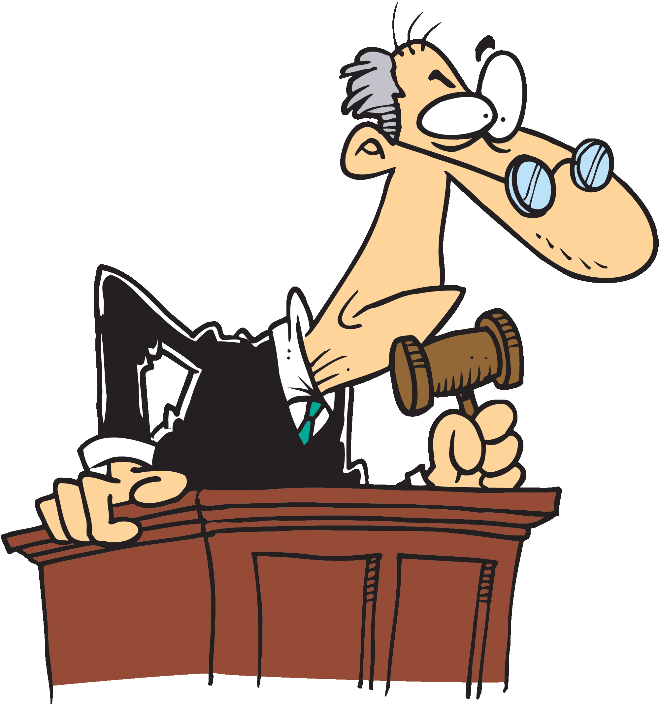
III. APPLY
KEY for this section: DON’T BE UNMOVED BY GOD’S WORD
If we were to stretch the detective analogy further, this stage would be taking all the evidence and results of your investigation before the judge to make a conviction of the criminal. (OK, I admit, this analogy is not perfect…)

Slide 70
III. APPLY
A. SUMMARIZE
What main point(s) has the text made? What’s the big idea?
What is the overall thrust—the persuasive logic—in this passage? Why should we believe the main point?
What were the important verses/sentences in this text?
What were the important words/phrases?
How would I explain this passage to a non-Christian? (missional aspect) or my 10-year old nephew? (discipleship aspect)

Slide 71
III. APPLY
B. HOW DOES IT TRANSFORM US?

Slide 72
James 1:22
“Do not merely listen to the word, and so deceive yourselves. Do what it says.”

Slide 73
HOW DOES IT TRANSFORM US?

Slide 74
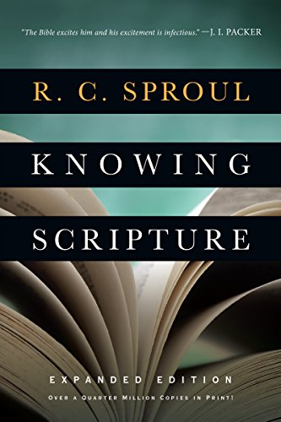
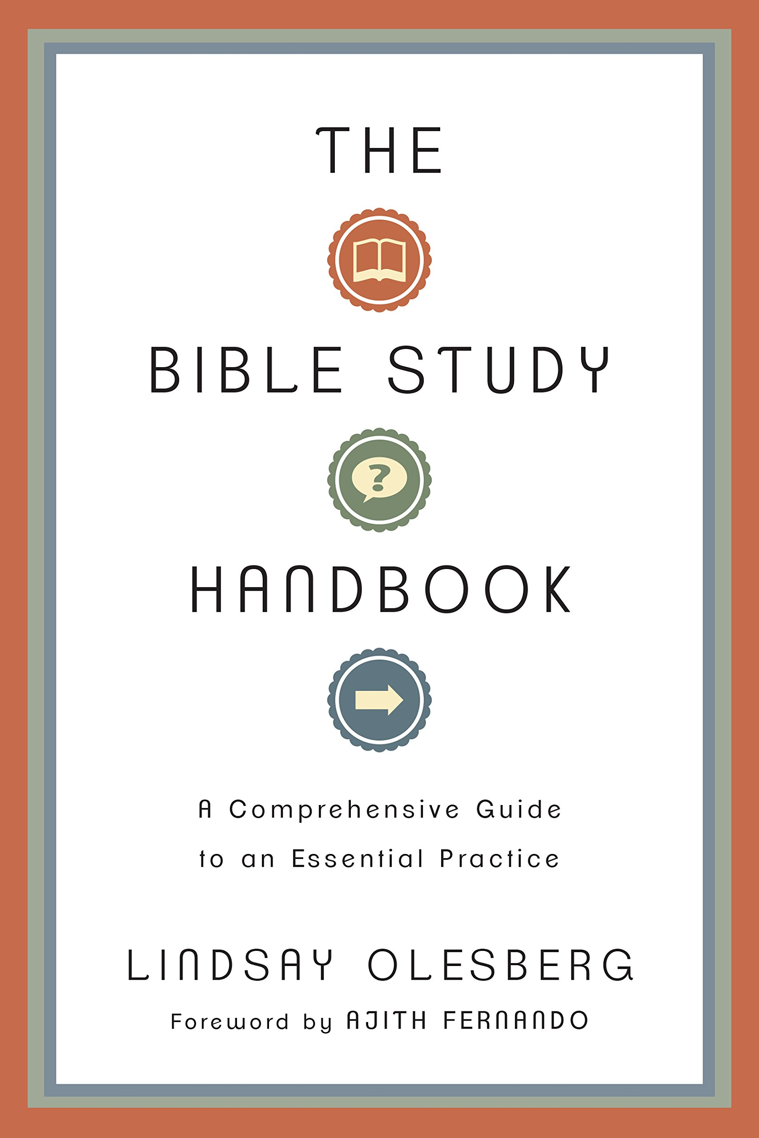
ON HOW TO STUDY THE BIBLE
A Visual Theology Guide to the Bible by Tim Challies
Knowing Scripture by R.C. Sproul
The Bible Study Handbook by Lindsay Olesberg
Inductive Bible Study by Andreas Kostenberger

Slide 75
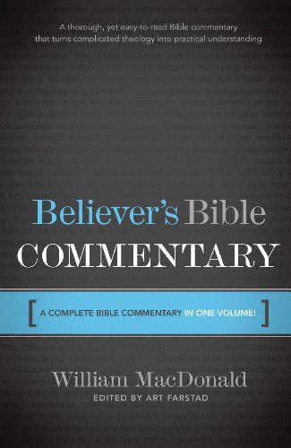
BIBLE STUDY TOOLS
ESV Study Bible by Crossway
The Believer’s Bible Commentary by William MacDonald
Best Commentaries List – Challies & Ligonier
Bible Software Apps – LOGOS, BibleWords, Accordance
Online FREE: BibleStudyTools.com, DesiringGod.org, Bible.org, BibleProject.com

Slide 76
C.BIBLE STUDY PRACTICE
PHILIPPIANS 1:12-30
OBSERVE > INTERPRET > APPLY

Slide 77
Thanks for coming…
YOU ARE LOVED
See you next week!

