Slide 2
CLASS SESSIONS
Intro & Canon
Inspiration & Authority
Necessity & Sufficiency
Clarity & Interpretation
Inerrancy & Translation
OUTLINE OF TOPICS

Slide 3
Matthew 24:35

Slide 4
Importance of these classes
Psalm 40:8 – our delight
2 Timothy 2:2 – Gospel multiplication
1 Peter 3:15-16 – ready to give an answer

Slide 5
SCRIPTURE’S INERRANCY
SECTION OUTLINE
Inerrancy Defined
Challenges to Inerrancy
Problems with Denying Inerrancy
Is the Bible without errors?

Slide 6
A. INERRANCY DEFINED
“The inerrancy of Scripture means that Scripture in the original manuscripts does not affirm anything that is contrary to fact.”
(Wayne A. Grudem, Systematic Theology, 90)
When we talk about the inerrancy of Scripture, we are talking about its truthfulness.

Slide 7
A. INERRANCY DEFINED
I. The Bible Speaks in Ordinary Language

Slide 8
“This is especially true in ‘scientific’ or ‘historical’ descriptions of facts or events. The Bible can speak of the sun rising and the rain falling because from the perspective of the speaker this is exactly what happens... From the standpoint of the speaker, the sun does rise and the rain does fall, and these are perfectly true descriptions of the natural phenomena the speaker observes.”
SYSTEMATIC THEOLOGY, p.91
Wayne Grudem

Slide 9
A. INERRANCY DEFINED
I. The Bible Speaks in Ordinary Language
Phenomenological language
Round numbers or measurements
Inerrancy has to do with truthfulness, not with the degree of scientific precision with which events are reported.

Slide 10
A. INERRANCY DEFINED
II. The Bible can contain loose quotations
“Bill said that he would come to the class a little early.”

Slide 11
“Written Greek at the time of the New Testament had no quotation marks or equivalent kinds of punctuation, and an accurate citation of another person needed to include only a correct representation of the content of what the person said (rather like our indirect quotations): it was not expected to cite each word exactly.”
SYSTEMATIC THEOLOGY, p.92
Wayne Grudem

Slide 12
A. INERRANCY DEFINED
II. The Bible can contain loose quotations
Inerrancy is consistent with loose or free quotations of the Old Testament or Jesus or someone else as long as the content is not false to what was originally said.

Slide 13
A. INERRANCY DEFINED
III. The Bible may have unusual grammar
We must recognize that the formalization of grammar and spelling did not become a widespread practice until more recent times.

Slide 14
“These stylistically or grammatically irregular statements (which are especially found in the book of Revelation) should not trouble us, for they do not affect the truthfulness of the statements under consideration: a statement can be ungrammatical but still be entirely true.”
SYSTEMATIC THEOLOGY, p.92
Wayne Grudem

Slide 15
A. INERRANCY DEFINED
III. The Bible may have unusual grammar
Inerrancy has to do with the truthfulness of the speech, not the perfection of the grammar by our modern standards.

Slide 16
B. CHALLENGES TO INERRANCY
I. Trying to limit inerrancy only to faith
This position would allow for Scripture to have false statements about other areas - such as historical details or scientific facts.

Slide 17
“For many this is an overwhelming argument that leads them to hold on to a form of scriptural authority that is limited to the “spiritual realm.” Supposedly, the Bible may be wrong about miracles or cosmology or creation, but it can safely be trusted in “spiritual matters.” Of course, this results in a complete disassociation of the “spiritual” from “everything else,” leaving these teachings hanging in midair with no foundation but feelings.”
SCRIPTURE ALONE, p.74
Dr. James R. White

Slide 18
The Bible affirms:
“ALL” of Scripture is inspired (God-breathed) and profitable (2 Tim. 3:16)
Completely pure (Ps. 12:6), perfect (Ps. 119:96) and true (Prov. 30:5)
We must believe everything laid down by the law and prophets (Acts 24:14 & Luke 24:25)
Whatever was written was written for our instruction (Rom. 15:4)

Slide 19
“If we begin to examine the way in which the New Testament authors trust the smallest historical details of the Old Testament narrative, we see no intention to separate out matters of “faith and practice,” or to say that this is somehow a recognizable category of affirmations, or to imply that statements not in that category need not be trusted or thought to be inerrant. Rather, it seems that the New Testament authors are willing to cite and affirm as true every detail of the Old Testament.”
SYSTEMATIC THEOLOGY, p.93
Dr. Wayne A. Grudem

Slide 20
B. CHALLENGES TO INERRANCY
I. Trying to limit inerrancy only to faith
If the Bible spoke falsely about historical details or scientific facts, then what confidence could we have that it speaks truthfully about the eternally important details of spiritual truth?!

Slide 21
B. CHALLENGES TO INERRANCY
II. Errors in the Transmission of Scripture
The Bible we hold today is obviously not the same as the parchment upon which Paul, Peter, or Moses wrote upon. What we have today is the product of thousands of copies from the originals which have been passed down through the centuries.
This is commonly referred to as the ‘Transmission’ of the text of Scripture.

Slide 22
IMPORTANT TERMS
Autograph - this refers to the original document which was written by the hand of the original human author.
Manuscripts - this refers to old copies of the documents of the Old and New Testament.
Variants - this refers to the variations or differences in one copy or manuscript to another.
Textual Criticism - this is the scholarly study of the form of the text of Scripture, based on comparing the available copies to us and the various variants between the manuscripts.

Slide 23
Chicago Statement on Biblical Inerrancy
“We affirm that inspiration, strictly speaking, applies to the autographic text of Scripture, which in the providence of God can be ascertained from available manuscripts with great accuracy. We further affirm that copies and translations of Scripture are the Word of God to the extent that they faithfully represent the original. We deny that any essential element of the Christian faith is affected by the absence of the autographs. We further deny that this absence renders the assertion of Biblical inerrancy invalid or irrelevant.”(Article 10)

Slide 24
The ‘Problem’ of Variants
Errors in Transmission…
No two copies before the invention of the printing press are exactly the same because they were hand-copied by various scribes of differing skills and accuracy.
Critical scholar Bart Ehrman -“there are more variants than there are words in the New Testament.” There are some 200,000-300,000 textual variants - and the total number of words in the Greek New Testament is 138,162 words. This sounds like a big problem on the surface and has led many a college freshman to abandon the faith in despair.

Slide 25
What is a ‘Variant’?
Any misspelling, omission of punctuation or accidentally skipping a word or line, etc - these all count as unique variants.
The reason we have so many variants is simply because we have so many copies!
The majority of the variants in the manuscripts are inconsequential and most of them are so minor they can’t even be translated.

Slide 26
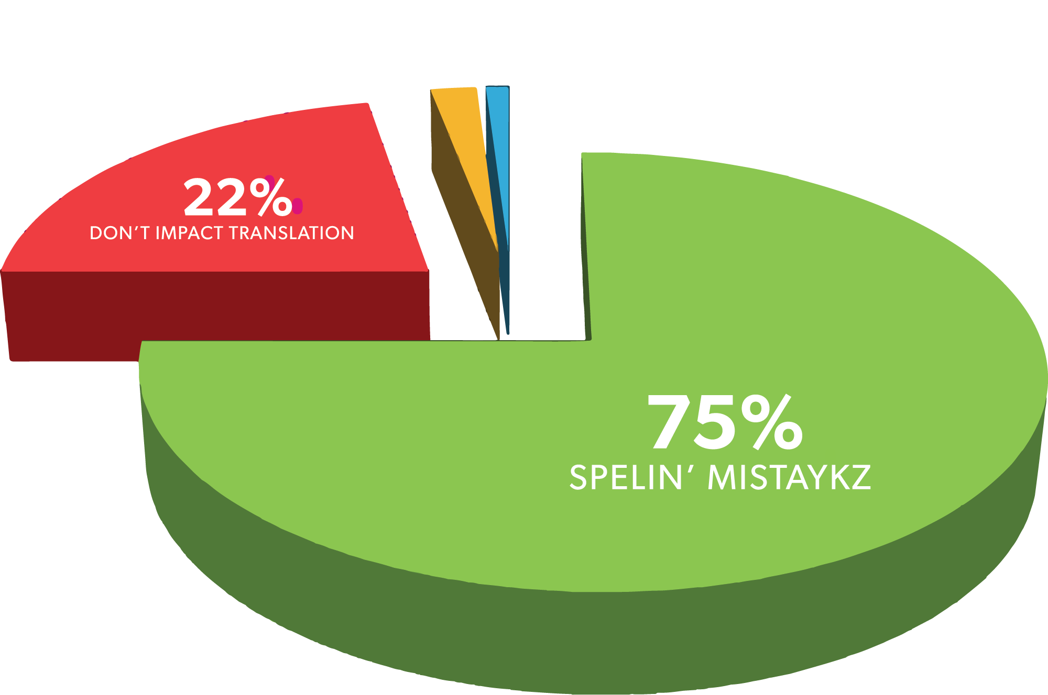

Slide 27
Bart D. Ehrman (Misquoting Jesus)
"To be sure, of all the hundreds of thousands of textual changes found among our manuscripts, most of them are completely insignificant, immaterial, of no real importance for anything other than showing that scribes could not spell or keep focused any better than the rest of us... In fact, most of the changes found in our early Christian manuscripts have nothing to do with theology or ideology. Far and away the most changes are the result of mistakes, pure and simple—slips of the pen, accidental omissions, inadvertent additions, misspelled words, blunders of one sort or another”

Slide 28
“...for over 99 percent of the words of the Bible, we know what the original manuscript said. Even for many of the verses where there are textual variants (that is, different words in different ancient copies of the same verse), the correct decision is often quite clear, and there are really very few places where the textual variant is both difficult to evaluate and significant in determining the meaning. In the small percentage of cases where there is significant uncertainty about what the original text said, the general sense of the sentence is usually quite clear from the context.”
SYSTEMATIC THEOLOGY, p.96
Dr. Wayne A. Grudem

Slide 29
The ‘Problem’ of Variants
Errors in Transmission…
The ‘Problem’ of Variants is really NO PROBLEM AT ALL.
The total number of variant readings that actually have any significance amount to less than 0.5%!
If you had any text that was 99.5% accurate, you would know with certainty what it said.

Slide 30
MISSING VERSES
Why are they not in modern translations?
Matthew 17:21
Matthew 18:11
Matthew 23:14
Mark 7:16
Mark 9:44
Mark 9:46
Mark 11:26
Mark 15:28
Luke 17:36
John 5:3–4
Acts 8:37
Acts 15:34
Acts 24:6–8
Acts 28:29
Romans 16:24
1 John 5:7–8

Slide 31
Is there a conspiracy?
You would find these ‘missing verses’ if you looked for them in a King James Version (KJV) of the Bible.
Are modern Bible translators removing Scripture?

Slide 32
Is there a conspiracy?
No. There is no conspiracy to remove verses.
This is simply explained by the fact that the KJV Bible was originally published in 1611, and the persons who produced the text of the KJV were using a manuscript collection called the Textus Receptus (received text).
At the time, this was the best collection of manuscripts available to the translators. These “missing verses” appear in those manuscripts of the Textus Receptus (abbreviated from now on as TR).

Slide 33
Comma Johannine
1 John 5:7-8
“For there are three that beare record in heaven, the Father, the Word, and the Holy Ghost: and these three are one. And there are three that beare witnesse in earth, the Spirit, and the Water, and the Blood, and these three agree in one.” (KJV 1611)
“For there are three that testify: the Spirit and the water and the blood; and these three agree.” (ESV)

Slide 34
Comma Johannine
The Comma Johannine doesn’t actually appear in any early Greek manuscripts of the NT. It actually first appears as an annotation in a Latin translation around the end of the 4th century. It was then back-translated into Greek, where it found its place within the Textus Receptus (TR) which the KJV was based on. It eventually ended up becoming part of the Latin Vulgate, and hence was kept in the Bible until better manuscript evidence was discovered.
Today we have much more and better manuscripts to translate from – this is why those verses were removed – because it can be proven that they weren’t original.

Slide 35
ADDING TO SCRIPTURE?
Doesn’t this show that scribes added to scripture?
No. The presence of these ‘extra verses’ in the TR and KJV shows us a tendency of the early scribes:
If they were ever unsure about a text of Scripture, whether it was original or not, they would rather keep it than throw it away because they did not want to lose anything that was Scripture. So the tendency was for the manuscript tradition to accumulate extra verses rather than lose verses.
When we compare the later manuscripts to earlier manuscripts, scholars are able to figure out what was original with a high degree of certainty.

Slide 36
Two Advantages of Variants
It shows us that at no time was there some council or powerful religious group that controlled the entirety of the text of the Bible.

Slide 37
“Never was there a time when any man, group of men, or church “controlled” the scriptural text. Even if a group had decided to alter it, they could never gather up all the copies already in existence; the means of travel would preclude such an attempt even if one was launched, for distribution of the copies would far exceed anyone’s ability to recover them all…”
SCRIPTURE ALONE, p.144
Dr. James R. White

Slide 38
Two Advantages of Variants
It shows us that at no time was there some council or powerful religious group that controlled the entirety of the text of the Bible.
Because there are variants, we are able to trace the transmission of the texts of Scripture.

Slide 39
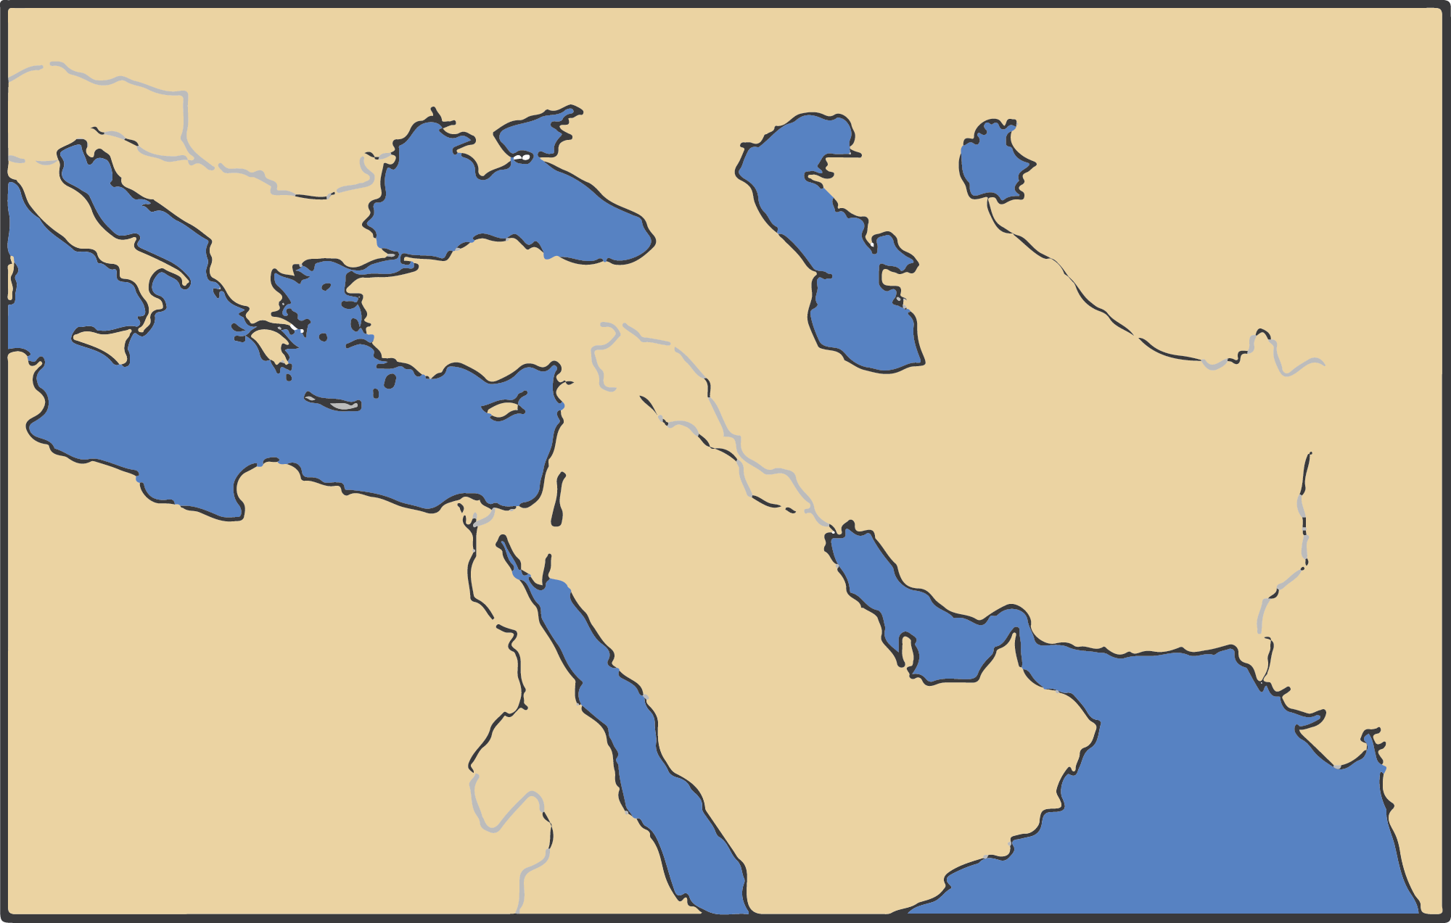
A
Scribes X & Y
Y Manuscript Family
A + X
A + Y
A + Y + F
Y
A + Y
X
A + X
A + Y + E
A + X + D
A + X + C
X Manuscript Family

Slide 40
“The original readings are still present, even when there are a number of options for a given word or phrase, but the benefit of knowing that the text has not been edited in wholesale fashion, as some assert, far outweighs the work we must invest in the study of textual variants.”
SCRIPTURE ALONE, p.144-145
Dr. James R. White

Slide 41
An Embarrassment of Wealth of Evidence

Slide 42
NT compared to other works of antiquity
There are over 5800 Greek manuscripts of the NT (not counting other translations) which is far more than any other comparable work of antiquity! Not only that, the dating of some of those manuscripts are far closer to when the originals were written than even the best comparable work of antiquity.

Slide 43
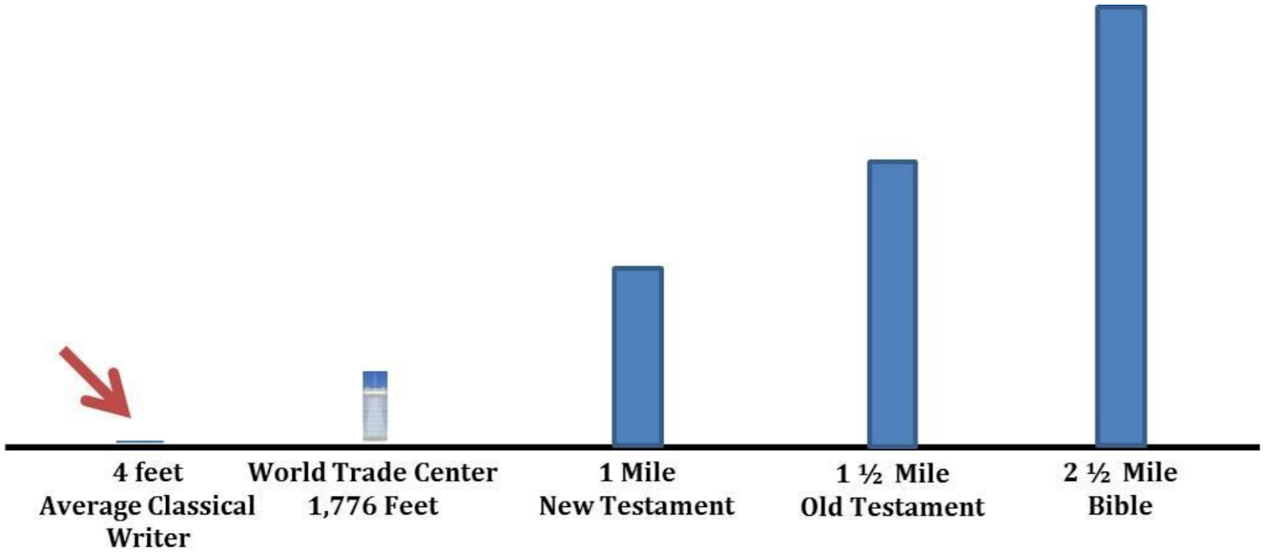
For the Greek NT alone there are more than 2.6 million pages. Combining both the Old and New Testament (the Bible) and there are more than 66,000 manuscripts and scrolls…
(Source: Dr. Josh MacDowell, The Bibliographical Test, available at josh.org)

Slide 44
Why is this important?
NOTHING TO HIDE!
Perhaps you’ve noticed in your Bibles little superscript numbers in the text and footnotes at the bottom of the text that say something like, “other manuscripts read this way…”
All the evidence is there for someone to look into every available variant if you wanted to.

Slide 45
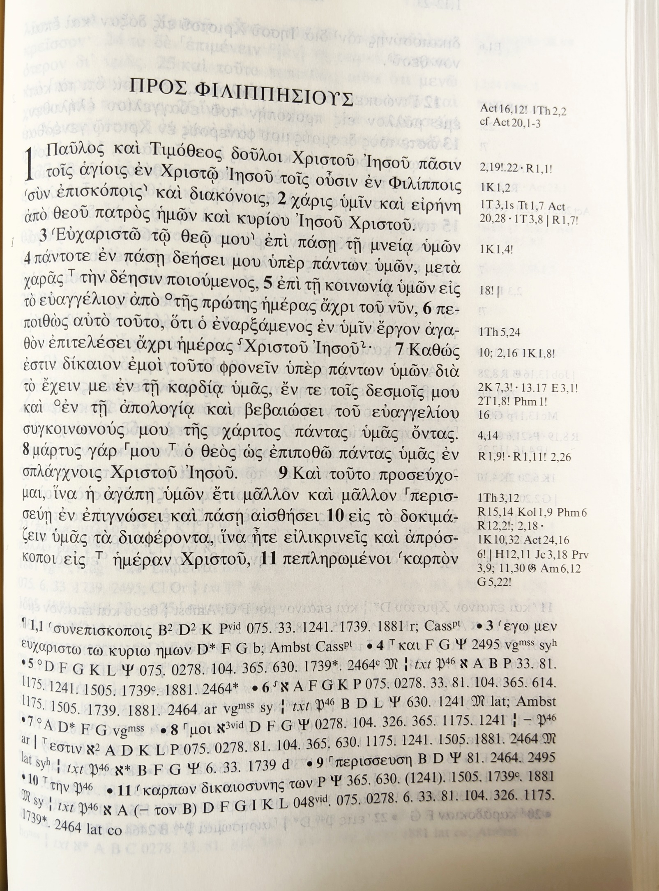
CRITICAL TEXT OF THE NT
(Nestle-Aland Greek NT – 28th edition)
Main Text
Contains the text of Scripture which is agreed upon by scholars as faithful to the original autographs
Cross-References
Textual Apparatus
Contains lists of all the major variants and what manuscripts they are found in. The different symbols and letters represent what type of variation (omission, different reading, etc.) and which manuscripts contain the variant reading.

Slide 46
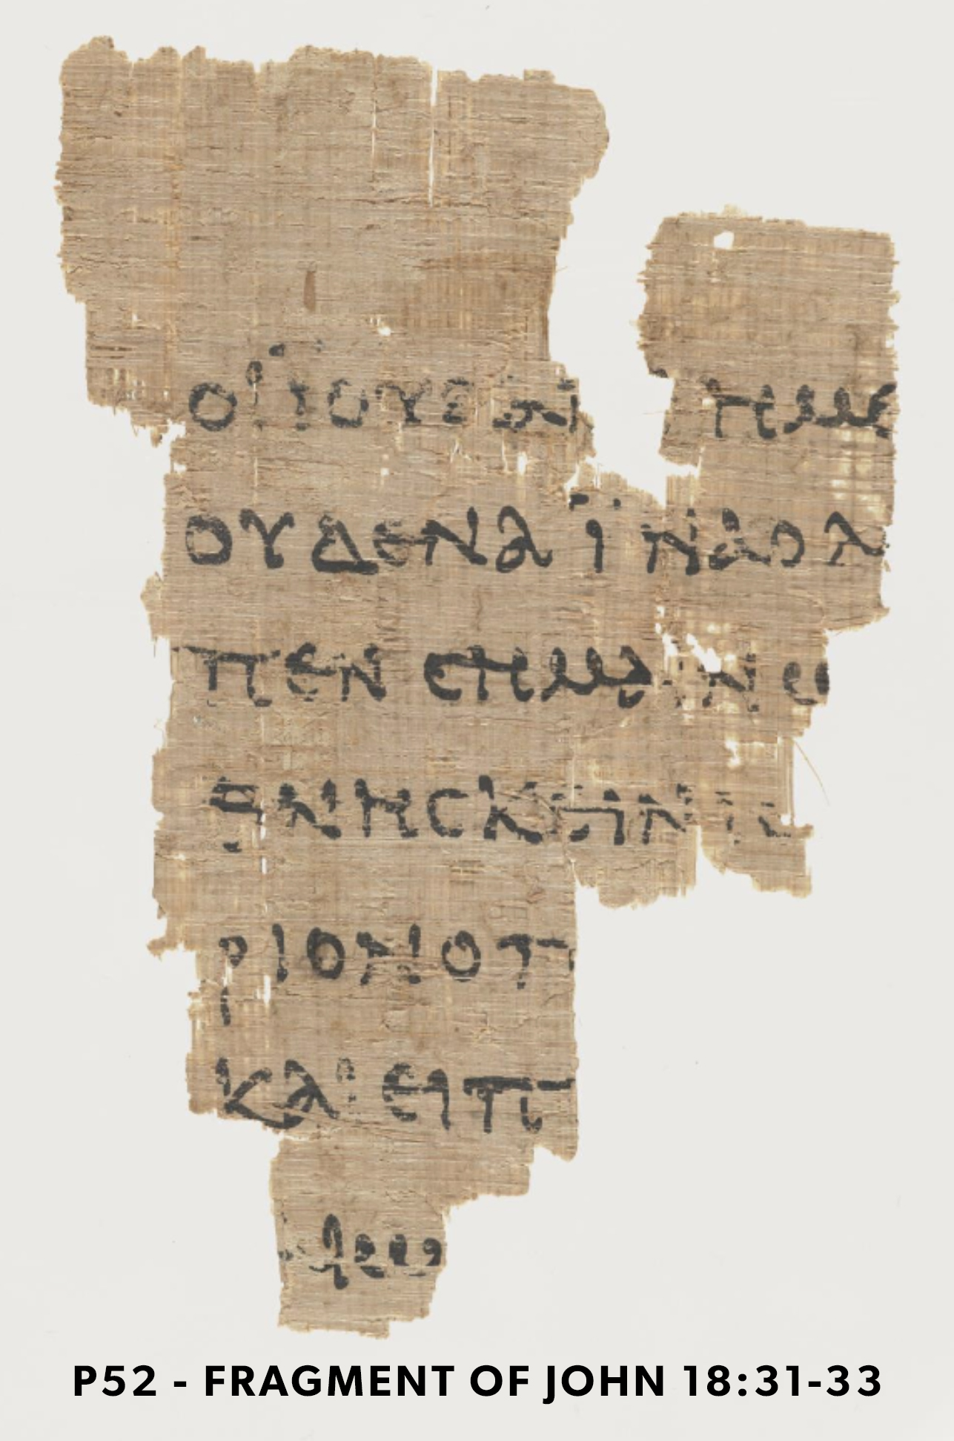
A LITTLE SHOW & TELL
Image from The Center for the Study of New Testament Manuscripts (cstm.org)
One of the most famous copies currently is P52 which is a copy of John dated to the beginning of the second century around 125 AD. This is only a few years after the original writing of John (around 90 – 100AD)!
We also have codices like the “Chester Beatty codex P45, dated c. 250, which contains all four canonical Gospels (Matthew, Mark, Luke, and John), which are followed by the book of Acts.” (Michael J. Kruger, Canon Revisited)

Slide 47
Lindisfarne Gospels
(8th Century)
Bristol Psalter
(11th Century)
Rossano Gospel (6th Century)

Slide 48
Dead Sea Scroll fragment
(c.408 BC - 318 AD)
Aleppo Codex
(10th Century)

Slide 49
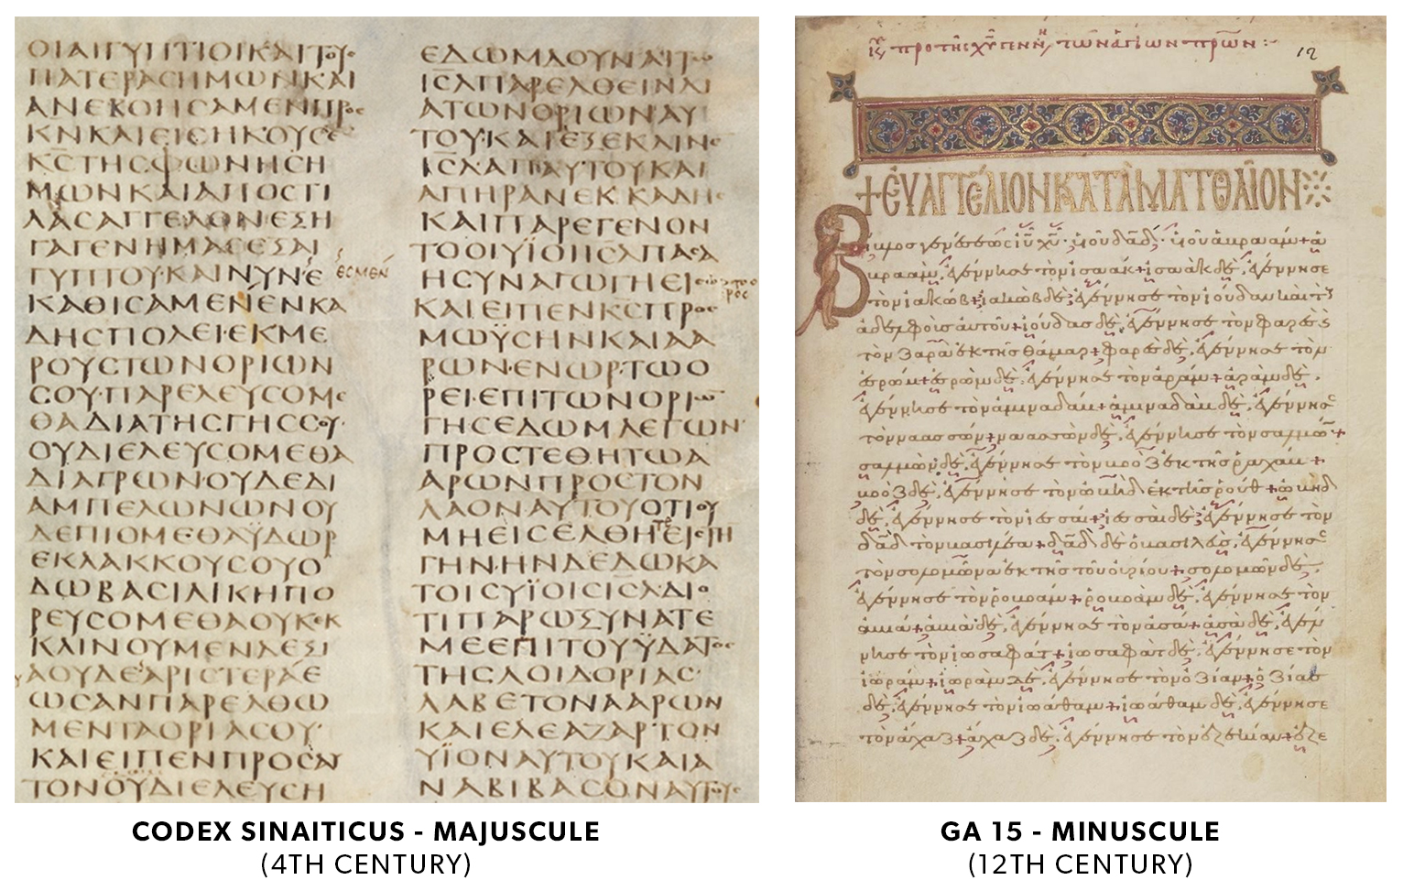

Slide 50
B. CHALLENGES TO INERRANCY
III. Alleged Errors in the Bible
Many of the alleged errors and contradictions in the Bible are not actually errors or contradictions of the text itself, but rather errors in understanding and interpretation by the reader. We must not confuse our ignorance of the correct meaning of a text with a legitimate error of the text.

Slide 51
“When we deal with Bible problems, then, it is important for us to be aware of these limitations, that is, to read humbly. When we are faced with a problem, it is no dishonour to say, “I don’t know how this can be resolved.” Scientists do that all the time, when they encounter a phenomenon that seems to run contrary to a theory they believe. When the evidence for the theory is otherwise substantial, the scientist rightly assumes that the phenomenon can somehow be reconciled to the theory, even if he doesn’t know how that will happen.”
The Doctrine of the Word of God, p.181
Dr. John Frame

Slide 52
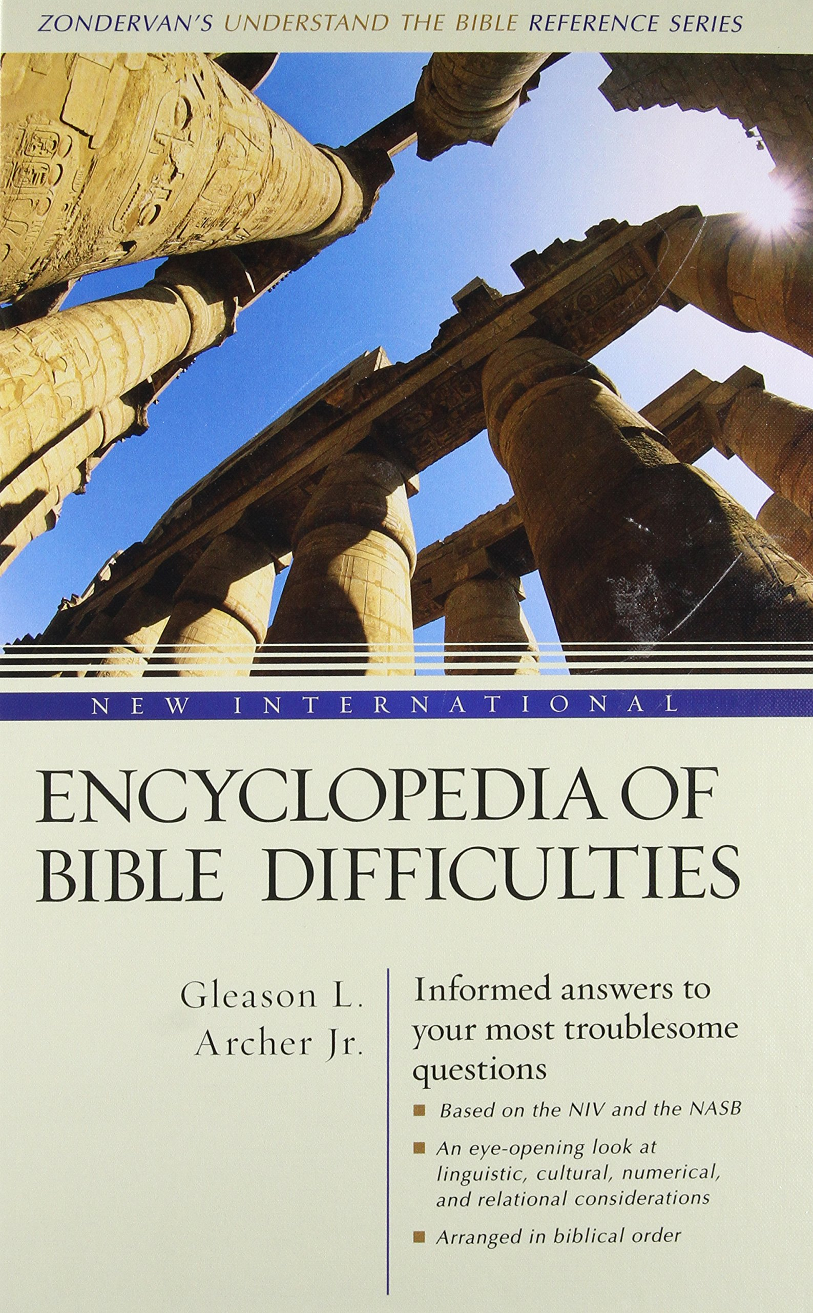
Keeping Faith in an Age of Reason: Refuting Alleged Bible Contradictions by Dr Jason Lisle
Encyclopedia of Bible Difficulties by Gleason L. Archer

Slide 53
C. PROBLEMS WITH DENYING INERRANCY
I. The Moral Problem: Does God lie?
II. The Trust Problem: Can we trust God?
III. The Pride Problem: We put ourselves above God’s Word
IV. The Doctrinal Problem: Where do we get our doctrine & theology?

Slide 54
F.F. Bruce (1910 – 1990)
“The evidence for our New Testament writings is ever so much greater than the evidence for many writings of classical authors, the authenticity of which no one ever dreams of questioning... if the New Testament were a collection of secular writings, their authenticity would generally be regarded as beyond all doubt.”
(F.F. Bruce, The New Testament Documents: Are They Reliable?, pg 10)

Slide 55
John 3:19
“And this is the judgment: the light has come into the world, and people loved the darkness rather than the light because their works were evil.”

Slide 56
WHY IS IT GLORIOUS?
The doctrine of the inerrancy of Scripture shows us God’s amazing providential care for His Word (to preserve and protect it from various threats through the centuries in a way that is so infinitely wise) so that YOU can have access to it, read it, study it, memorize it, and have your life transformed by it.

Slide 57
A Fun Exercise (John 1:1-3)
INTHEBEGINNINGWASTHEWORDANDTHEWORDWASWITHGODANDTHEWORDWASGODHEWASINTHEBEGINNINGWITHGODALLTHINGSWEREMADETHROUGHHIMANDWITHOUTHIMWASNOTANYTHINGMADETHATWASMADE

Slide 58
You’re a Scribe!
Ἐν ἀρχῇ ἦν ὁ λογοσ, καὶ ὁ λογος ἦν πρὸς τὸν θεον, καὶ θεὸς ἦν ὁ λογος. οὗτος ἦν ἐν ἀρχῇ πρὸς τὸν θεον. παντα διʼ αὐτοῦ ἐγενετο, καὶ χωρὶς αὐτοῦ ἐγενετο οὐδὲ ἕν. ὃ γεγονεν

Slide 59
You’re a Scribe!
ΕΝΑΡΧΗΗΝΟΛΟΓΟΣΚΑΙΟΛΟΓΟΣΗΝΠΡΟΣΤΟΝΘΕΟΝΚΑΙΘΕΟΣΗΝΟΛΟΓΟΣΟΥΤΟΣΗΝΕΝΑΡΧΗΠΡΟΣΤΟΝΘΕΟΝΠΑΝΤΑΔΙΑΥΤΟΥΕΓΕΝΕΤΟΚΑΙΧΩΡΙΣΑΥΤΟΥΕΓΕΝΕΤΟΟΥΔΕΕΝΟΓΕΓΟΝΕΝ

Slide 60
5 Minute Break
Stretch
Use the washroom

Slide 61
SCRIPTURE’S TRANSLATION
SECTION OUTLINE
How is the Bible Translated?
What are the differences between translations?
Which translation should I choose?
What’s up with translations of the Bible?

Slide 62
A. HOW IS THE BIBLE TRANSLATED?
I. The Supposed Problem of Translation
“What you have is not what was originally written, but rather copies of copies of translations of translations. And just like you lose the original meaning of a message when it is translated from one language to another to another, etc. - you also don’t have any confidence that your modern translations are accurate.”

Slide 63
A. HOW IS THE BIBLE TRANSLATED?
II. The Truth About Bible Translation
Bible translations today are not based on other translations in different languages, but rather are based on the best information we have about the originals. Every modern translation is produced by going back to the original Hebrew, Aramaic and Greek texts.

Slide 64
B. WHAT ARE THE DIFFERENCES IN TRANSLATIONS?
I. Formal Equivalent
Formal Equivalent translations aim to be as rigidly equal to the original text, even sometimes keeping the word order of the original languages.
They are sometimes called “Word-for-Word” or “literal” translations.
Examples of a Formal Equivalent are the NASB, KJV and ESV.

Slide 65
B. WHAT ARE THE DIFFERENCES IN TRANSLATIONS?
I. Formal Equivalent
PROS: Good for study, less interpretation on the text by the translator
CONS: Sometimes hard to read, no translation can truly be called ‘literal’ because of differences in languages

Slide 66
B. WHAT ARE THE DIFFERENCES IN TRANSLATIONS?
I. Formal Equivalent
For example:
1 Peter 1:13 in Greek literally says, “Gird up the loins of your mind.”
This is sort of meaningless in English.
This is why most translations render it something like “prepare your minds” or “pay careful attention” because it conveys the meaning of the idiom.

Slide 67
B. WHAT ARE THE DIFFERENCES IN TRANSLATIONS?
II. Functional Equivalent
A functional equivalent attempts to convey the thought expressed in the source text using equivalent expressions from a contemporary language like English.
They are sometimes also called “Dynamic Equivalents” or “thought-for-thought” translations.
Examples of functional equivalents are the CSB and NIV.

Slide 68
B. WHAT ARE THE DIFFERENCES IN TRANSLATIONS?
II. Functional Equivalent
PROS: Smooths out the text to be easier to read, rewords expressions, customs, idioms, etc. from the original language so they make sense in English
CONS: More interpretation by the translator – danger of translating something wrong, or introducing theological bias to the text.

Slide 69
B. WHAT ARE THE DIFFERENCES IN TRANSLATIONS?
II. Functional Equivalent
Example:
Psalm 23:5 literally reads, “you anointed my head with oil.”
However, many modern readers would not understand the significance of this custom. So, the Good News Bible renders it as “you welcomed me as an honoured guest” because that’s what that custom meant.

Slide 70
B. WHAT ARE THE DIFFERENCES IN TRANSLATIONS?
II. Functional Equivalent
For the majority of popular and scholarly translations, these risks are reduced by the fact that, usually, a team of scholars from varying backgrounds and theological persuasions work on a translation.
This helps to reduce the factor of individual bias.
This is why translations produced by a single person are usually less preferred than translations produced by a team of scholars.

Slide 71
B. WHAT ARE THE DIFFERENCES IN TRANSLATIONS?
III. Paraphrases
Paraphrases are really not to be considered translations at all. They are a summary of what the translator/publisher thinks is the main gist or message the Biblical passage is communicating. As a result - there is quite a bit of interpretation that happens and there may be some bias introduced to the text.
Examples of paraphrases are the NLT and The Message.

Slide 72
B. WHAT ARE THE DIFFERENCES IN TRANSLATIONS?
III. Paraphrases
PROS: Good way to get a summary of the big picture of a section of Scripture. Helpful for beginners.
CONS: Some paraphrases are terrible and distort the meaning of Scripture (e.g. The Passion Translation)

Slide 73
The Passion ‘Translation’
Dr. Andrew Shead describes the Passion Translation as:
“...abandoning all interest in textual accuracy, playing fast and loose with the original languages, and inserting so much new material into the text that it is at least 50% longer than the original. The result is a strongly sectarian translation that no longer counts as Scripture; by masquerading as a Bible it threatens to bind entire churches in thrall to a false god.”
(The Passion Translation was translated by one person without a credible command of the Biblical languages and the use of ‘sketchy’ manuscripts.)

Slide 74
C. WHICH TRANSLATION SHOULD I CHOOSE?
The answer to that question depends on what is your goal and how experienced of a Bible reader you are.
In practice, it is totally fine to have one translation for daily use (CSB) and another more ‘literal’ one for personal study (ESV).

Slide 75
Q&A Time
Any questions about this session or any previous topics we covered in this class?

Slide 76
Evaluation Forms
Before you go: Please take a few minutes to fill out the Evaluation Form for this class and hand it in.

Slide 78
Thanks for coming…
YOU ARE LOVED

