Slide 1
WELCOME!

Slide 2
From the comic strip, FOXTROT

Slide 3
“This is a doctrine which deals with some of the most profound truths revealed in Scripture and it will abundantly repay careful study on the part of Christian people.
If any are disposed to reject it without first making a careful study of its claims, let them not forget that it has commanded the firm belief of multitudes of the wisest and best men that have ever lived, and that there must, therefore, be strong reasons in favor of its truth.”
LORAINE BOETTNER| The Reformed Doctrine of Predestination

Slide 4
3 POINTS TO KEEP IN MIND
OUR FOCUS is on the relationship between Divine Sovereignty and Human Responsibility.
OUR GOAL is to see what the Bible clearly says about this topic.

Slide 5
“The secret things belong to the LORD our God, but the things that are revealed belong to us and to our children forever, that we may do all the words of this law.”
Deuteronomy 29:29

Slide 6
3 POINTS TO KEEP IN MIND
OUR FOCUS is on the relationship between Divine Sovereignty and Human Responsibility.
OUR GOAL is to see what the Bible clearly says about this topic.
OUR LOVE for God & one another must guide our dialogue.

Slide 7
LET’S PRAY

Slide 8
DEFINITIONS
DIVINE SOVEREIGNTY
The doctrine of the sovereignty of God states simply that God unrestrictedly controls and directs all things in the universe and whatsoever that comes to pass throughout history according to His eternal decree, will and nature.

Slide 9
“To say that God is sovereign is to declare that He is the Almighty, the possessor of all power in heaven and earth, so that none can defeat His counsels, thwart His purposes, or resist His will (Psa. 115:3)...”
A.W. PINK | The Sovereignty of God, p. 13-15

Slide 10
DEFINITIONS
HUMAN RESPONSIBILITY
This is simply the concept that people are rational beings who freely make choices, motivated by their desires and in accordance to their basic nature for which they are culpable or responsible.

Slide 11
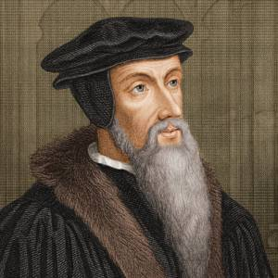
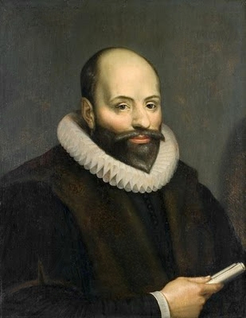
A WORD OF CAUTION
CALVINISM & ARMINIANISM
Many people tend to assume that only Calvinists believe in God’s sovereignty, while only Arminians believe in human free will. This is plainly false and misrepresentative of both theological systems.

Slide 12
THE REAL ISSUE
WHAT DOES THE BIBLE TEACH?
Any theological system stands or falls only as far as it aligns with God’s authoritative, infallible, and sufficient Word.

Slide 13
DEFINITION
THE CHALLENGE OF LIBERTARIAN FREE WILL
Libertarianism believes that a person’s will is so free that nothing decisively influences them to make a choice one way or another between several options. Ultimately, the reason for that choice lies solely in the person’s will itself.

Slide 14
“Free agency is the ability to do other than what one in fact does.
…Free and rational creatures have the power to resist the influence of God. This power was given to them by God Himself.”
ROGER OLSEN | Arminian Theology, p. 131

Slide 15
“…no matter how much or how strong the aid of the Holy Spirit may be, the ‘yes’ decision [to choose Christ] is still a decision that can be rightly called the person’s decision.
Also, he could have said no.”
LEROY FORLINES | Classical Arminianism, p. 52

Slide 16
“Libertarianism argues that some conditions (reasons, causes) may be necessary for a choice to be made, but they are never sufficient for that choice to be made; otherwise, we are not free.”
SCOTT CHRISTENSEN | What About Free Will?, p. 19

Slide 17
DEFINITION
LIBERTARIAN FREE WILL
Libertarian free will is often simplified as the ability of contrary choice.

Slide 18
LIBERTARIAN FREE WILL
THE LIBERTARIAN’S BIBLICAL CASE:
Commands to ‘choose whom you will serve’ – Joshua 24:15
Give as one has freely decided in their heart – 2 Cor. 9:7
“Whosoever” believes will be saved – John 3:16
People resist God’s commands and desires – Acts 7:15
God seems to change His mind - Exodus 32:14
Jesus expresses his desire to gather Jerusalem to him like a mother hen, but they would not - Matt. 23:37
God doesn’t wish that any should perish and desires all people to be saved - 2 Peter 3:9 & 1 Timothy 2:4

Slide 19
LIBERTARIAN FREE WILL
OUGHT IMPLIES CAN
“Moral obligations imply that we have self-determining moral free choice. For ought implies can. That is, what we ought to do implies that we can do it. Otherwise, we have to assume that the Moral Lawgiver is prescribing the irrational, commanding that we do what is literally impossible for us to do.” (Norman Geisler)

Slide 20
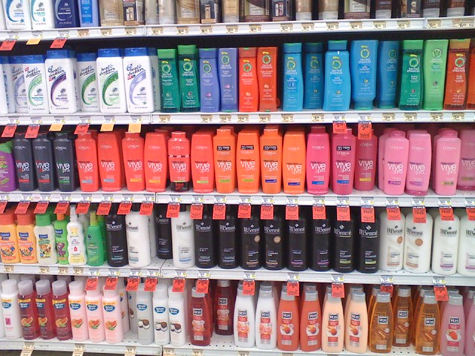
LIBERTARIAN FREE WILL
IT SEEMS INTUITIVE

Slide 21
PROBLEMS WITH LIBERTARIANISM
1. If people truly had libertarian free will, we would seem to be irrational and chaotic beings.
This is because every choice we make is dependent on some or several prior factors and influences, both internal and external, which together provide sufficient reason or cause for your choice.

Slide 22
“If our choices have the possibility of being cut off from our circumstances, desires, motives, beliefs, and so forth, then in what sense can we say that choices come from ourselves at all?”
SCOTT CHRISTENSEN | What About Free Will?, p. 19

Slide 23
PROBLEMS WITH LIBERTARIANISM
2. The argument that ought implies can and that inability absolves guilt proves to be untrue.
The inability to pay a debt you owe doesn’t absolve you of the debt.
We sin willfully according to our nature, and therefore it is entirely just for God to condemn sin.

Slide 24
MAIN PROBLEM
Scripture tells us clearly that since the Fall, humanity’s will is not free but rather in bondage to sin.
Man is not the measure of ultimate truth; God and His Word are.

Slide 25
BIBLICAL COMPATIBILISM
DEFINITION:
Compatibilism simply means that these two truths (of Divine sovereignty and human responsibility) are not in disagreement or at odds with each other, but rather are compatible.

Slide 26
“Biblical compatibilism says that our choices proceed from the most compelling motives and desires we have, which in turn is conditioned on our base nature, whether good or evil. The more voluntarily and unconstrainedly our choices are made, the more freedom and responsibility we have in making them.”
SCOTT CHRISTENSEN | What About Free Will?, p. 19

Slide 27
BIBLICAL COMPATIBILISM
A. WHAT IT IS NOT
I. Compatibilism is NOT Fatalism or ‘hard determinism’

Slide 28
SLIDO QUESTION
“Does the doctrine of Predestination align with the secular Philosophy of Determinism?”

Slide 29
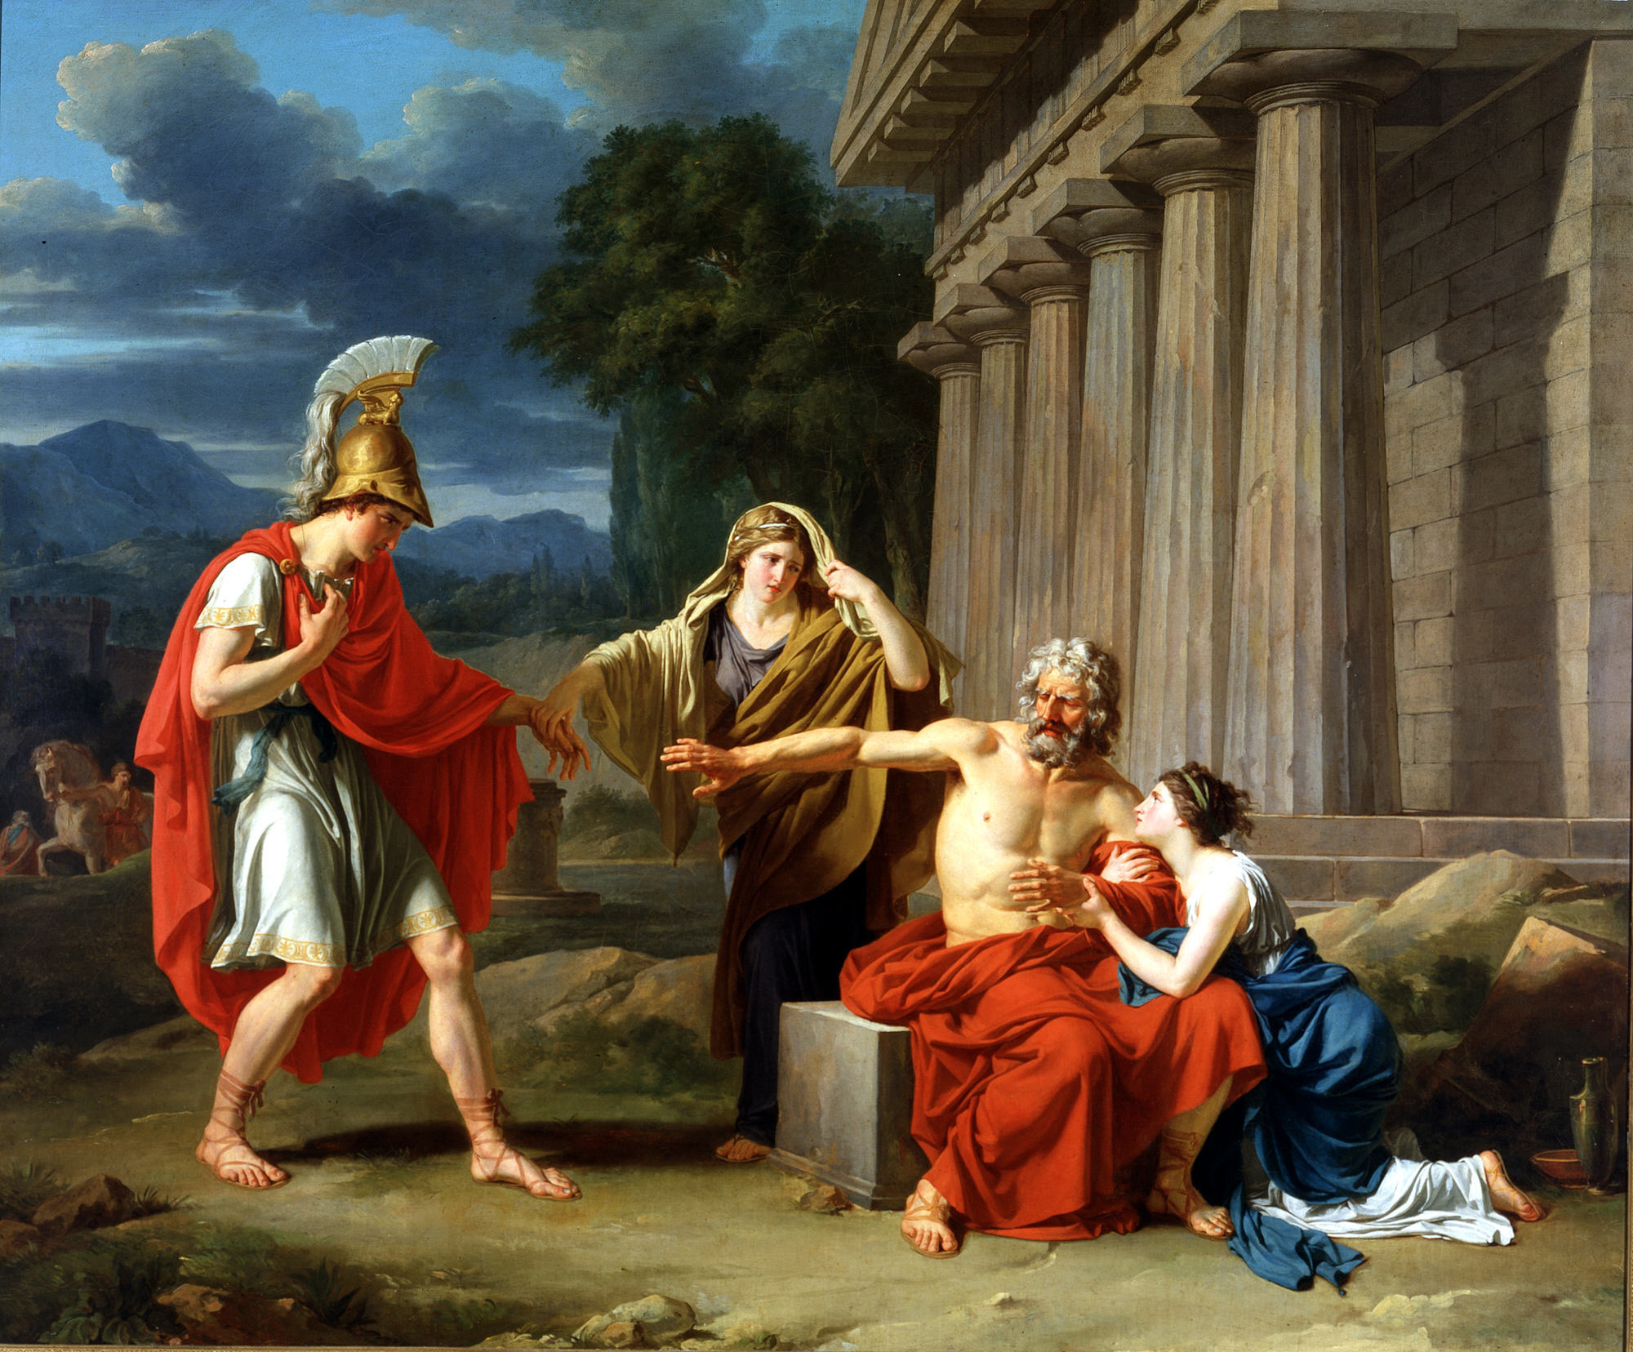
BIBLICAL COMPATIBILISM
A. WHAT IT IS NOT
I. Compatibilism is NOT Fatalism or ‘hard determinism’
The Myth of Oedipus

Slide 30
BIBLICAL COMPATIBILISM
A. WHAT IT IS NOT
I. Compatibilism is NOT Fatalism or ‘hard determinism’
Fatalism/determinism is about impersonal blind, cold fate or the product of purely material processes.
Biblical compatibilism affirms the necessity and importance of choices and the reality of their consequences within the framework of the loving, wise and sovereign plan of a Personal God.

Slide 31
BIBLICAL COMPATIBILISM
A. WHAT IT IS NOT
II. Compatibilism is NOT God forcing someone against their will
God does not force anyone to sin, but rather we are lured away by our own sinful desires (see James 1:13-15).

Slide 32
BIBLICAL COMPATIBILISM
A. WHAT IT IS NOT
II. Compatibilism is NOT God forcing someone against their will
When God brings someone to Himself, He is not dragging them kicking and screaming against their will. Scripture teaches that God gives us a new nature that desires the things of God. This is the new birth, and the reason why we come to Him.

Slide 33
“…work out your own salvation with fear and trembling, for it is God who works in you, both to will and to work for His good pleasure.”
Philippians 2:12b-13

Slide 34
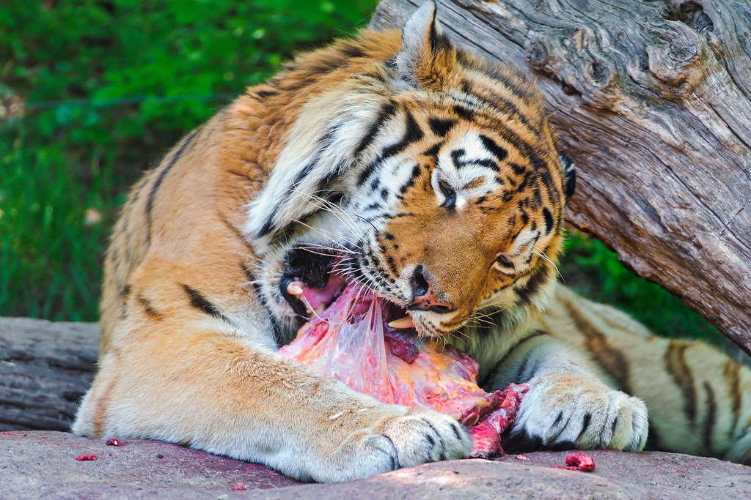
BIBLICAL COMPATIBILISM
WE ALWAYS ACT IN ACCORDANCE WITH OUR NATURE

Slide 35
BIBLICAL COMPATIBILISM
Compatibilists believe in biblical free will—that is, that we always will act freely according to our most compelling motives and desires of our heart based on our nature.
God so acts through a person’s will and desire according to their nature (whether good or evil) so that they freely and willingly do that which He has purposed to come to pass.

Slide 36
BIBLICAL COMPATIBILISM
A. WHAT IT IS NOT
III. Compatibilism is NOT a case of Either/Or

Slide 37
“Though the relationship between divine sovereignty and human freedom may be mysterious, they are by no means contradictory.
The antithesis [opposite] to divine sovereignty is not human freedom, but human autonomy. Autonomy represents a degree of freedom that is unlimited by any higher authority or power.
If God is sovereign, then man cannot be autonomous. Conversely, if man is autonomous, then God cannot be sovereign. The two are mutually exclusive concepts. Some argue that God’s sovereignty is limited by human freedom. If this were the case, then man, not God, would be sovereign.”
R.C. SPROUL | Willing to Believe: The Controversy Over Free Will

Slide 38
BIBLICAL COMPATIBILISM
A. WHAT IT IS NOT
III. Compatibilism is NOT a case of Either/Or
To quote a verse out of context, ‘what God has joined together, let no one tear asunder!’

Slide 39
BIBLICAL COMPATIBILISM
B. WHAT IT IS
I. A Display of Divine Order and Glory

Slide 40
“It is unthinkable that a God of infinite wisdom and power would create a world without a definite plan for that world. And because God is thus infinite His plan must extend to every detail of the world's existence.”
LORAINE BOETTNER | The Reformed Doctrine of Predestination

Slide 41
BIBLICAL COMPATIBILISM
B. WHAT IT IS
I. A Display of Divine Order and Glory
The greater the task to be undertaken, the more important it is that we should plan out the details meticulously to ensure its accomplishment.
How much more so for God’s ultimate goal – the glory of His Name!?

Slide 42
BIBLICAL COMPATIBILISM
B. WHAT IT IS
II. God decrees BOTH the End AND the Means
Leviticus 20:7-8 - “Consecrate yourselves, therefore, and be holy, for I am the Lord your God. Keep my statutes and do them; I am the Lord who sanctifies you.”
Paul said that he worked harder than any, but it was ultimately not him, but the grace of God working through him (1 Cor. 15:10). He says similarly that he toiled and struggled with all God’s energy that He powerfully worked in him (see Col. 1:29 & Eph. 3:20).

Slide 43
BIBLICAL COMPATIBILISM
These two truths mean:
We don’t get to blame God for our laziness, stupidity or inactivity because we neglected His prescribed means of spiritual growth.
We don’t get to boast in any of our accomplishments because we know it is God working in and through us, and apart from Him we can do nothing (John 15:5).

Slide 44
BIBLICAL COMPATIBILISM
B. WHAT IT IS
III. CONCURRENCE: Dual Agency
Concurrence simply means that the decisions and actions of created beings and the plans and decrees of God happen concurrently - or at the same time together.

Slide 45
“God cooperates with created things in every action, directing their distinctive properties to cause them to act as they do.”
WAYNE GRUDEM | Systematic Theology, p. 317

Slide 46
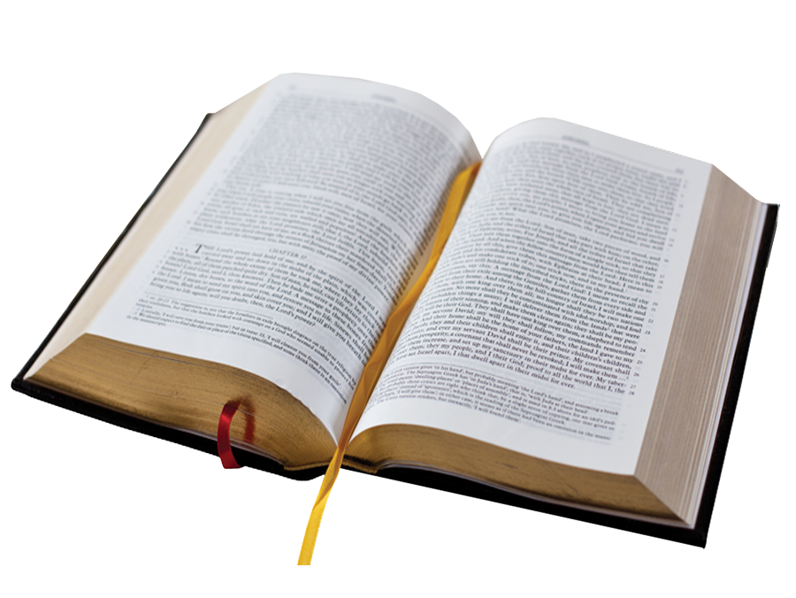
ANALOGY OF SCRIPTURE’S INSPIRATION
SCRIPTURE IS AT THE SAME TIME, BOTH:
Really the product of its human authors (2 Pet. 1:20-21).
Really the product of its Divine Author (1 Tim. 3:16-17).

Slide 47
BIBLICAL COMPATIBILISM
Two Clear Truths in Tension
Divine Sovereignty & Human Responsibility
One Ultimate Purpose
God’s Glory

Slide 48
KEY BIBLICAL TEXTS
THE LITMUS TEST OF TRUE THEOLOGY
The litmus test of whether a theology is biblical or not is whether or not it can deal honestly with the text of scripture and stay with the consistent argument of the text.

Slide 49
ROMANS 8-10
The Sovereignty of God in Salvation

Slide 50
CONTEXT
ROMANS 1-3
The wrath of God against sinful human rebellion: God ‘gives them up’ to their sinful desires so that they reap the consequences of their rebellion.
People are inexcusable for their rebellion because of what’s been revealed in creation and His Word, and God’s kind withholding of judgment is supposed to lead them to repentance.
God is just in judging sin because no one seeks God, and all are under condemnation.
People are fallen in Adam, willfully sinning, and under just condemnation for their sin.

Slide 51
CONTEXT
ROMANS 4-6
Due to man’s sin and sinful nature, the only hope of justification (salvation) is not in their own works, but rather by faith in God’s promise of salvation.

Slide 52
CONTEXT
ROMANS 7-8
The experience of the believer in this life is one of continued struggle with sin.
Believers have two desires warring within them: the flesh and the spirit.
However, because they are in Christ, there is no condemnation for them if they do sin.
God also gives us His Spirit to live in us through Whom we are able to cry out for help to overcome sin by the Spirit.

Slide 53
“And we know that for those who love God all things work together for good, for those who are called according to His purpose.
For those whom he foreknew he also predestined to be conformed to the image of his Son, in order that he might be the firstborn among many brothers. And those whom he predestined he also called, and those whom he called he also justified, and those whom he justified he also glorified.”
Romans 8:28-30

Slide 54
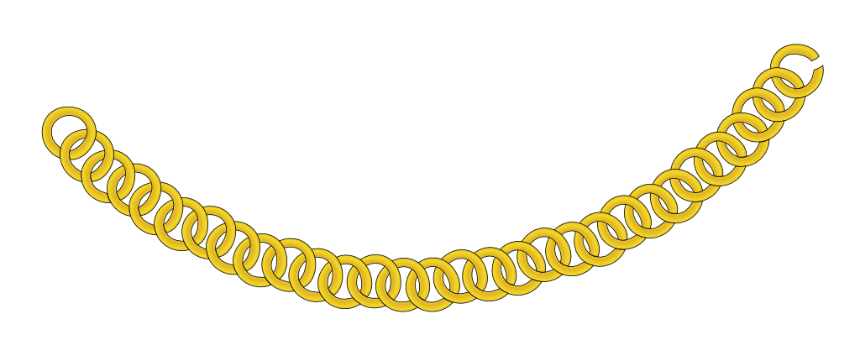
ROMANS 8:28-30
THE GOLDEN CHAIN OF REDEMPTION
God is the subject of all the verbs – He is the active agent.
The ones who are foreknown, are also predestined, and called, and justified, and glorified. There is no break in this chain.
It is the reason why nothing can separate us from the love of Christ (see 8:31-39)

Slide 55
ROMANS 9:10-13
GOD’S SOVEREIGN CHOICE
Salvation is not genetically inherited.

Slide 56
“And not only so, but also when Rebekah had conceived children by one man, our forefather Isaac, though they were not yet born and had done nothing either good or bad—in order that God's purpose of election might continue, not because of works but because of Him who calls— she was told, “The older will serve the younger.” As it is written, “Jacob I loved, but Esau I hated.”
Romans 9:10-13

Slide 57
ROMANS 9:10-13
GOD’S SOVEREIGN CHOICE
Salvation is not genetically inherited. (v.6-8)
Emphasis on God’s purpose (see also Isa. 46:10; 44:26-28; Psa. 33:11; Prov. 19:21)

Slide 58
ROMANS 9:14a
OBJECTION: THAT’S NOT FAIR!
“What shall we say then? Is there injustice on God's part?” (9:14a)

Slide 59
SLIDO QUESTION
“God is sovereign and full of justice. If God didn’t elect some people how would they get judged if God didn’t choose them to be saved?”‭ (cf. Romans‬ ‭1:32‬ & 2:1)

Slide 60
ROMANS 9:14-16
OBJECTION: THAT’S NOT FAIR!
Paul answers the question by quoting from Exodus 33:19 that God says that He will have mercy and compassion on whoever He choses.
This is because mercy cannot be demanded.
Mercy is not getting the punishment we deserve for our sins. If we got the punishment for our sin, that’s not unfair, it’s simply justice.

Slide 61
ROMANS 9:14-16
OBJECTION: THAT’S NOT FAIR!
Mercy is given at the discretion of the One who has the right to deal out justice—God the Judge of all.
CONCLUSION:
“So then it depends not on human will or exertion, but on God, who has mercy.” (9:16)

Slide 62
ROMANS 9:17
THE EXAMPLE OF PHARAOH
From Exodus:
Three times God says that He will harden Pharaoh’s heart (Ex. 4:21; 7:3 & 14:4)
Six times God actually hardens Pharaoh’s heart (Ex. 9:12; 10:1, 20, 27; 11:10 & 14:8)
Seven times it says Pharaoh’s heart was hardened (Ex. 7:13, 14, 22; 8:19; 9:7, 35; 14:5)
Three times we are told that Pharaoh hardened his own heart (Ex. 8:15, 32; 9:34)

Slide 63
For the Scripture says to Pharaoh, “For this very purpose I have raised you up, that I might show my power in you, and that my name might be proclaimed in all the earth.”
Romans 9:17 (quoting Exo. 9:16)

Slide 64
“But the Lord hardened Pharaoh’s heart, and he was not willing to let them go.”
Exodus 10:27

Slide 65
ROMANS 9:17
THE EXAMPLE OF PHARAOH
Note that God’s will doesn’t override the human will, but rather, the two wills spring forth from each individual and yet at the same time work together to achieve God’s purpose.
God doesn’t wrestle Pharaoh to do something he is unwilling to do. Pharaoh acts in full complicity with his own heart’s desires and that’s why he’s culpable.

Slide 66
ROMANS 9:18
THE EXAMPLE OF PHARAOH
“So then he has mercy on whomever he wills, and he hardens whomever he wills.” (9:17).
CONCLUSION:
The purpose of God’s free choice to show mercy on whom He pleases is His glory.

Slide 67
ROMANS 9:19
A DANGEROUS RESPONSE
“You will say to me then, ‘Why does he still find fault? For who can resist his will?’” (9:19)

Slide 68
But who are you, O man, to answer back to God?
Will what is molded say to its Molder, “Why have you made me like this?” Has the Potter no right over the clay, to make out of the same lump one vessel for honorable use and another for dishonorable use?”
Romans 9:20-21

Slide 69
ROMANS 9:19-21
A DANGEROUS RESPONSE
“But who are you, O man, to answer back to God?” (9:20)
This is not a mindless dismissal. Look at the content of the rebuke.

Slide 70
ROMANS 9:21
THE APPROPRIATE RESPONSE
Paul’s rebuke here is that it is inappropriate for the thing made to question its Maker’s motives and purposes for creating it as such.
This statement should floor us.
The doctrine of God’s sovereignty is one which squarely confronts us with the separation between Creator and created. He alone is God and we are not.

Slide 71
ROMANS 9:21
THE APPROPRIATE RESPONSE
God alone actually has truly ‘free’ will—He can do and does whatever He pleases:
“Our God is in the heavens; He does all that He pleases.” (Psa. 115:3; cf. Psa. 135:6)
…and this bare truth by itself scares us:
For it is a fearful thing to fall into the hands of the Living God (cf. Heb. 10;31).

Slide 72
…all the inhabitants of the earth are accounted as nothing, and He [God] does according to His will among the host of heaven and among the inhabitants of the earth; and none can stay His hand or say to Him, “What have you done?”
Daniel 4:35

Slide 73
ROMANS 9:19-21
THE APPROPRIATE RESPONSE
CONCLUSION:
In light of Romans 9:19-21, our appropriate response is to hold our hands over our mouths and marvel that God extends grace at all, since all deserve His wrath.

Slide 74
ROMANS 9:22-24
GOD’S PURPOSE IN ELECTION

Slide 75
“What if God, desiring to show his wrath and to make known His power, has endured with much patience vessels of wrath prepared for destruction, in order to make known the riches of His glory for vessels of mercy, which He has prepared beforehand for glory— even us whom He has called, not from the Jews only but also from the Gentiles?”
Romans 9:22-24

Slide 76
ROMANS 9:22-24
GOD’S PURPOSE IN ELECTION
The purpose of God’s election is to show God’s glory: either displayed in His wrath against those on whom just condemnation falls, or His power on those who He saves.

Slide 77
ROMANS 9:22-24
ASYMMETRY IN SALVATION & REPROBATION
I. The vessels of wrath were prepared for destruction – it is a passive construction.
God does not have to do anything to make sinful humanity worthy of judgment but just leave them to their sin. (cf. John 3:18; 3:36; Rom. 3:23).

Slide 78
ROMANS 9:22-24
ASYMMETRY IN SALVATION & REPROBATION
II. God has to actively do something to save people.
Note how the text talks about the vessels of mercy which “He has prepared beforehand for glory.”
As we saw in Romans 8:28-30 in the Golden Chain: God foreknew them, predestined them, called them, justified them and glorified them - all active verbs where God is doing everything.

Slide 79
ROMANS 9:22-24
God stands asymmetrically behind salvation and reprobation.

Slide 80
ASYMMETRY
REPROBATION:
God does not tempt anyone to sin because they are tempted from their own evil desires (James 1:13-15). God lets go of His restraint of people’s evil desires (cf. Rom. 1:18-32). God does not delight in the destruction of the wicked (see Ezek. 18:32; 33:11; 1 Tim. 2:1-4; 2 Pet. 3:9).
SALVATION:
God actively accomplishes their salvation making people who were dead in sins alive in Christ (cf. Eph. 2:1-7). Both salvation and faith are the gift of God’s grace so that it precludes all boasting (Eph. 2:8-9).

Slide 81
ROMANS 9 TAKEAWAY
RECAP
God is sovereign in salvation – actively and solely accomplishing it for those He has chose according to His good purposes.
God is not unjust to withhold mercy because it cannot be demanded.
It warns us of an inappropriate response to God’s sovereign choice—He is the Potter, we are the clay.
It shows us that God’s purpose in election and reprobation is to display His glory and that He stands asymmetrically behind them.
Our appropriate response in light of all of this is awe and fear of this untamed God!

Slide 82
ROMANS 9 TAKEAWAY
WHY IS THIS GOOD NEWS?
It is good news because God is not just uncontrollable sovereign power, but He is also good, just, true, merciful and gracious.
“For you, O Lord, are good and forgiving, abounding in steadfast love to all who call upon you.” (Psa. 86:5)
(cf. Ex. 34:6; Neh. 9:17; Psa. 25:8; 100:5; 145:8; Joel 2:13; Num. 14:18)

Slide 83
So he [Jonah] prayed to the LORD, saying, "O LORD, is this not what I said while I was still in my own country? This is why I was so quick to flee toward Tarshish. I knew that You are a gracious and compassionate God, slow to anger, abounding in loving devotion--One who relents from sending disaster.
Jonah 4:2

Slide 84
ROMANS 9 TAKEAWAY
May we all remember that God is far more just than we realize and far more merciful than we deserve!

Slide 85
ROMANS 10
A CORRECTION TO FATALISM
“Doesn’t the doctrine of God’s sovereignty make evangelism and our ‘seeking God’ unnecessary?”

Slide 86
ROMANS 10
A CORRECTION TO FATALISM
“Doesn’t the doctrine of God’s sovereignty make evangelism and our ‘seeking God’ unnecessary?”
“if you confess with your mouth that Jesus is Lord and believe in your heart that God raised him from the dead, you will be saved.” (Rom. 10:9)

Slide 87
“How then will they call on him in whom they have not believed? And how are they to believe in him of whom they have never heard? And how are they to hear without someone preaching? And how are they to preach unless they are sent?”
Romans 10:14-15a

Slide 88
“The sinner's inability to save himself, therefore, should not make him less diligent in seeking his salvation in the way which God has appointed. Some leper when Christ was on earth might have reasoned that since he could not cure himself, he must simply wait for Christ to come and heal him. The natural effect, however, of a conviction of utter helplessness is to impel the person to make diligent application at the source from whence alone help can come.”
LORAINE BOETTNER| The Reformed Doctrine of Predestination

Slide 89
ROMANS 10:14-15
A CORRECTION TO FATALISM
God ordains BOTH the ends and the means in evangelism as well.

Slide 90
JOHN 6
The Sovereignty of God Over Who Comes

Slide 91
“All that the Father gives me will come to me, and whoever comes to me I will never cast out.”
John 6:37

Slide 92
And this is the will of him who sent me, that I should lose nothing of all that he has given me, but raise it up on the last day. For this is the will of my Father, that everyone who looks on the Son and believes in him should have eternal life, and I will raise him up on the last day.
John 6:39-40

Slide 93
“No one can come to me unless the Father who sent me draws him. And I will raise him up on the last day.”
John 6:44

Slide 94
JOHN 6:44
WHAT DOES “DRAW” MEAN?
NT uses of this same Greek verb (ἑλκύω):
John 18:10 – when Peter ‘draws’ out his sword to strike the ear of the high priest’s slave.
John 21:6 – when the disciples were ‘drawing’ or hauling in the net.
Acts 16:19 & 21:30 use the verb for when the disciples are dragged into the market place and out of the temple.
James 2:6 – about the rich dragging people into court.

Slide 95
“But there are some of you who do not believe.” (For Jesus knew from the beginning who those were who did not believe, and who it was who would betray him.) And he said, “This is why I told you that no one can come to me unless it is granted him by the Father.”
John 6:64-65

Slide 96
CONCLUDING THOUGHTS
THE CHALLENGE OF FULLY GRASPING THIS DOCTRINE

Slide 97
“But while the Bible repeatedly teaches that this providential control is universal, Powerful, wise, and holy, it nowhere attempts to inform us how it is to be reconciled with man's free agency. All that we need to know is that God does govern His creatures and that His control over them is such that no violence is done to their natures.”
LORAINE BOETTNER| The Reformed Doctrine of Predestination

Slide 98
“Much of the difficulty in regard to the doctrine of Predestination is due to the finite character of our mind, which can grasp only a few details at a time, and which understands only a part of the relations between these. We are creatures of time, and often fail to take into consideration the fact that God is not limited as we are.”
LORAINE BOETTNER| The Reformed Doctrine of Predestination

Slide 99
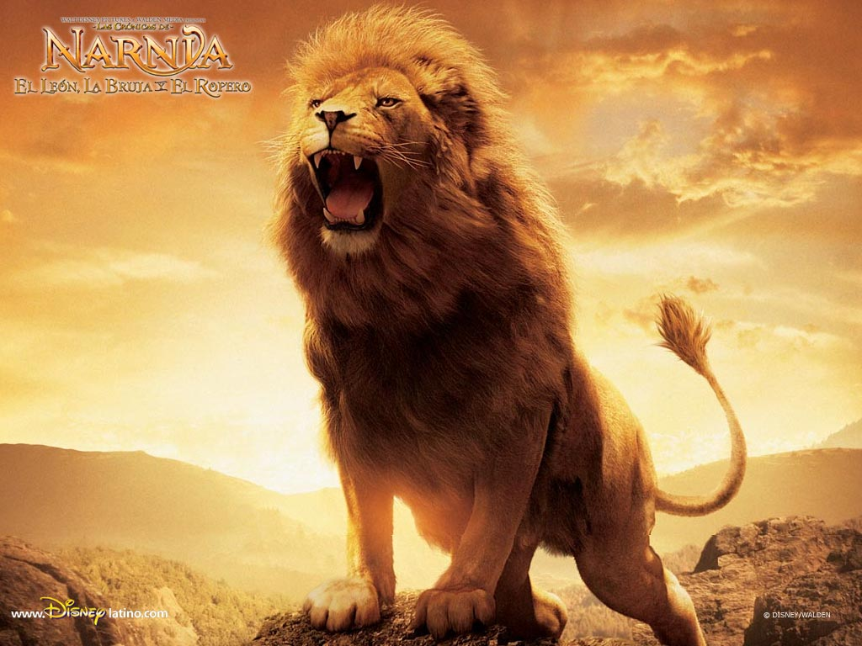
CONCLUDING THOUGHTS
NOT SAFE BUT GOOD
“Aslan is a lion- the Lion, the great Lion." "Ooh," said Susan. "I'd thought he was a man. Is he-quite safe? I shall feel rather nervous about meeting a lion"..."Safe?" said Mr. Beaver ..."Who said anything about safe? 'Course he isn't safe. But he's good. He's the King, I tell you.”

Slide 100
CONCLUDING THOUGHTS
NOT SAFE BUT GOOD
To be under the rule of wicked tyrant is a terror, but to be under the loving rule of an Infinitely Good King is a blessing!
We know that anything which comes to pass - even the things we don’t understand and the difficulties we face - are from the nail-scarred hands of a Loving Lord who has objectively shown us the extent of His love on the Cross when He stretched out His hands and said, “it is finished.”

Slide 101
“Who would not prefer to have his affairs in the hands of a God of infinite power, wisdom, holiness and love, rather than to have them left to fate, or chance, or irrevocable natural law, or to short-sighted and perverted self ? Those who reject God's sovereignty should consider what alternatives they have left.”
LORAINE BOETTNER| The Reformed Doctrine of Predestination

Slide 102
CONCLUDING THOUGHTS
5 TRUTHS TO HOLD IN YOUR HEART
God is Good.
God is sovereign, evil is not.
We are responsible, but not in absolute control.
Because God is sovereign, He WILL accomplish His good plans.
God’s sovereignty is the basis for our effort and confidence of final victory (cf. Psa. 119:35; Phil. 1:6; Rom. 8:30).

Slide 103
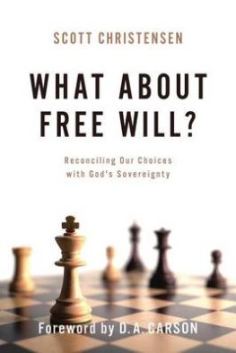
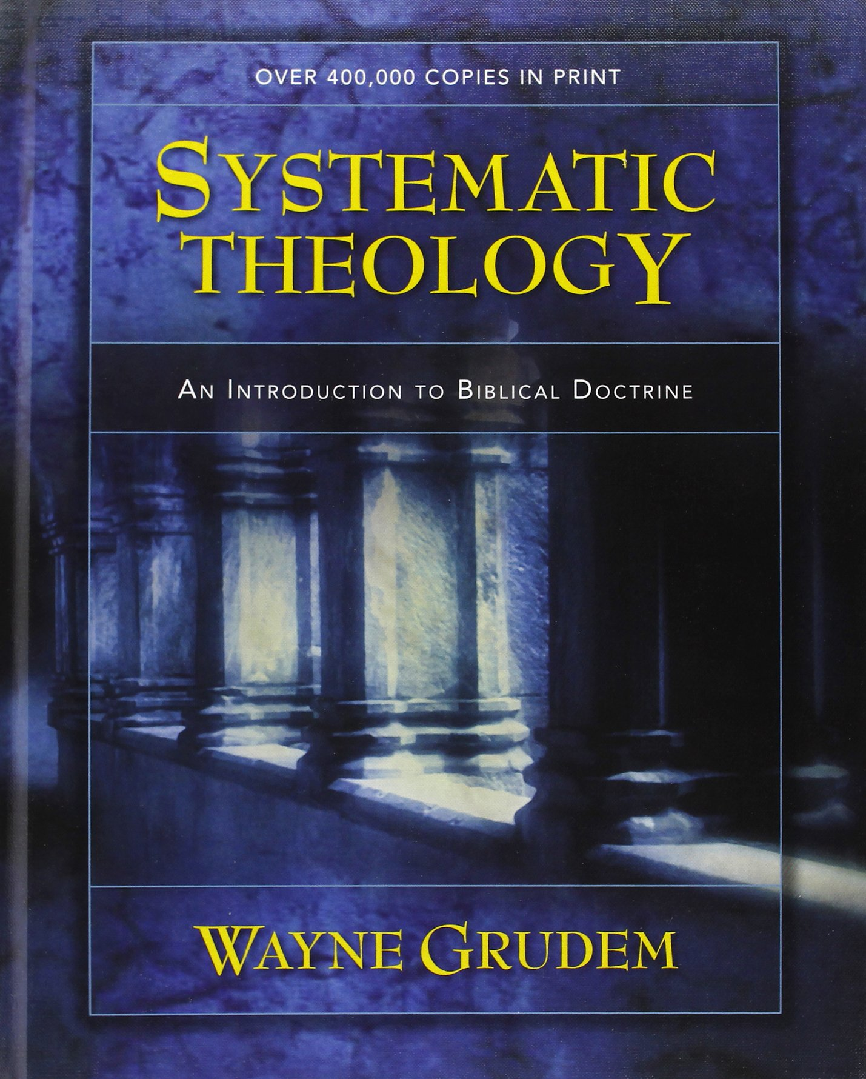
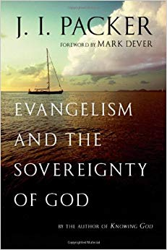
RECOMMENDED RESOURCES
Systematic Theology - Wayne Grudem
What About Free Will? - Scott Christensen
Evangelism and the Sovereignty of God – J.I. Packer

Slide 104
Q&A

Slide 105
Q&A
Doesn’t God’s sovereignty make Him the author of evil?

Slide 106
Q&A
Does God elect those whom He foresees will choose Him?

Slide 107
Q&A
Can foreordained choices be real choices?

Slide 108
Q&A
Doesn’t authentic love require free will?

Slide 109
Q&A
Further questions?

Slide 110
YOU ARE LOVED

